Slide 1
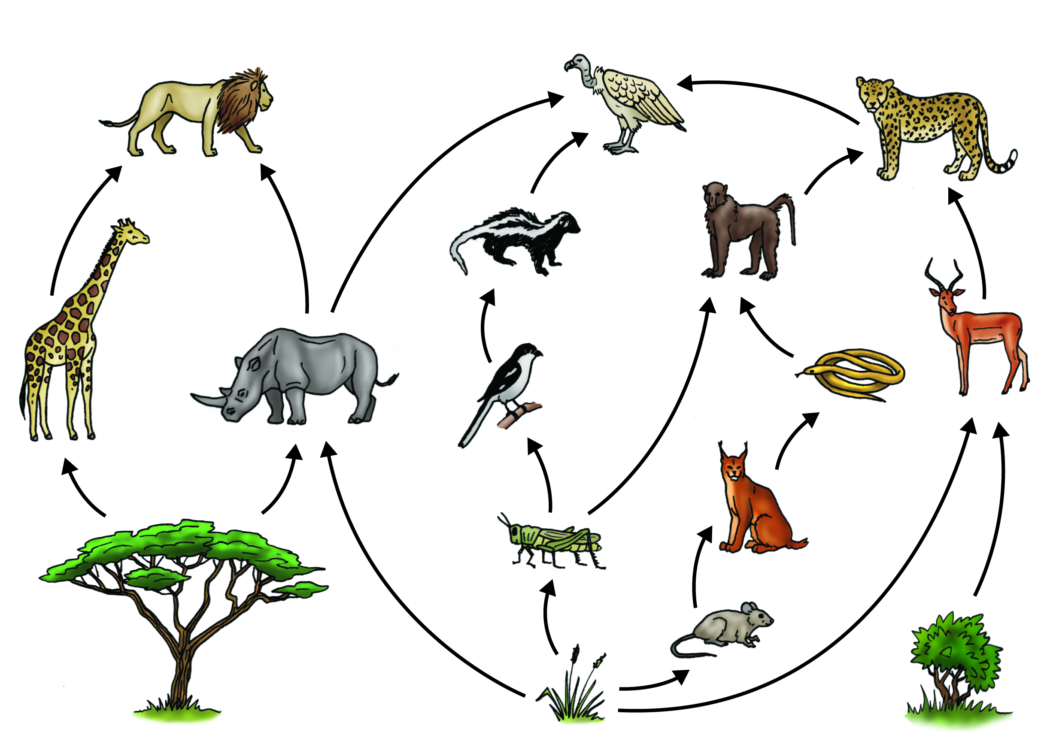
Bellwork #2 01/23/18
What is the difference between an autotroph and a heterotroph?

Slide 2
Name That Stage!
This is the first step in cellular respiration that begins releasing energy stored in glucose.
This step produces CO2 which is then released into the blood stream.
This step takes place in the cytoplasm.
This step creates the most ATP.
This step creates NADH AND FADH2.
This step requires oxygen to take place.
This step takes place in the inner membrane.
This step creates water.
Glycolysis
Krebs Cycle
Glycolysis
ETC
Krebs Cycle
Krebs Cycle or ETC
ETC
ETC

Slide 3
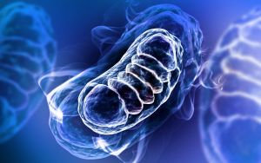
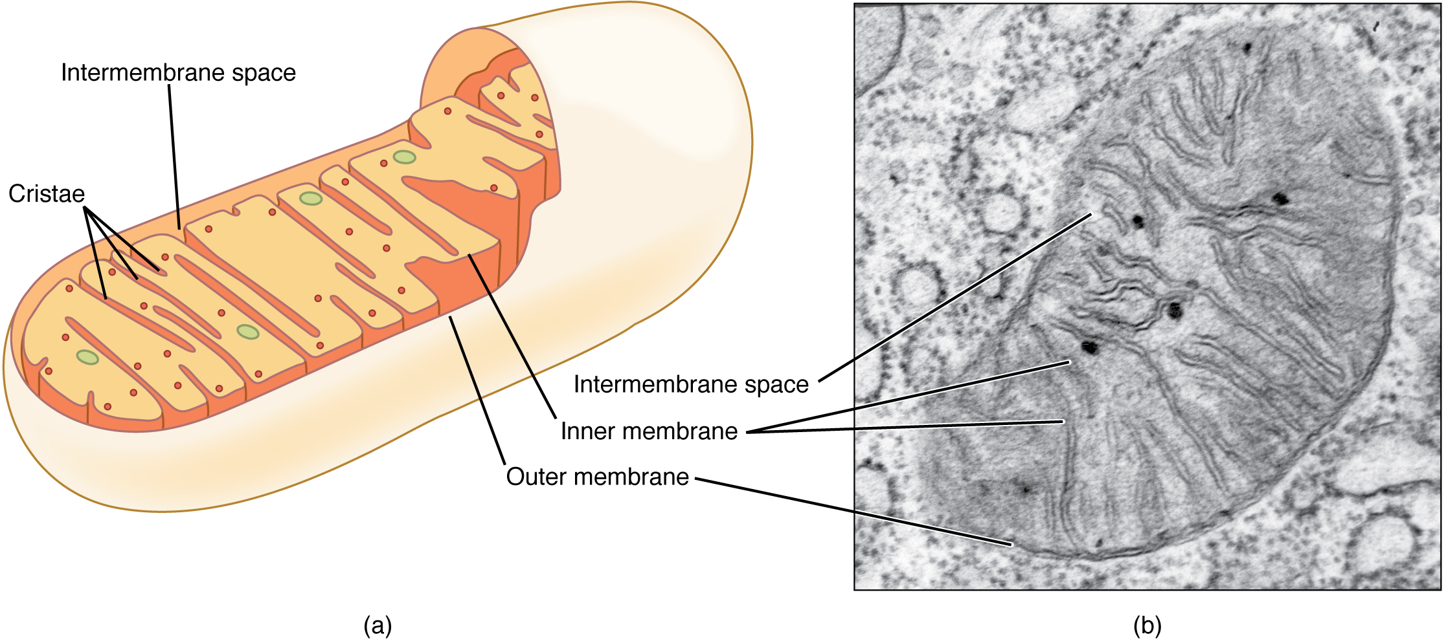
The Powerhouse of the Cell Video
http://cms.gavirtualschool.org/Shared/Science/Biology17/CellEnergetics/Biology_CellEnergetics_Shared3.html

Slide 4
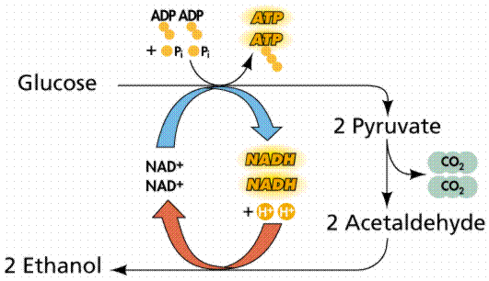
Anaerobic Respiration: Fermentation

Slide 5
Objectives
Compare and contrast cellular respiration and photosynthesis as energy conversion pathways.
1
Describe the model of the conversion of stored energy (glycolysis, Krebs cycle, electron transport chain) in organic molecules into usable cellular energy (ATP).
2
Understand the mechanisms behind muscle fatigue.
3

Slide 6
Why Fermentation?
What happens if there is not enough oxygen for cellular respiration?
Glycolysis can still occur, but it is followed by a different pathway called fermentation.
Processes that do not require oxygen are “anaerobic” processes.
Fermentation is an anaerobic process
Cells that use fermentation to generate very little ATP compared to cellular respiration
Lactic acid fermentation and alcoholic fermentation

Slide 7
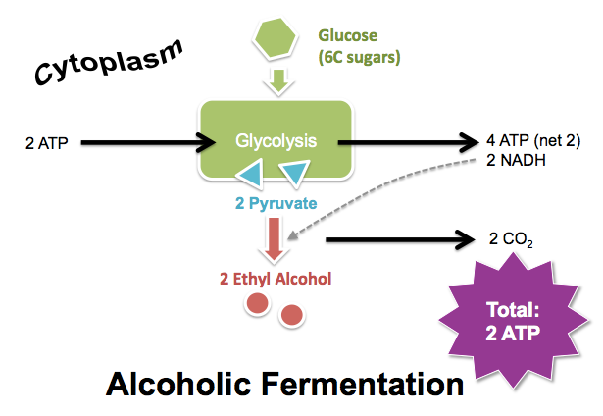
Alcoholic Fermentation
Begins with glycolysis.
However, since the pyruvic acid cannot move on to the Krebs Cycle due to the lack of oxygen, it is converted to ethyl alcohol and carbon dioxide by using the NADH produced during glycolysis.
2 ATP result
This allows glycolysis to continue producing small amounts of ATP.

Slide 8
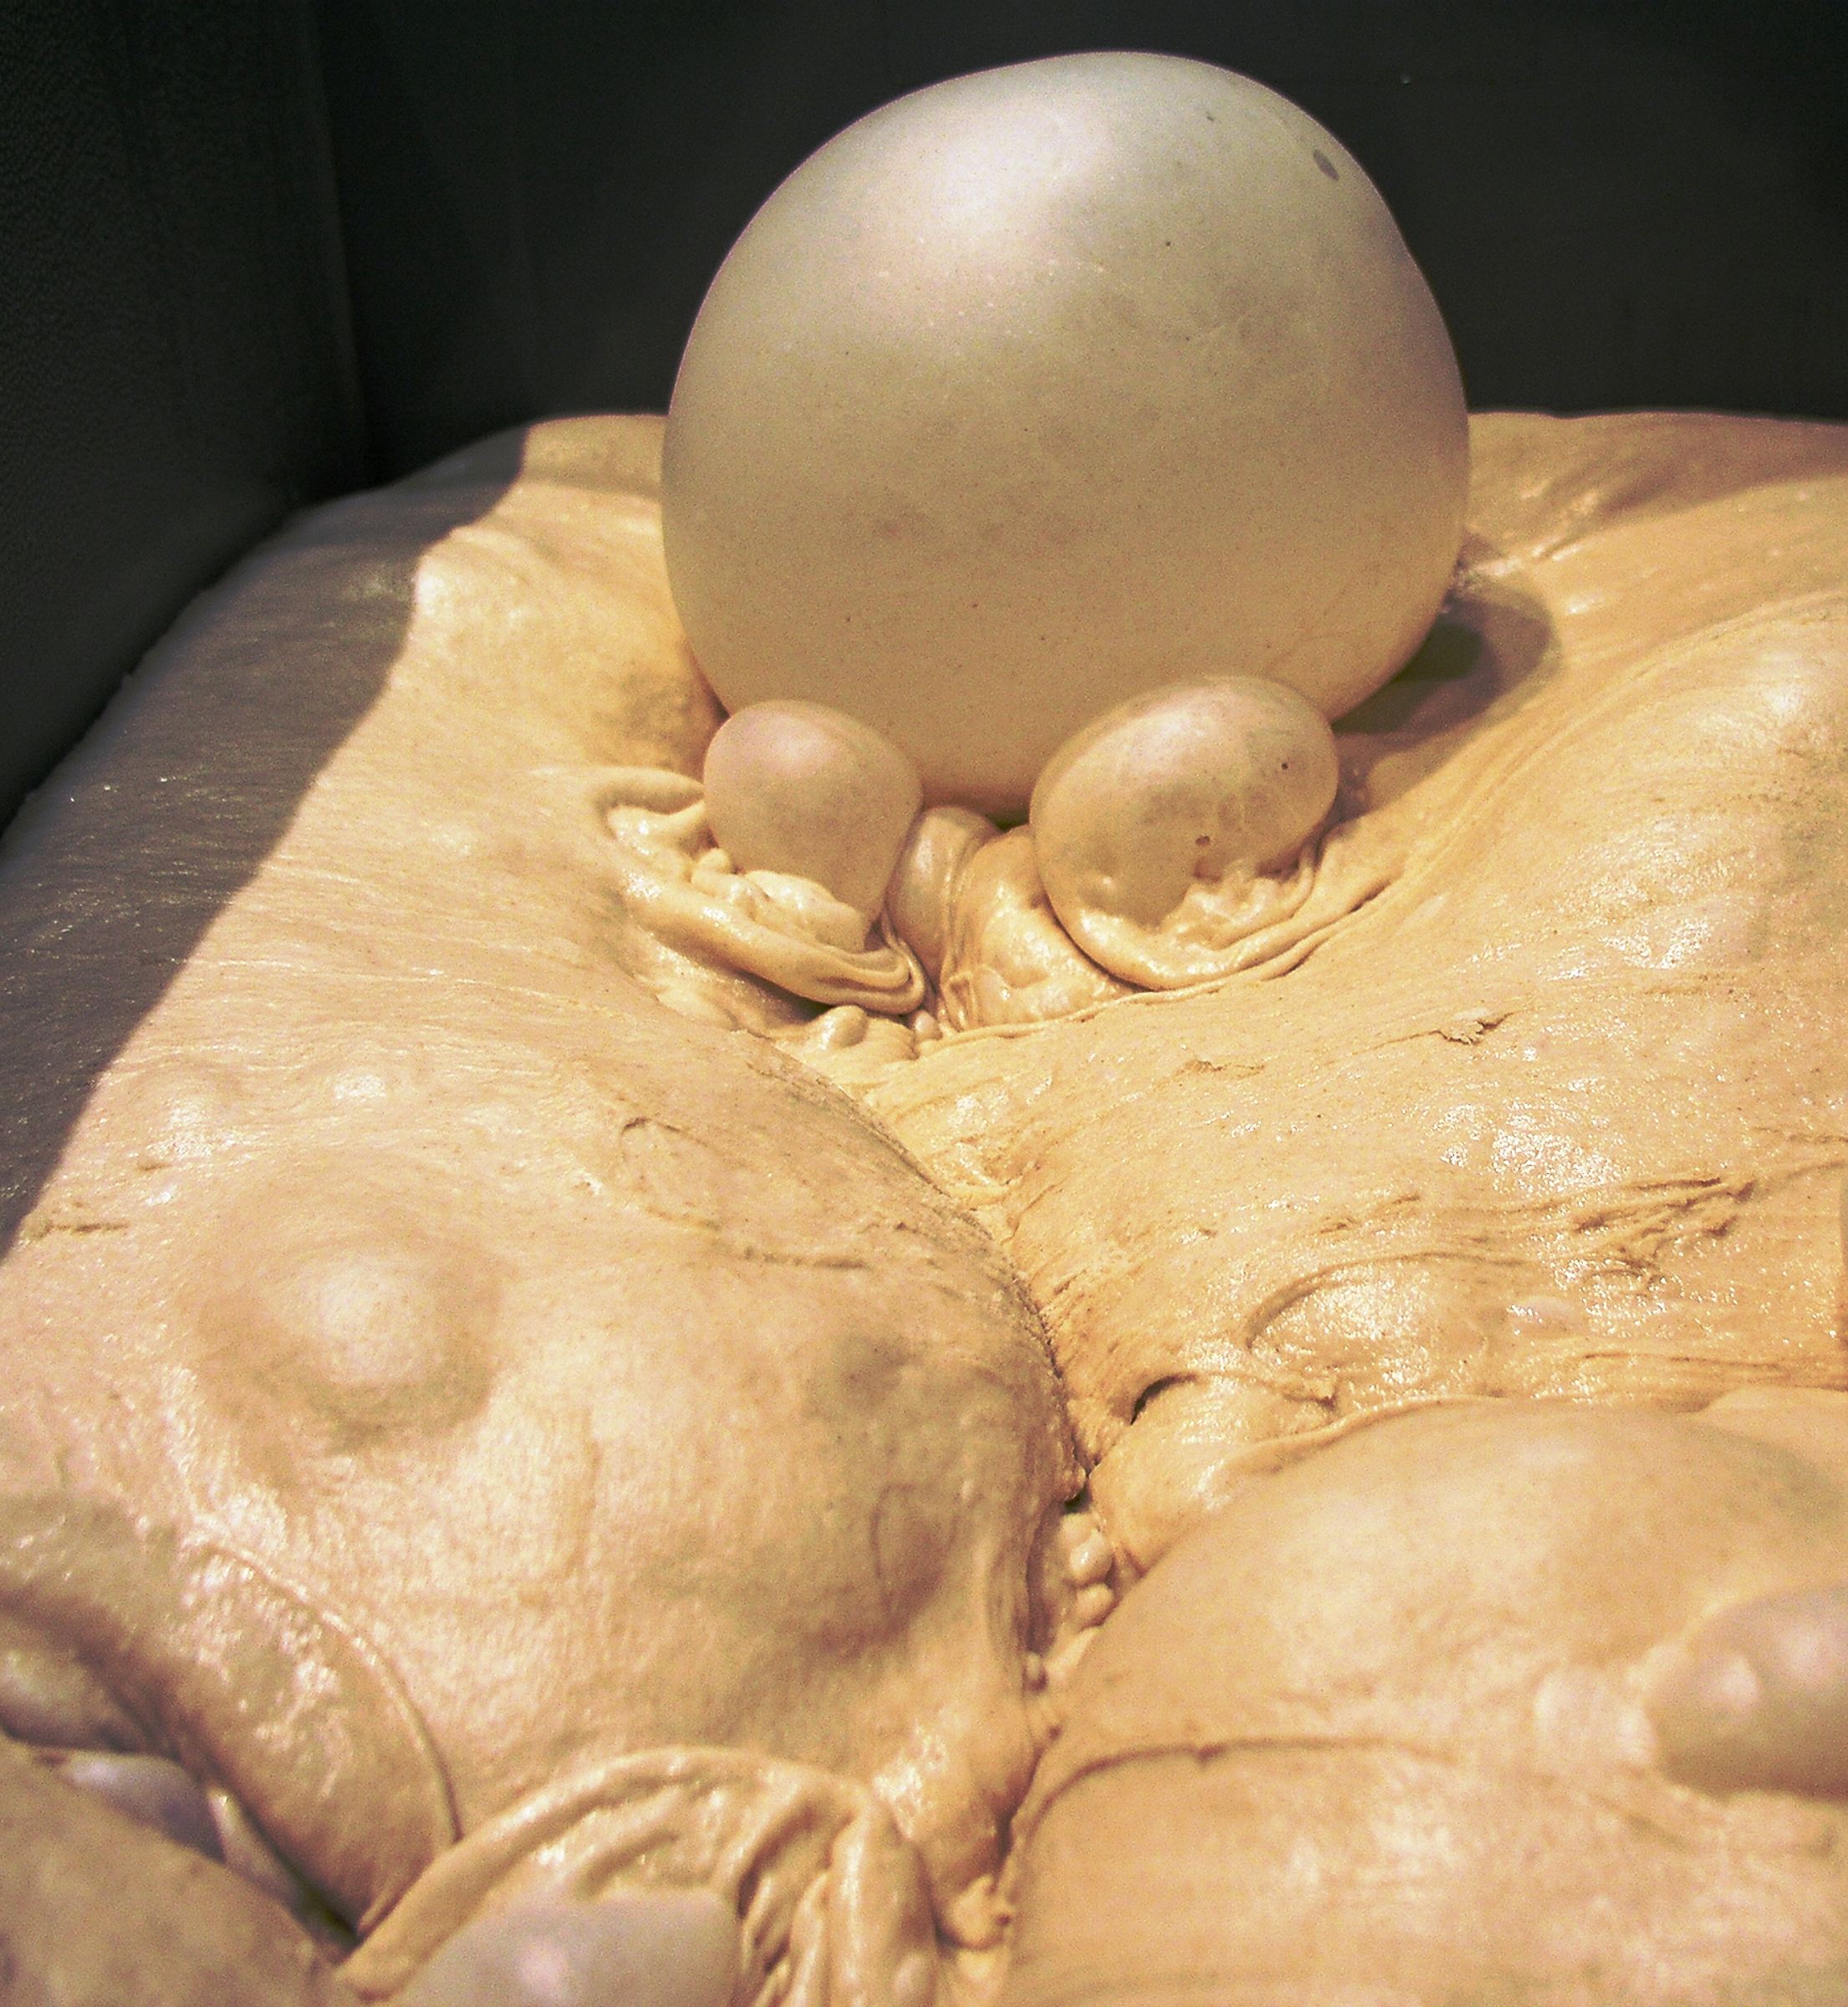
Alcoholic Fermentation
Occurs in some plants and unicellular organisms such as yeast and bacteria.
This process occurs when making bread, beer, and wine.
When making bread, you would use yeast, a unicellular organism that undergoes alcoholic fermentation.
Why do we put yeast in bread?
If ethyl alcohol is produced by yeast, how is it that bread is not an “alcoholic” food?

Slide 9
Why do we put yeast in bread?

Slide 10
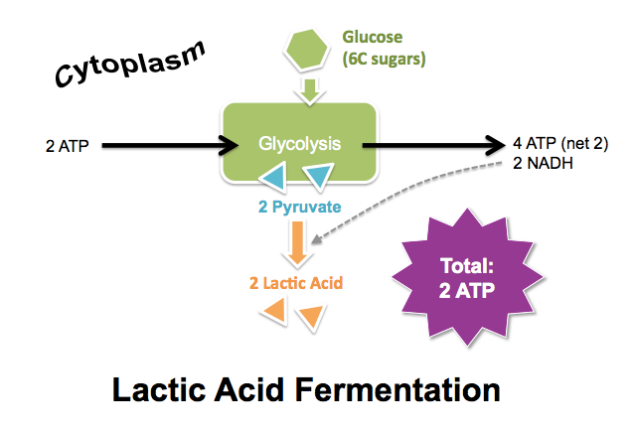
Lactic Acid Fermentation
When there is no oxygen available after glycolysis, the pyruvate molecules leaving glycolysis are converted into waste product called lactic acid using the NADH produced in glycolysis.
Lactic acid: a 3-carbon molecule, so we can see that CO2 is not released during lactic acid fermentation.

Slide 11
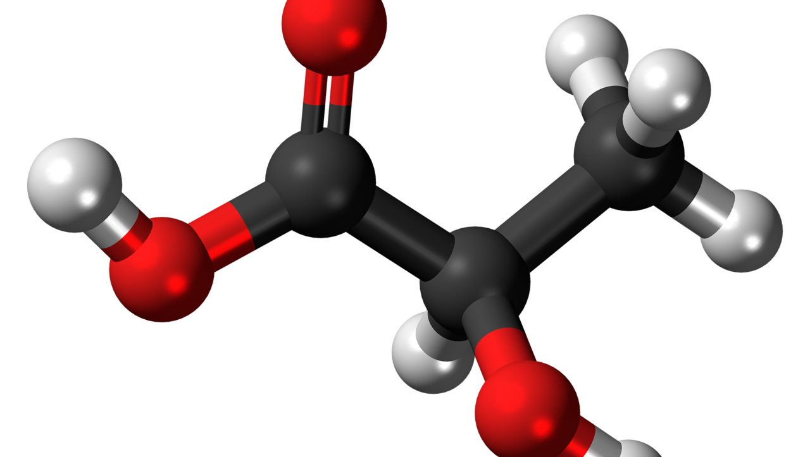
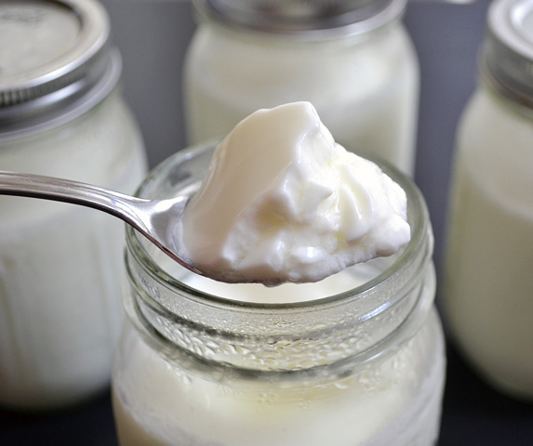
Lactic Acid Fermentation
Some bacteria can use lactic acid fermentation.
We use bacteria that undergo lactic acid fermentation to produce yogurt and sauerkraut.
Humans may resort to lactic acid fermentation too.

Slide 12
Energy and Exercise
Cells normally contain small amounts of ATP produced during glycolysis and cellular respiration.
At the start of a race, muscle cells only contain enough ATP for a few second of activity.
When running a long race, muscle cells are producing most of their ATP by lactic acid fermentation.

Slide 13
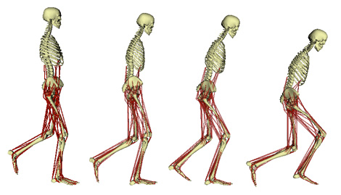
Muscle Fatigue Activity
Purpose:
Demonstrate how muscle fatigue works.
Materials:
Timer

Slide 14
Muscle Fatigue Activity
Procedure:
Create a chart to show the data collected in this experiment.
Work with a group of 3 people.
Decide who will be doing the exercise, who will be timing, and who will be recording the data.
Choose an exercise: push-ups, sit-ups, jumping jacks, etc.
Using the timer, one of your group members will count the number of the exercises you complete for a total of 150 continuous seconds (5 trials).
Switch. Now one of your group members does steps 4 and 5.
Copy down your group member’s data and put data in a graph.

Slide 15
Data Table – Muscle Fatigue Over Time
 | 30s | 60s | 90s | 120s | 150s
You
Your Partner
Once you have all your data, be sure to graph your results! One paper per group. Due at the end of class.

Slide 16
What’s happened in this activity?

Slide 17
Muscle Fatigue and Lactic Acid
Lactic acid buildup in your muscles could be the cause of cramps.
Sometimes, an animal’s lungs or bloodstream cannot get enough oxygen to the muscles of the body to make enough ATP.
You muscle cells use lactic acid fermentation to make ATP without using oxygen.
Lactic acid builds up and causes muscle soreness and burning (a cramp).
Taking in oxygen breaks down lactic acid
The only way to get rid of extra lactic acid is to acquire more oxygen.

Slide 18
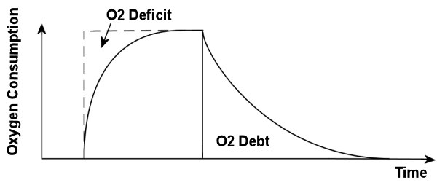
Muscle Fatigue and Lactic Acid
When the exercise is over, the only way to get rid of lactic acid is to get more oxygen.
This is know as “oxygen debt” because oxygen must be “paid back” to the cells to remove the lactic acid.
The debt is paid as you continue to breathe deeply for several moments after the activity stops.
For longer exercises, cellular respiration is the only way to generate a continuing supply of ATP.
It releases energy more slowly than fermentation.

Slide 19
Comparing Aerobic and Anaerobic Respiration
Aerobic respiration (with oxygen) can produce 36 ATP molecules from each glucose molecule.
Anaerobic respiration (without oxygen) only allows production of 2 ATP molecules from each glucose molecule.
Therefore, aerobic respiration is significantly more efficient than anaerobic respiration.

Slide 20
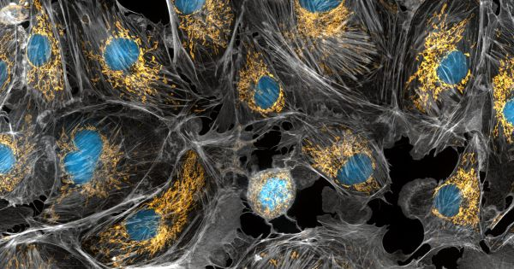
Exit Ticket

