Slide 1
Bellwork #3 - 01/11/18
Which atomic model was considered the plum pudding model?

Slide 2
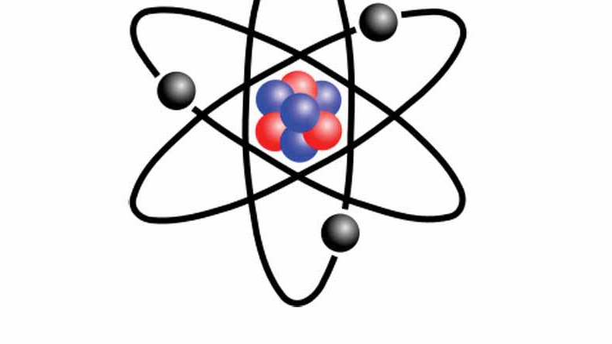
Atoms and the Atomic Theory
This Photo by Unknown Author is licensed under CC BY-SA

Slide 3
Objectives
Describe Dalton’s atomic theory and its significance in the study of matter.
1
Infer a conceptual model of the structure of an atom, including the properties of the major subatomic particles.
2
Demonstrate the relationship between the atomic mass of an element and the isotopes of the element.
3
Give a short history of how the concept of the atom developed.
4

Slide 4
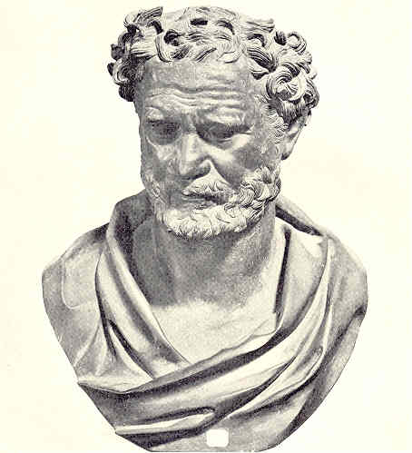
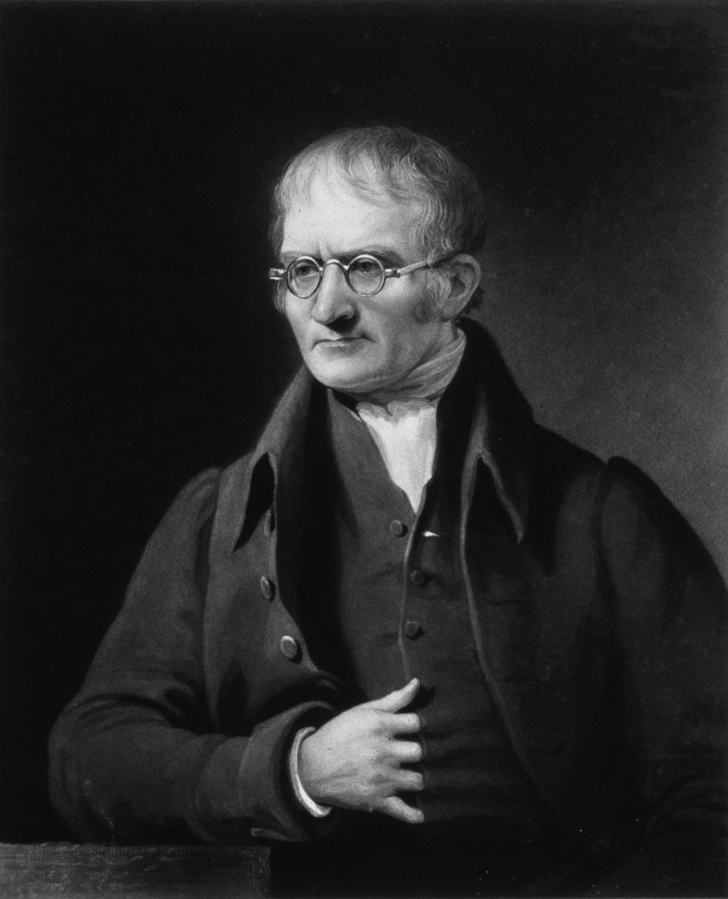
History of the Atom
Domecritus of Abdera (4th century B.C.)
First to suggest the idea of atoms
Thought that matter was composed of tiny indivisible particles called atoms
Atoms were invisible, indestructible, fundamental units of matter
John Dalton (1766-1844)
Performed experiments to prove atoms
Formulated hypotheses and theories to explain his observations
Dalton’s atomic theory
This Photo by Unknown Author is licensed under CC BY-SA
This Photo by Unknown Author is licensed under CC BY-SA

Slide 5
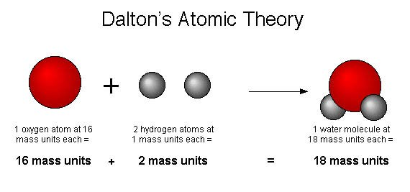
Dalton’s Atomic Theory
All elements are composed of submicroscopic indivisible particles called atoms.
Atoms of the same element are identical. The atoms of any one element are different from those of any other element.
Atoms of different elements can physically mix together or can chemically combine with one another in simple whole-number ratios to form compounds.
Chemical reactions occur when atoms are separated, joined, or rearranged. However, atoms of one element are never changed into atoms of another element as a result of chemical reaction.

Slide 7
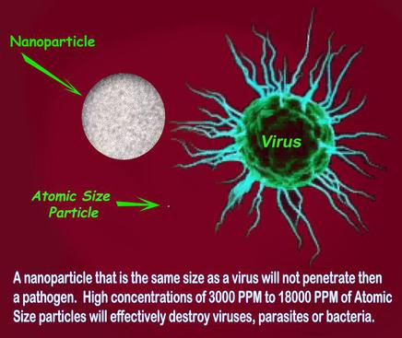
What is an Atom?
Atom: the smallest particle of an element that retains the properties of that element.
Atoms are far too small to see with the unaided eye

Slide 8
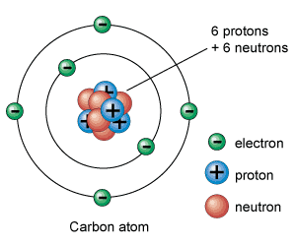
Electrons, Protons, and neutrons
Atoms are divisible!
Subatomic particles: Electrons, Protons, and Neutrons
Electrons: negatively charged subatomic particles
Discovered by Sir J.J. Thomson in 1867.
Used a cathode ray → glowing beam of electrons from one point to another.
Protons: positively charged subatomic particles
Discovered by E. Goldstein in 1886.
Neutrons: subatomic particles with not charge, but their mass nearly equals that of the proton.
Discovered by Sir James Chadwick in 1932.
This Photo by Unknown Author is licensed under CC BY-SA

Slide 10
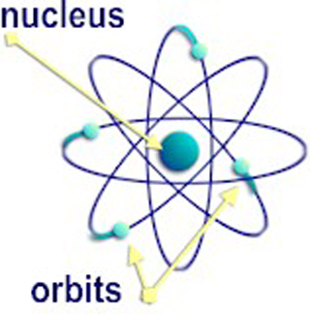
The structure of the nuclear atom
Ernest Rutherford (1871-1937) developed a new theory about the atom using gold
Proposed that almost all the mass and all the positive charge are concentrated in a small region at the center of the atom.
Nucleus: the central core of an atom, composed of protons and neutrons.
This Photo by Unknown Author is licensed under CC BY-NC-SA

Slide 11
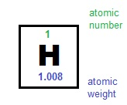
Atomic Number
Most atoms are composed of electrons, protons, and neutrons.
Protons and neutrons make up the nucleus
Electrons surround the nucleus
Each element in the periodic table has a different number. Why?
Atomic number: the number of protons in the nucleus of the atom of that element
Example: Since all hydrogen atoms have 1 proton, the atomic number of hydrogen is 1
Thus, the number of protons (positively charged particles) in the nucleus of an atom must equal the number of electrons (negatively charged particles) around its nucleus
This Photo by Unknown Author is licensed under CC BY-SA

Slide 12
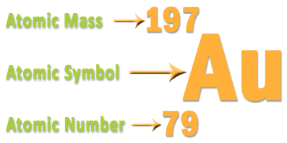
Mass number/Atomic Mass
Mass Number: the total number of protons and neutrons in the nucleus.
You can determine the composition (make up) of an atom of any element form its atomic number and its mass number.
Number of neutrons = mass number – atomic number
# protons = # electrons
This Photo by Unknown Author is licensed under CC BY-SA

Slide 13
Atomic Number and Mass Number Practice
Element | # Protons | # Electrons | # Neutrons
Carbon
Neon
Potassium
Nickel

Slide 14
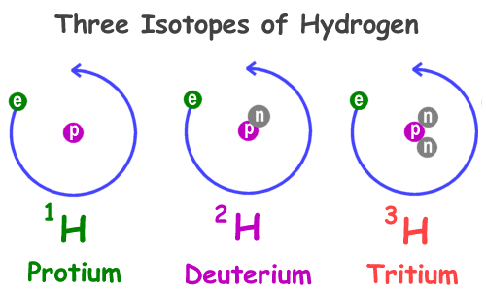
Isotopes of the Elements
Atoms of the same element may have different nuclear structures.
The number of protons will remain the same, however, the number of neutrons may differ.
Isotopes: atoms that have the same number of protons but different numbers of neutrons.
Despite these differences, isotopes are chemically alike because they have identical numbers of protons and electrons.
These subatomic particles are responsible for the characteristic chemical behavior of each element.

Slide 15
Isotope Practice
 | Chromium - 58 | Chromium - 63
# of protons | 24 | 24
# of neutrons | 34 | 39
# of electrons | 24 | 24

Slide 16
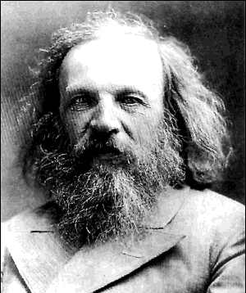
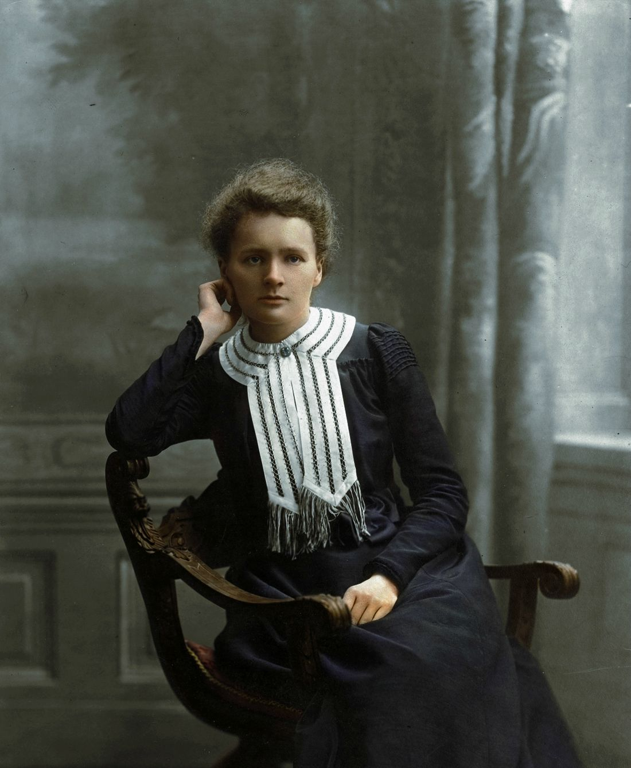
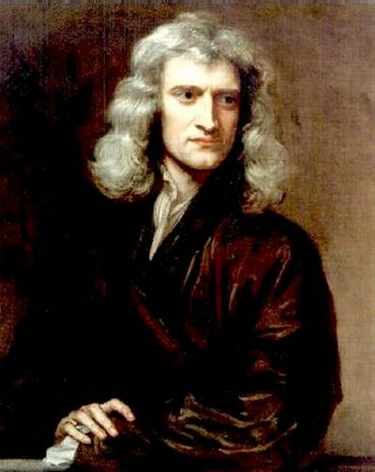
Famous Chemist group project
In partners choose 2 of the following chemists and create a presentation describing their lives and work. You should be able to argue which of the chemists had the biggest impact on the chemistry community when you have finished your research.
Group project is due JANUARY 22ND.
This Photo by Unknown Author is licensed under CC BY-NC
This Photo by Unknown Author is licensed under CC BY-SA
This Photo by Unknown Author is licensed under CC BY-SA

Slide 17
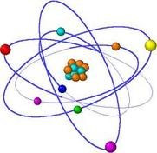
Exit ticket
This Photo by Unknown Author is licensed under CC BY-SA

