Slide 1
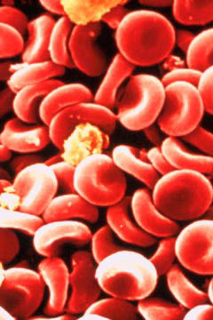
Bellwork #3 – 01/18/18
What would happen to a red blood cell if it were placed in pure water? Describe with a complete sentence.

Slide 2
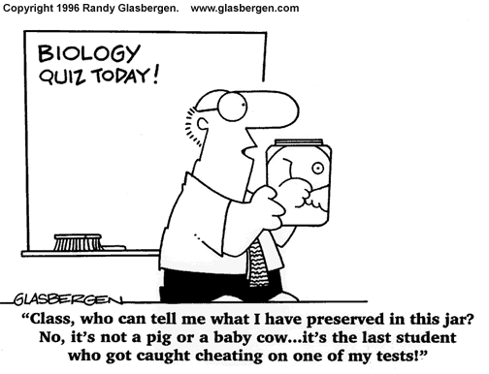
Quiz Time!!
Take 5-6 minutes to do some last minute studying
(you cannot use your notes for the quiz)

Slide 3
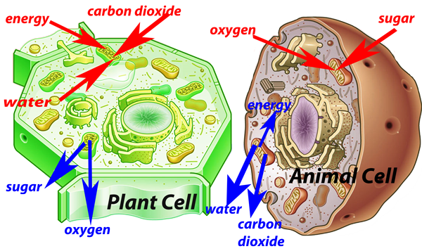
Cell Energetics

Slide 4
Objectives
Relate the function of the plasma (cell) membrane to its structure.
1
Compare and contrast the structure and function of mitochondria and chloroplasts.
2
Describe the model of conversion of light energy to chemical energy by photosynthetic organisms.
3
Compare and contrast cellular respiration and photosynthesis as energy conversion pathways.
4

Slide 5
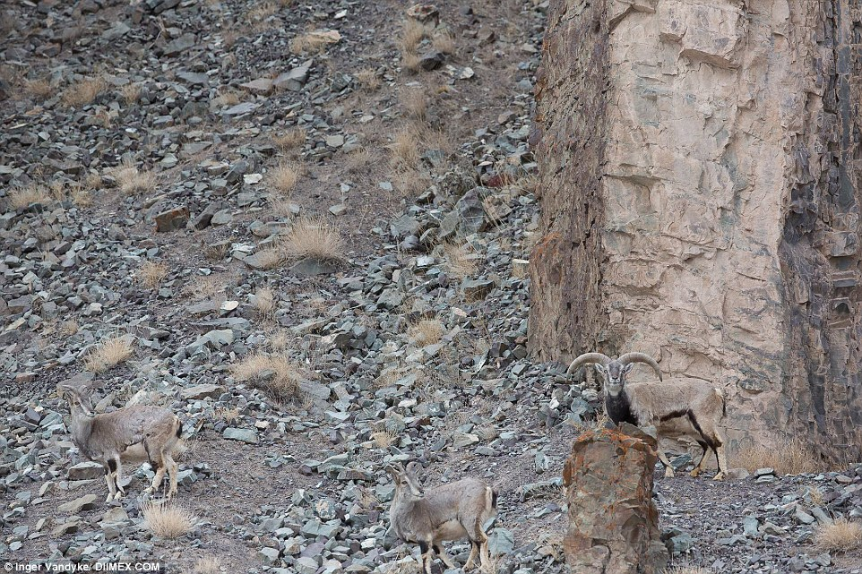

Slide 6
Flow of Energy
All living things need energy
Energy: is the ability to do work or cause change
Work: involves moving something against a force, or going form one place or position to another while overcoming some force to get there.

Slide 7
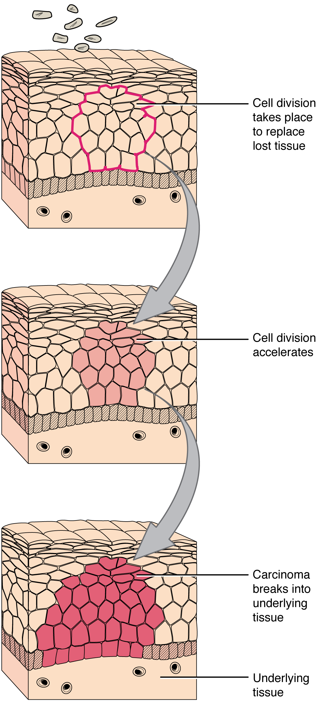
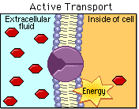
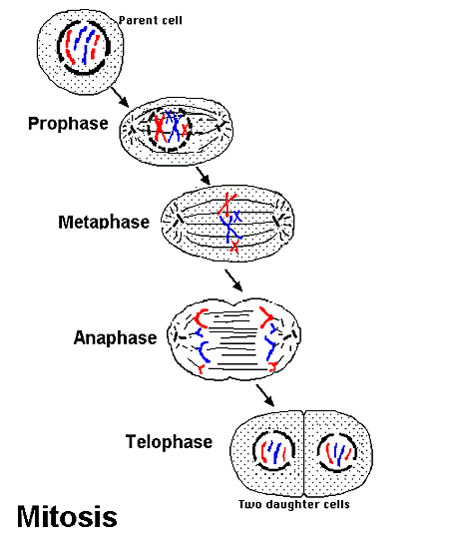
Cells do a lot of work
Growth and Repair
Active Transport
Reproduction
This Photo by Unknown Author is licensed under CC BY-SA
This Photo by Unknown Author is licensed under CC BY-NC-SA
This Photo by Unknown Author is licensed under CC BY

Slide 8
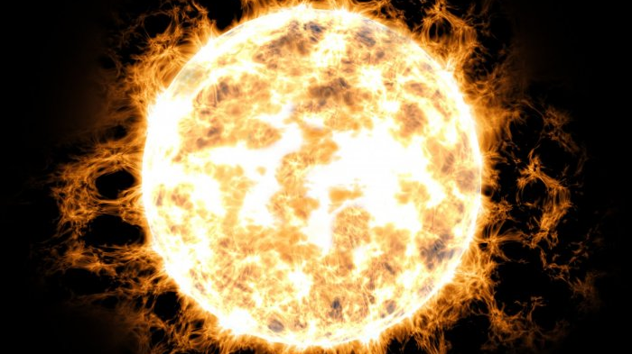
Energy = Life
The ultimate source of energy is the sun
Photosynthetic organisms convert the energy from the sunlight into chemical energy (sugars) that is stored in food.
Food is broken down (in eukaryotes) in the mitochondria to release ATP, and energy storage molecule that is useable by the cell.
Prokaryotes are able to use energy from food, but they do so in a primitive way (don’t worry about it now).

Slide 9
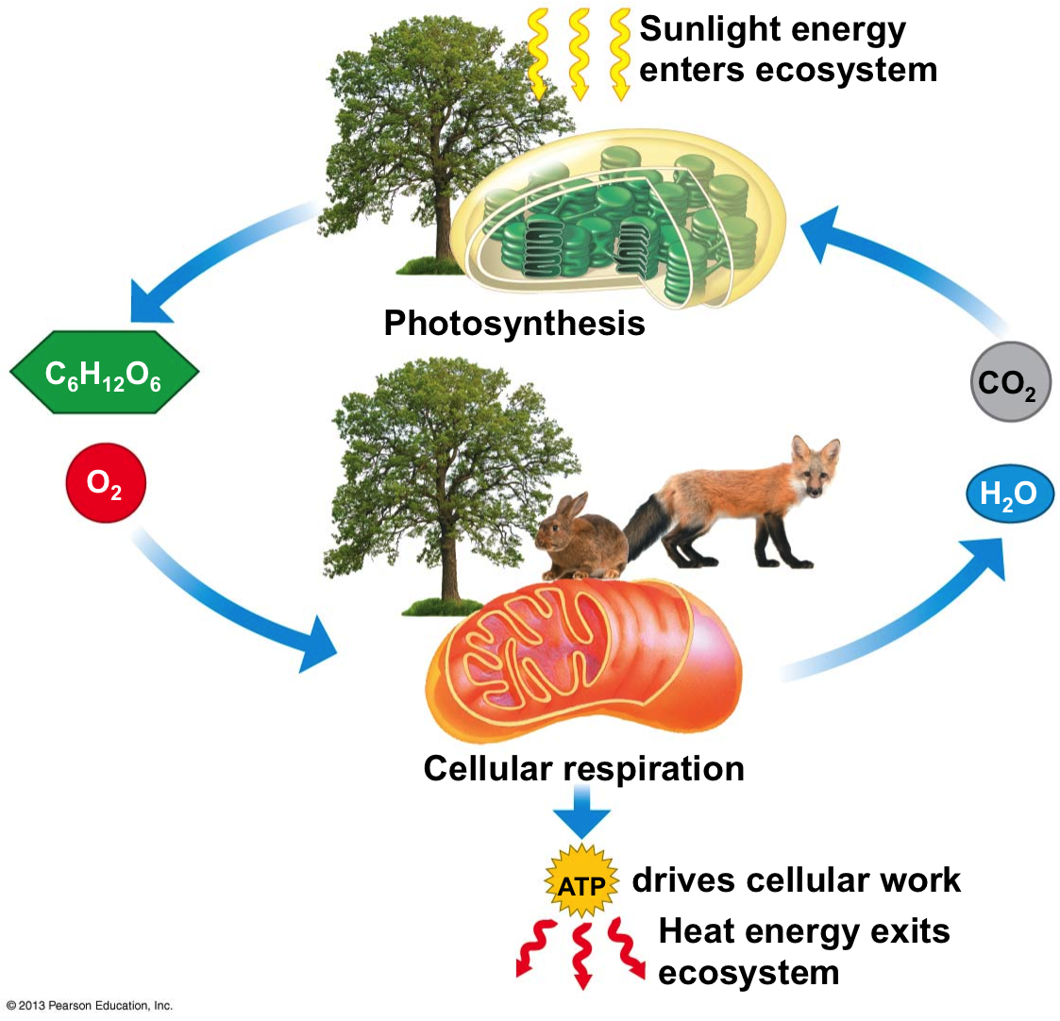
What is the source of energy for life on Earth?
Which product of photosynthesis stores energy?
What form of chemical energy is useable by the cell?
Is energy recycled?
Sunlight
Glucose (C6H12O6)
ATP
Yes!

Slide 10
STOP and THINK: Did you notice that the products of one equation almost perfectly match the reactants of the other????

Slide 11
Why Should we care?
Simple. Metabolism.
Metabolism: the sum total of all chemical reaction within organisms.
Photosynthesis and cell respiration are some of those chemical reactions
There are two types of metabolic reactions:
Catabolic: reactions break down large molecules into smaller ones. Usually these release energy.
Anabolic: reactions build larger molecules form atoms or smaller molecules. These require an input of energy.
Photosynthesis? Cellular Respiration?

Slide 12
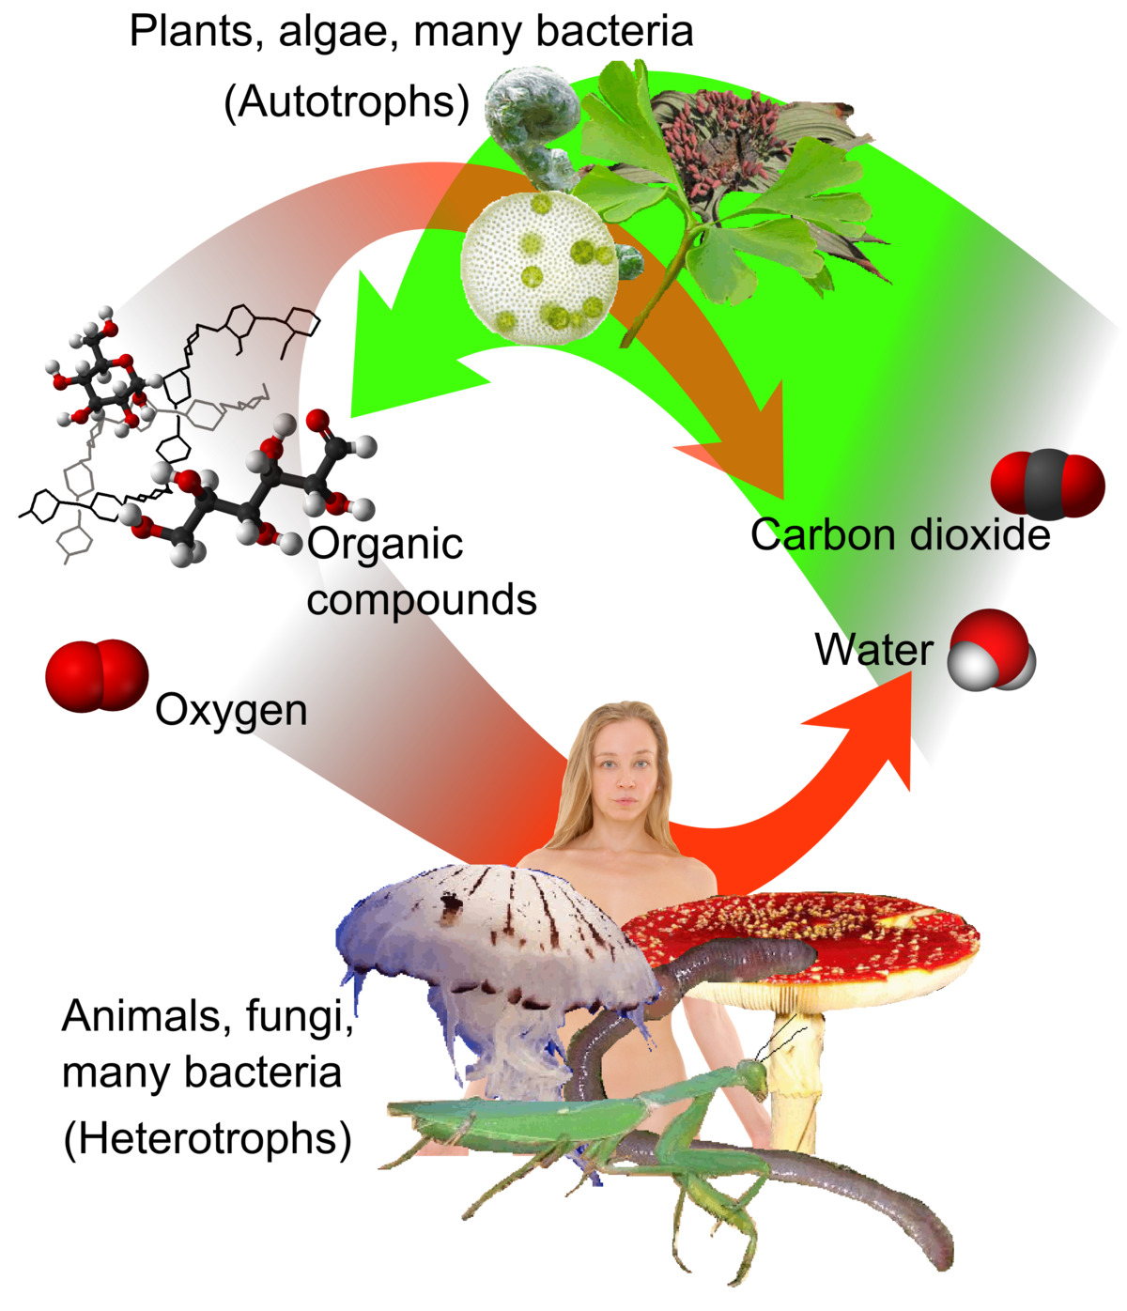
Classifying Organisms Based on Energy Sources
We can classify, or group, organisms based on which processes they perform:
Autotrophs (or Producers): use photosynthesis to collect and store energy originally from the sunlight. Examples of autotrophs include algae and plants.
Chemotrophs: these types of organisms tend to live in extreme environments. These organisms can obtain energy from inorganic compounds or chemicals.
Heterotrophs (or Consumers): need to consume food to get their energy. Heterotrophs include animals, fungi, and many unicellular organisms.

Slide 13
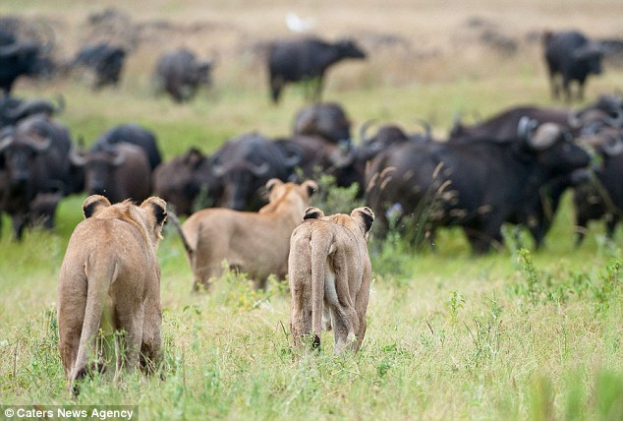

Slide 14
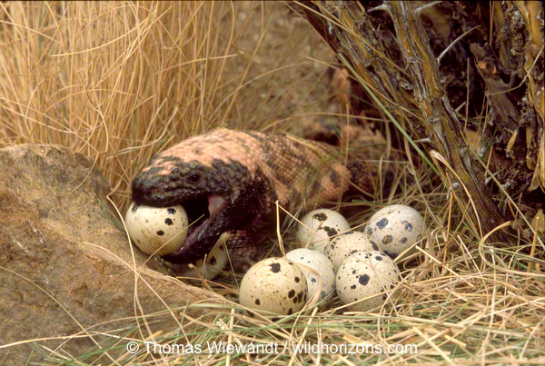

Slide 16
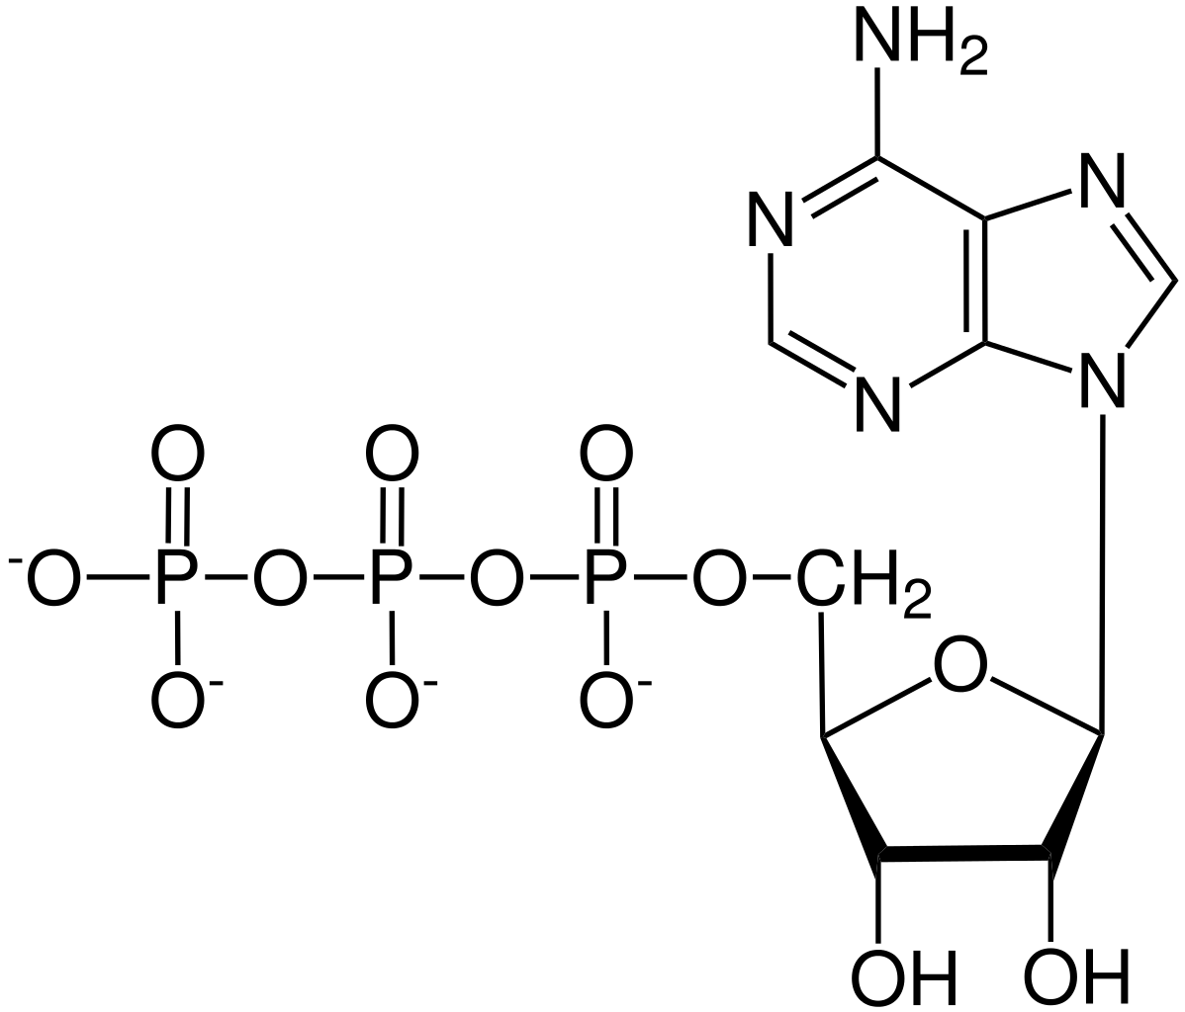
ATP is the Energy Currency of the Cell
An ATP molecule is made up of adenine, ribose (a sugar), and three phosphate groups

Slide 17
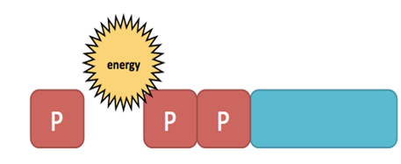
How does ATP store chemical Energy?
ATP will release energy when it breaks the bond holding onto a phosphate group.
When the last phosphate is removed, energy is released from that chemical bond, resulting in ADP (adenosine disphosphate) and a free phosphate group.

Slide 18
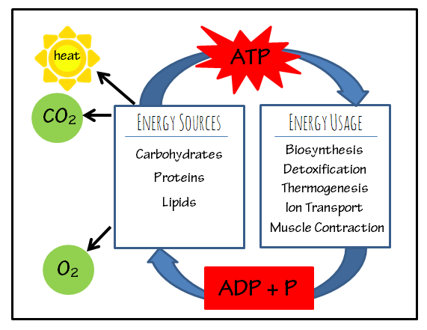
ADP Molecule
The ADP molecule can be recycled to store energy again.
Since the cell can add or subtract a phosphate group, it has a way of storing and releasing energy.
Cells normally have only a small amount of ATP available.
ATP cannot be used for long periods of time.
Cells can regenerate ATP from ADP as needed by using the energy in carbohydrates like glucose.

Slide 19
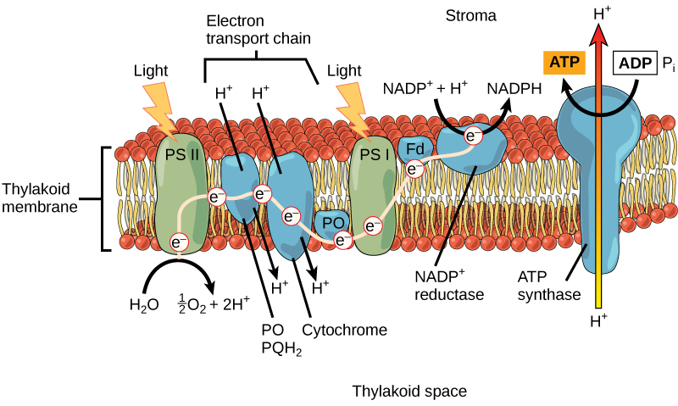
Other High Energy Carriers
Sometimes, we are unable to directly collect energy and place it into ATP.
They can, however, collect high energy electrons from other molecules during catabolism.
The electrons are stored in electron carriers such as NADH, FADH2, and NADPH.
They serve an important purpose as a “middle man” for energy storage.

Slide 21
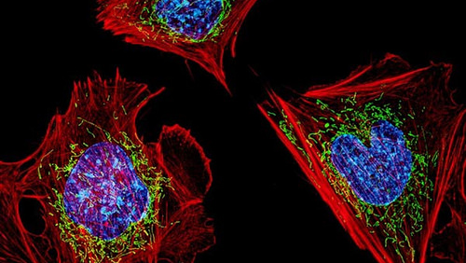
Exit Ticket

