Slide 1
Bellwork #2 – 11/07/17
Do you think water is important to life? Please explain with one complete sentence.

Slide 2
Lab Safety

Slide 3
Laboratory Safety Challenge

Slide 4
Laboratory Safety Challenge Discussion

Slide 5
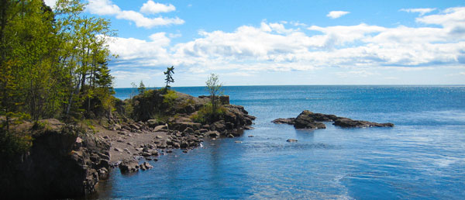
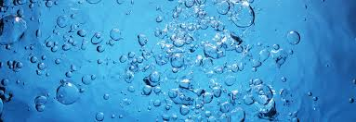
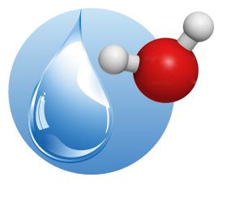
Chemistry of life: Properties of Water

Slide 6
Objective
Identify the unique chemical and physical properties of water and how they impacts life’s processes.

Slide 7
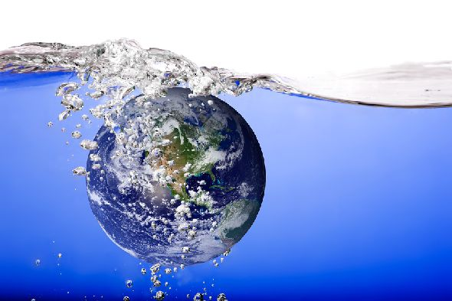
Water in our world
Water is necessary for life
Water in our atmosphere helps to keep the planet warm
Our bodies are composed of and dependent on water

Slide 8
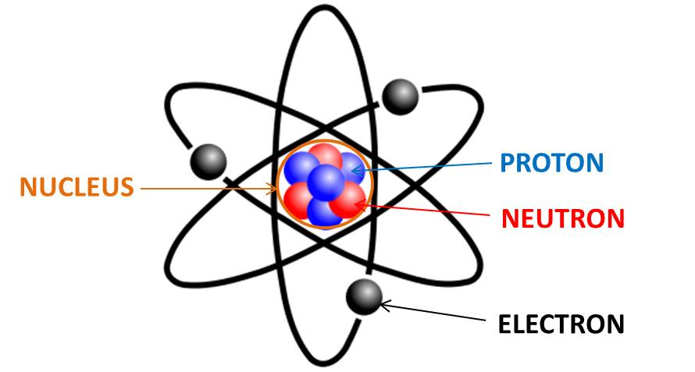
All matter is composed of atoms
The atom is composed of
A nucleus made of neutrons and protons
An electron “cloud” composed of electrons
Protons and neutrons have nearly identical masses, but their charge is different
Protons have a positive (+) electrical charge and neutrons do not have an electrical charge

Slide 9
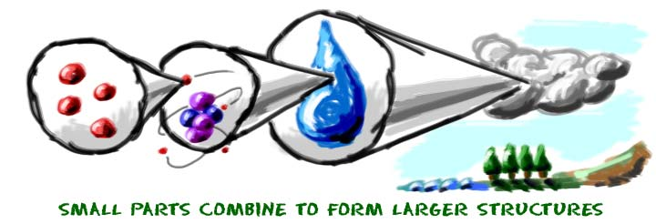
Why do we care about what atoms are made of?

Slide 10
Electrons Charge
Electric charge is a basic force that causes movement

Slide 11
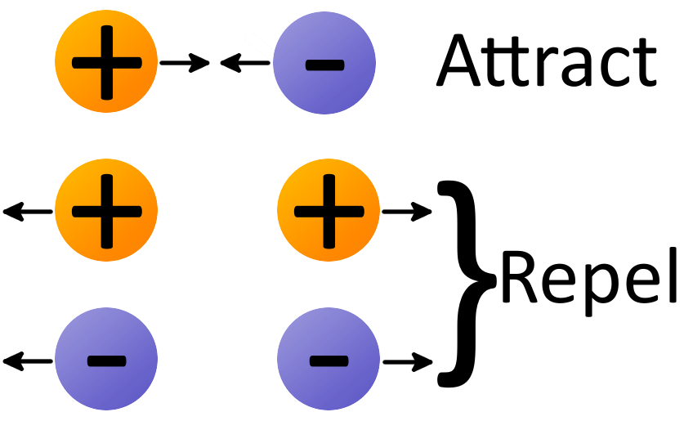
Atoms bond
Electrons of both atoms are mutually attracted to the nucleus
Oppositely charged particles form a bond

Slide 12
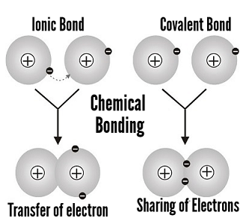
Why are bonds formed?
Bonds are formed because of electrostatic attraction (attraction between electrons) between atoms

Slide 14
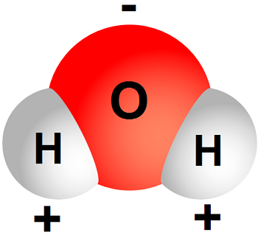
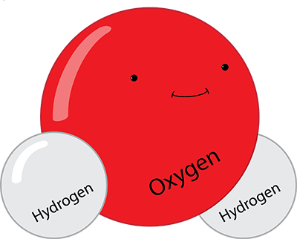
Forming a water molecule
Unequal attraction to bonding electrons
Oxygen is a strong electron grabber
Hydrogens electrons tend to hand out close to oxygen, makes hydrogen positive

Slide 15
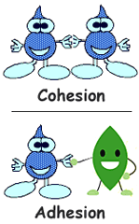
Unique properties of water
Universal solvent
Exists in nature as a solid, liquid, and gas
The density of ice is less than liquid water
High surface tension
High heat capacity
Exists as a liquid at room temperature

Slide 16
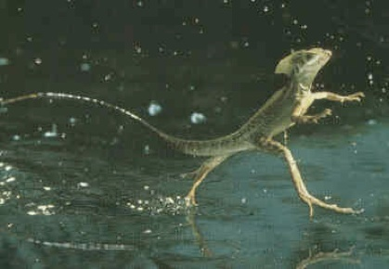
High surface tension
Allows water to form drops
Allows water to form waves
Water drops can “adhere” to surfaces even though gravity is pulling on them

Slide 17
Can you explain why this drop sticks to the Stick and grows larger?

Slide 18
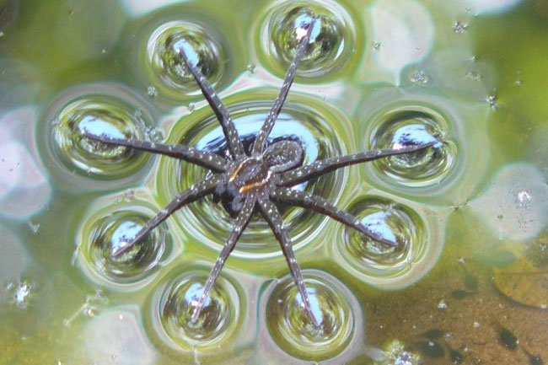
Or how this spider can walk on water?

Slide 19
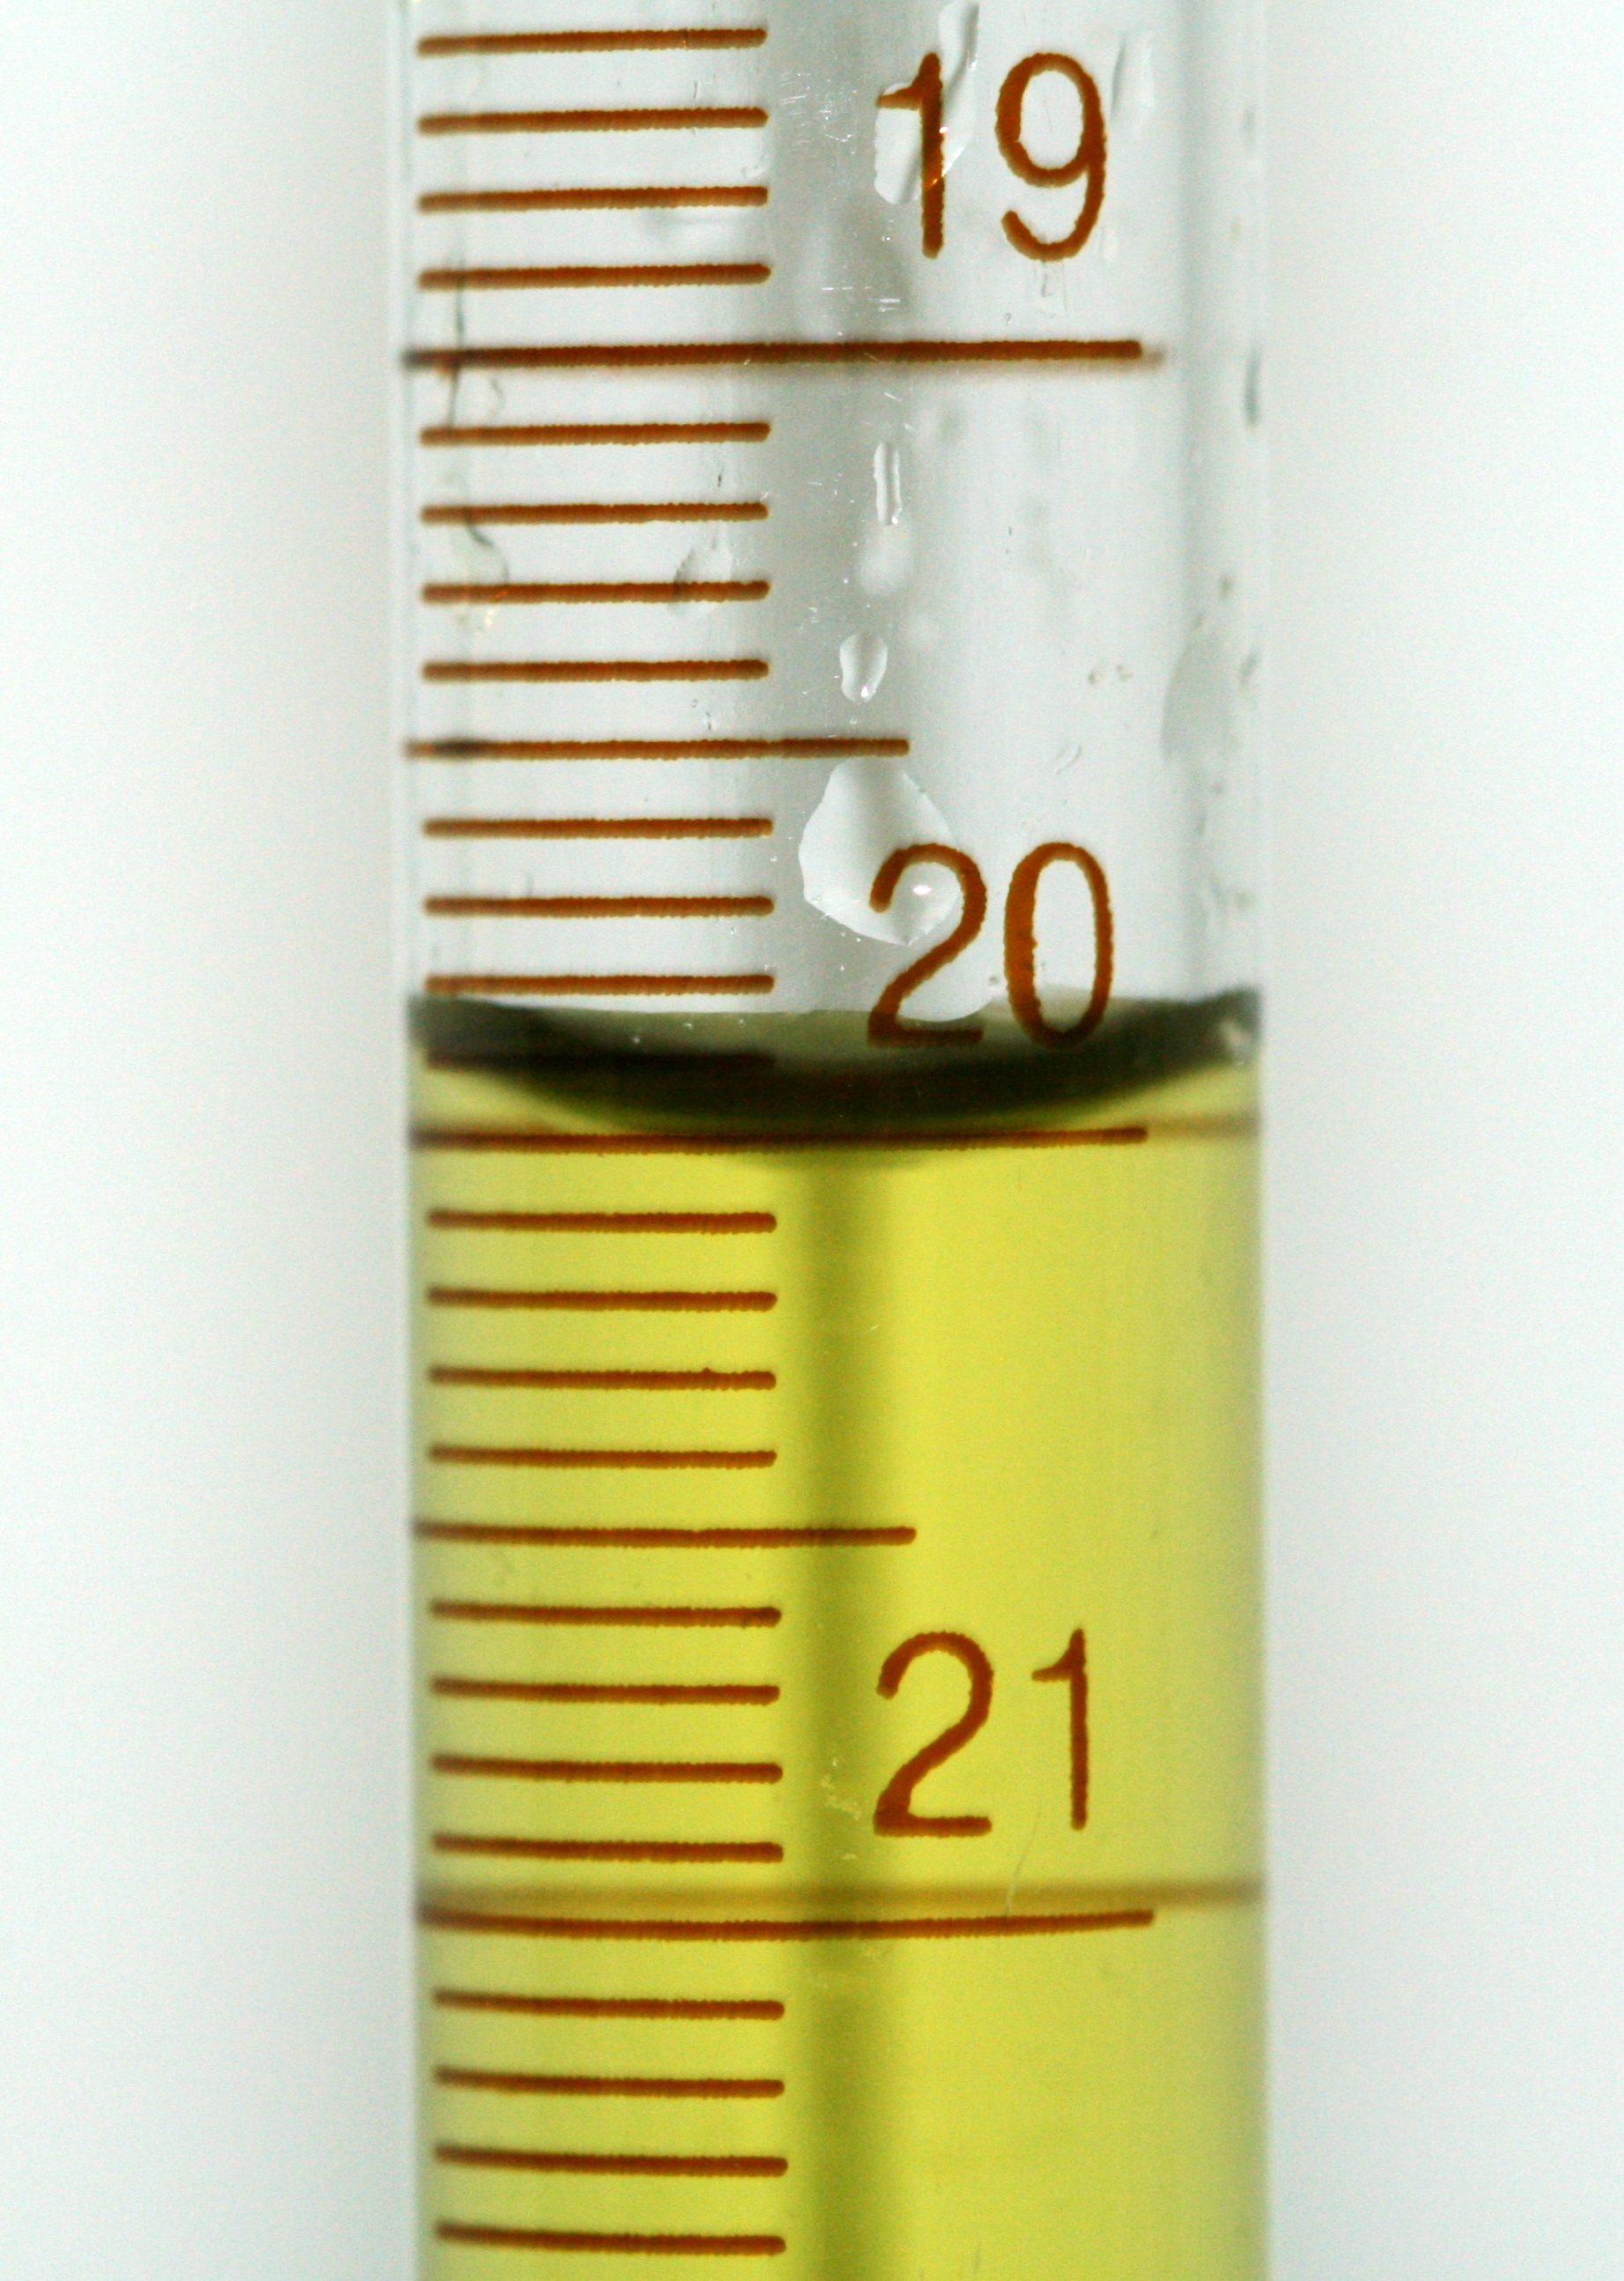
Adhesion
Adhesive forces are attractive forces that occur between two unlike substances
In a narrow glass tube
Water molecules are more strongly attracted to the tube than they are to each other (cohesion)
The cup shape formed at the top of the water is called the meniscus

Slide 20
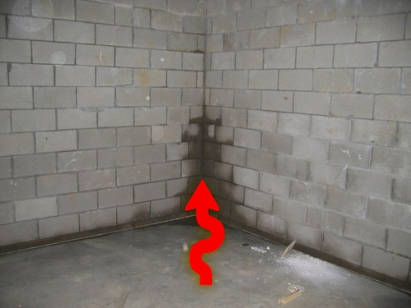
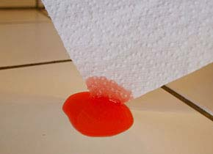
Water climbing!

Slide 21
High specific heat keeps beaches cooler in the day and warmer at night!
Specific heat: the amount of energy required to change 1 gram of a substance 1 degree Celsius
water has a high specific heat
Absorbs large amounts of heat energy before it begins to get hot
Releases heat energy slowly
Moderates the Earth’s climate and helps living organisms regulate their body temperature

Slide 22
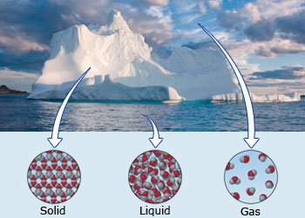
Solid, liquid, gas
Water is the only substance which exists under normal conditions on earth as a solid, a liquid, and a gas!!!!!!!!!!!

Slide 23
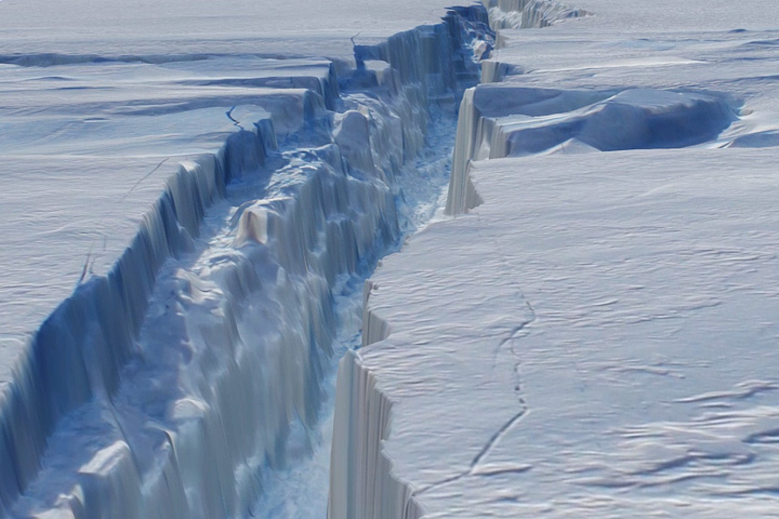
Can you imagine if ice did not float? How do you think that would affect the world?

Slide 24
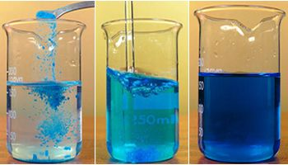
Water is a universal solvent
Water is a polar molecule with one end more positive and one end more negative
Being polar allows water to dissolve nearly any substance with an unequal distribution of charges
Water is the best substance that is universally used for transporting dissolved substances

Slide 25
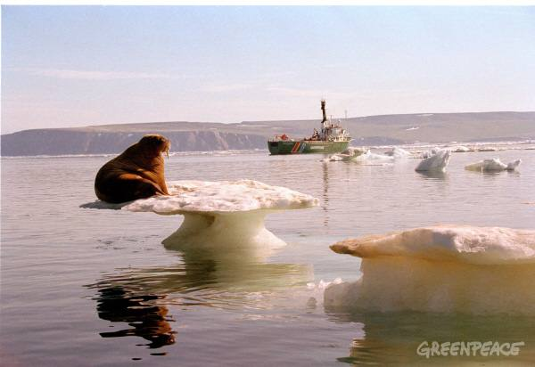
Why should we care about water so much?

Slide 26
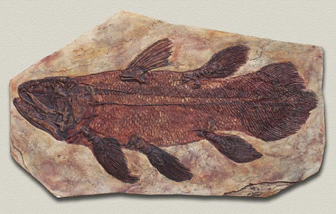
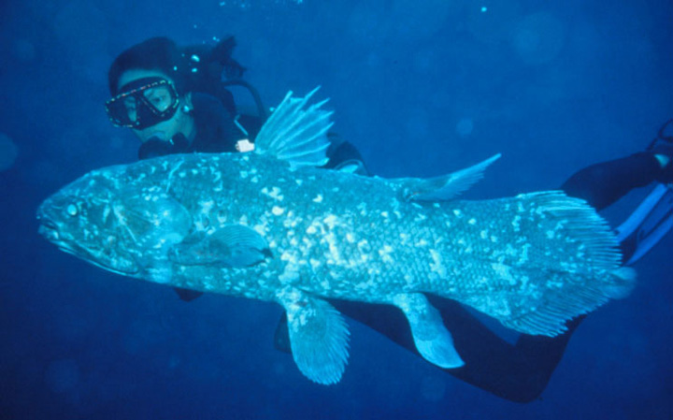
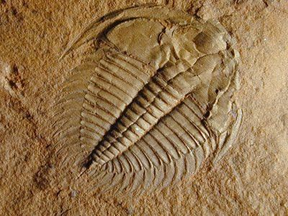
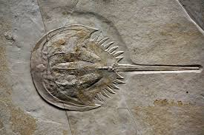
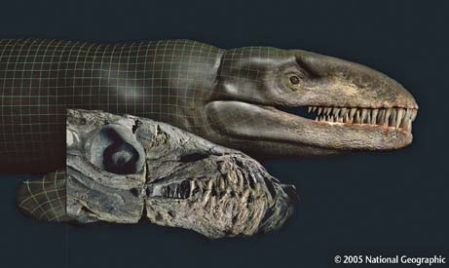
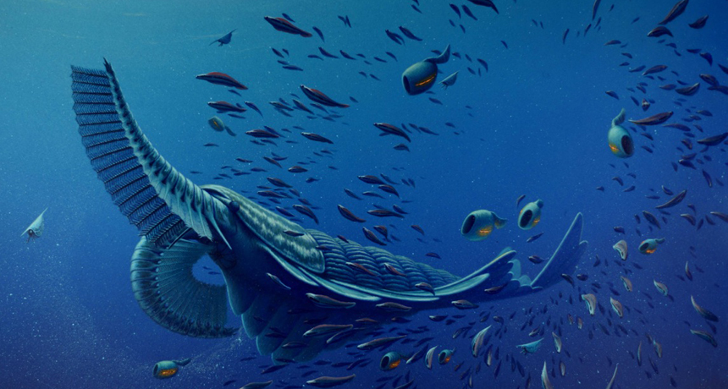
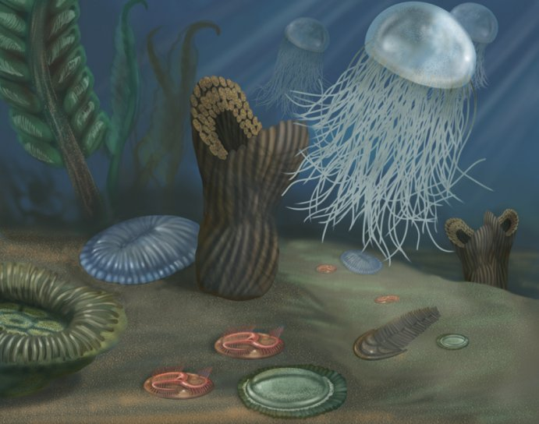
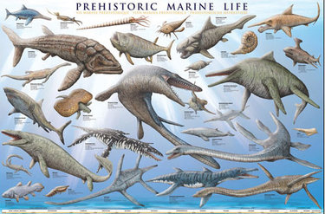
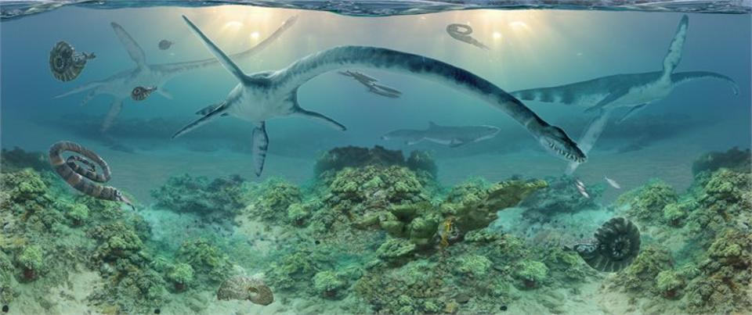
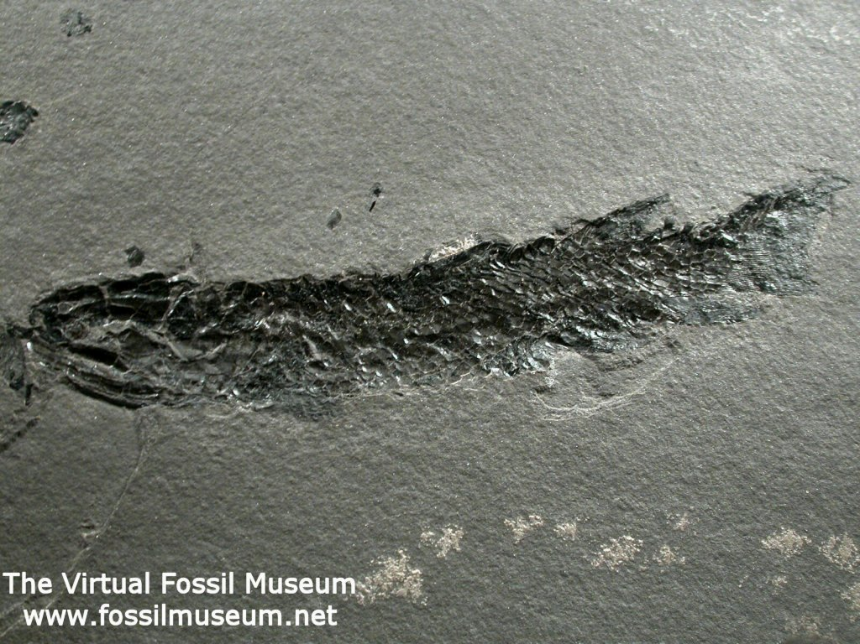
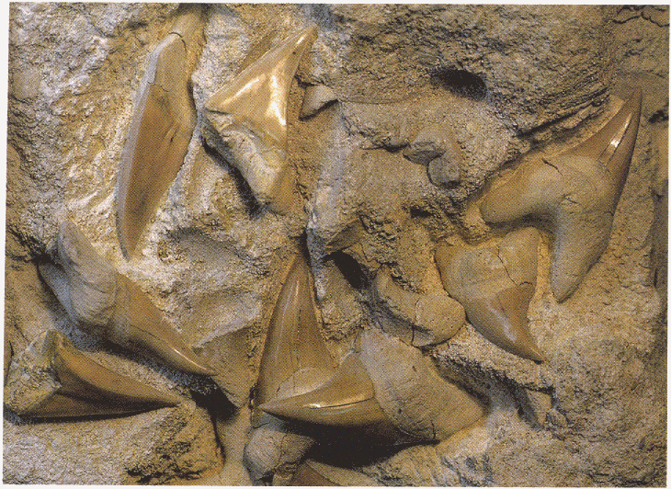
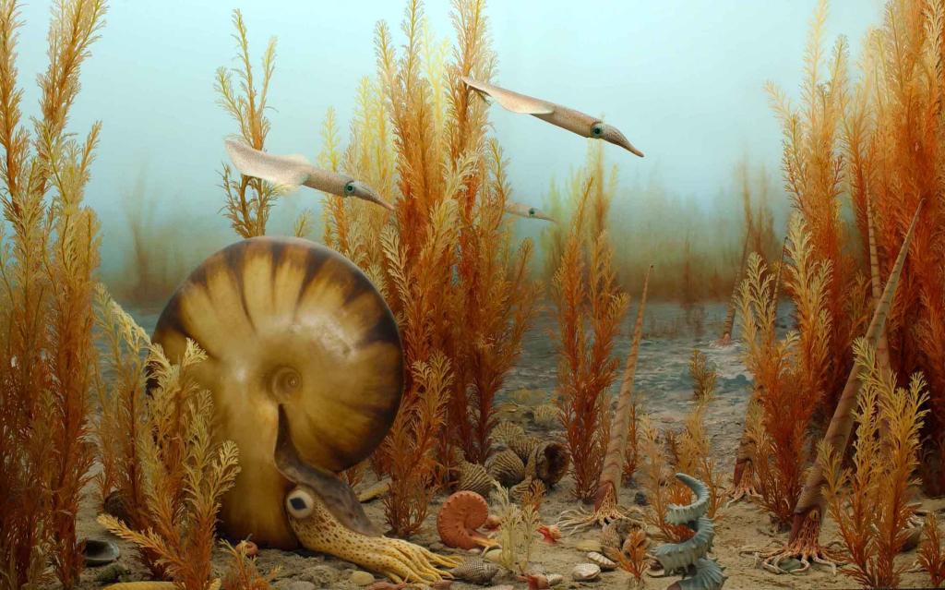

Slide 28
Exit Ticket

