Slide 1
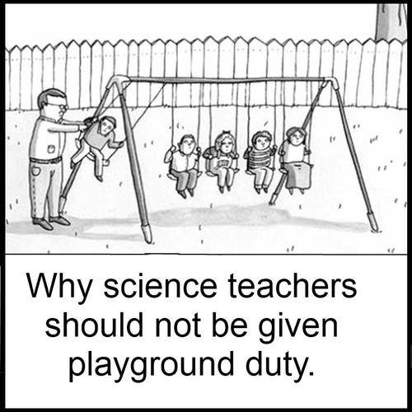
Bellwork #3-11/01/17
What is the difference between an independent and dependent variable?

Slide 2
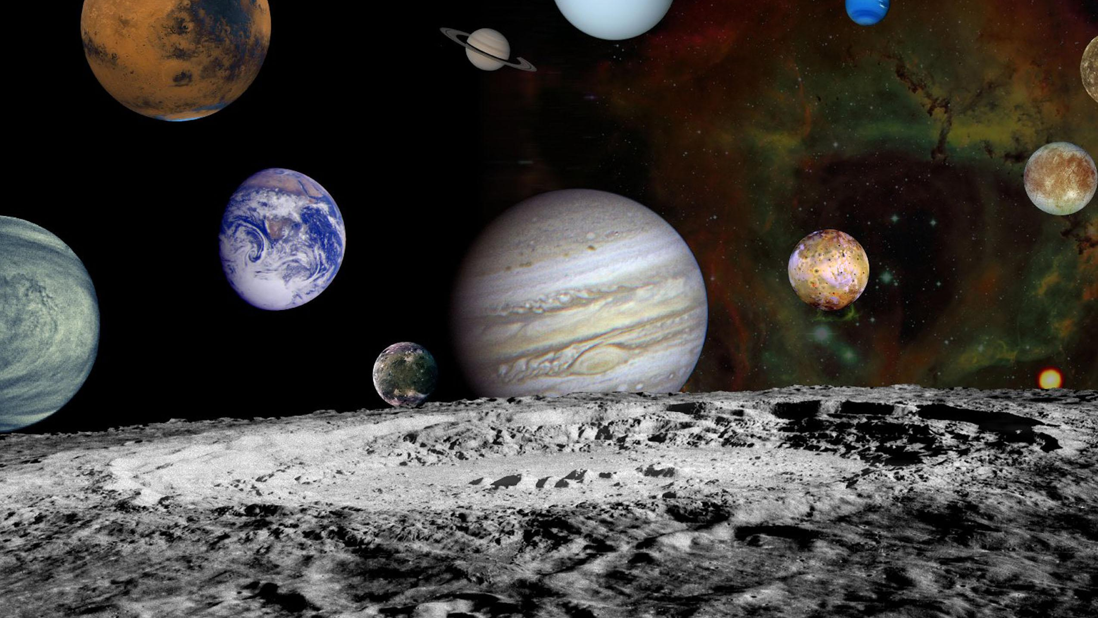
Development of Scientific Knowledge
This Photo by Unknown Author is licensed under CC BY-SA

Slide 3
Objectives
Determine
Determine the levels of certainty in science and how they are distinguished.
Determine
Determine the strategies used to design controlled experiments that provide valid results.
Understand
Understand how scientists effectively and properly collect, report and interpret data.

Slide 4
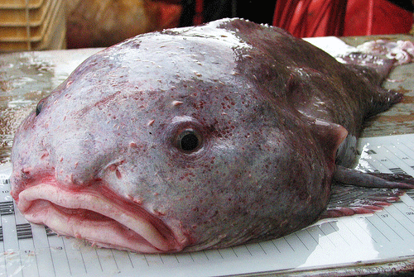
Levels of Certainty in Science: Hypothesis, Theory and Law
Hypothesis
Possible explanation for a set of observations OR
An answer to a scientific problem that can be tested
Examples
Students do better on exams when they study.

Slide 5
Levels of Certainty in Science: Hypothesis, Theory and Law
Theory
Broad explanation that explains a number of natural phenomena
Has been tested many times and shown to be reliable.
Examples
Cell Theory
Theory of Relativity
Theory of Evolution
Big Band Theory
This Photo by Unknown Author is licensed under CC BY-NC-ND

Slide 6
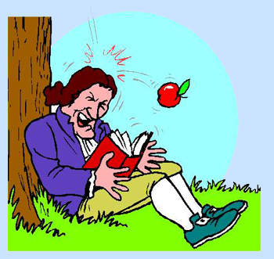
Levels of Certainty in Science: Hypothesis, Theory and Law
Law
Foundation for all sciences
Describe something in the natural world.
Must be simple, true, universal, and absolute, and they are accepted at face value.
Examples
Newton’s Law of Motion
Laws of thermodynamics
This Photo by Unknown Author is licensed under CC BY-ND

Slide 8
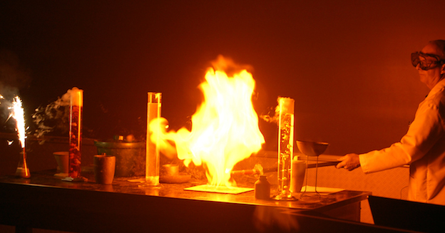
Experimental Design
Well designed experiments include:
Large sample size
Unbiased opinions
Testing one variable at a time
Placebos as controls
Bad experimental design:
Low sample size
Confounding variables → variables that could negatively influence your results.
Bias
This Photo by Unknown Author is licensed under CC BY-NC-SA

Slide 10
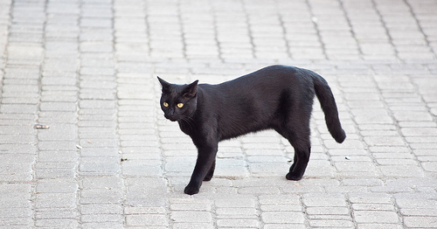
Experimental Design - Activity
You are the people at your table will design an experiment focusing on a superstition.
Example. An apple a day keeps the doctor away, eating chocolate causes zits, etc.
Make sure to follow the scientific method and use the appropriate variables for your experiment.
Hypothesis
Procedure/Materials
Etc.
This Photo by Unknown Author is licensed under CC BY-SA

Slide 11
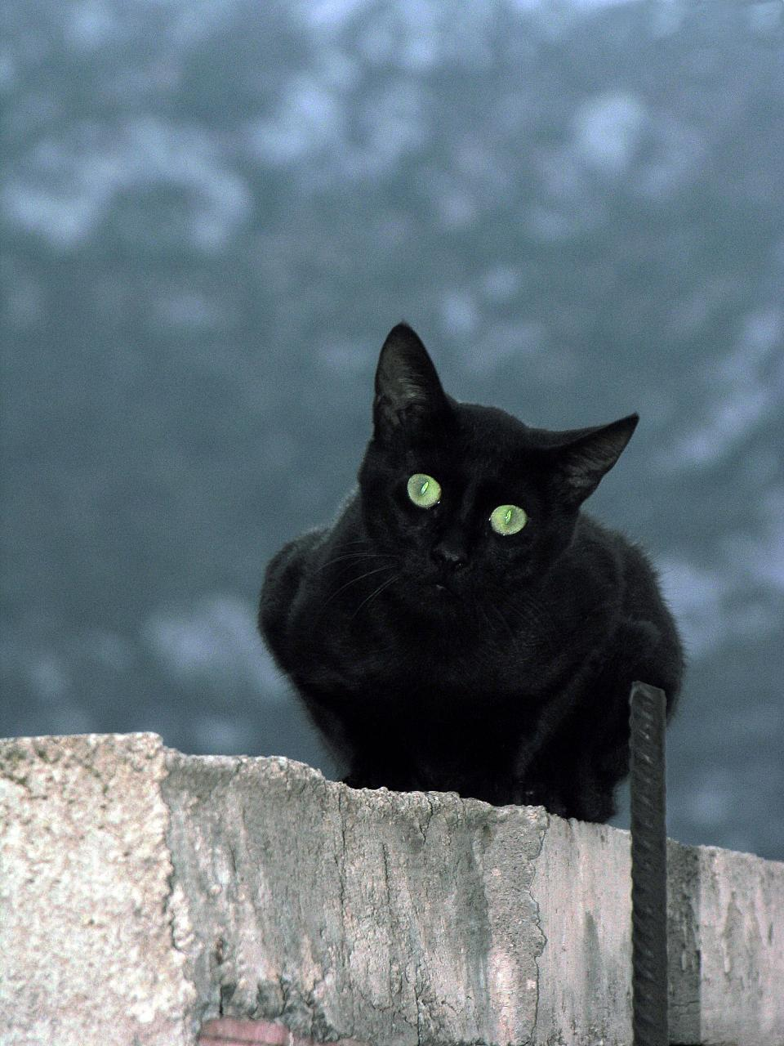
Experimental Design – Peer Review
Peer review another group’s experiment
Does this group have the following:
Hypothesis
Procedure
Materials and Methods
Variables – Control, Independent, Dependent
Large sample size
Etc.
This Photo by Unknown Author is licensed under CC BY-SA

Slide 12
Discussion – Current Science Experiments (Due Monday)
Read through the article and describe how the experiment was designed, including:
The title (required for a grade)
What question did the scientists want to answer?
Identify the independent and dependent variables.
What controlled variables are mentioned?
It non are mentioned, describe a possible controlled variable for this experiment.
In a sentence, describe their findings/results. Do not copy and paste from the article.

Slide 13
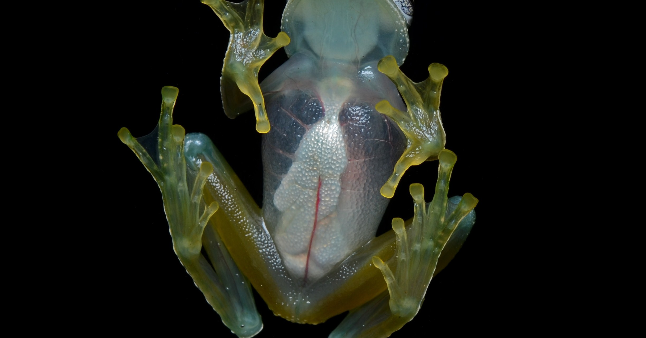
Exit Ticket
This Photo by Unknown Author is licensed under CC BY-SA

