Slide 1
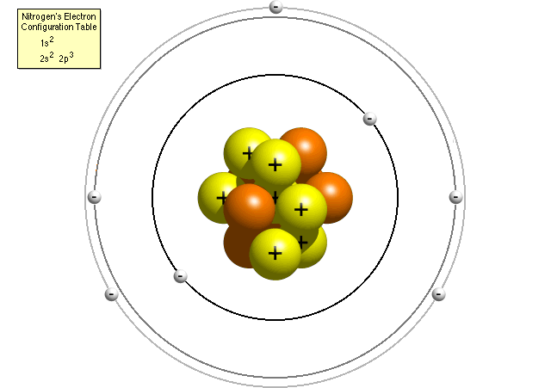
Drawing Bohr Models

Slide 2
Bohr Models
Bohr models are used to predict reactivity in elements.
Reactivity refers to how likely an element is to form a compound with another element.
When looking at Bohr models, we look at its valence electrons (the electrons on the last energy level) to determine reactivity.

Slide 3
Drawing Bohr Models
Draw the nucleus.
Write the number of neutrons and the number of protons in the nucleus.
Draw the first energy level.
Draw the electrons in the energy levels according to the rules below. Make sure you draw the electrons in pairs.
Keep track of how many electrons are put in each level and the number of electrons left to use.

Slide 4
Rules for Energy Levels
Level 1 (closest to the nucleus) can hold a maximum of 2e.
Level 2 can hold a max of 8e.
Level 3 can hold a max of 18e.
Level 4 can hold a max of 32e.
You must fill one level before going on to draw the next level!

Slide 5
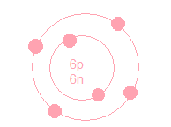
Guided Practice
In order to draw Bohr models of these elements, you must first determine the number of protons, neutrons, and electrons. Once you have found this information, follow the directions to draw your model.
6
C
Carbon
12.011
6
6
6
Protons: _____ Neutrons: _____ Electrons: ______
How many energy shells will this have? ____
How many valence (outer) electrons does this element have? ____
Bohr Model:
2
4

Slide 6
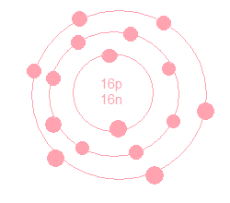
Guided Practice
16
S
Sulfur
32.066
16
16
16
Protons: _____ Neutrons: _____ Electrons: ______
How many energy shells will this have? ____
How many valence (outer) electrons does this element have? ____
Bohr Model:
3
6

Slide 7
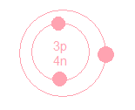
Guided Practice
3
Li
Lithium
6.941
3
4
3
Protons: _____ Neutrons: _____ Electrons: ______
How many energy shells will this have? ____
How many valence (outer) electrons does this element have? ____
Bohr Model:
2
1

Slide 8
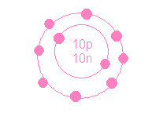
Guided Practice
10
10
10
10
Ne
Neon
20.180
Protons: _____ Neutrons: _____ Electrons: ______
How many energy shells will this have? ____
How many valence (outer) electrons does this element have? ____
Bohr Model:
2
8

Slide 9
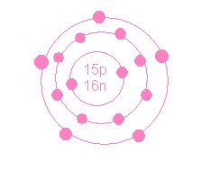
Guided Practice
15
P
Phosphorus
30.974
15
16
15
Protons: _____ Neutrons: _____ Electrons: ______
How many energy shells will this have? ____
How many valence (outer) electrons does this element have? ____
Bohr Model:
3
5

Slide 10
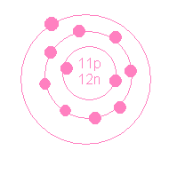
Guided Practice
11
Na
Sodium
22.990
11
12
11
Protons: _____ Neutrons: _____ Electrons: ______
How many energy shells will this have? ____
How many valence (outer) electrons does this element have? ____
Bohr Model:
3
1

