Slide 1
Bellwork #1 – 09/11/17
What is the atomic number of an element?
What is the atomic mass of an element?

Slide 2
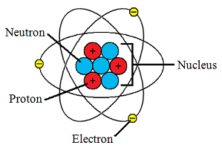
Electrons in Atoms
This Photo by Unknown Author is licensed under CC BY-SA

Slide 3
Objectives
Compare and contrast the Bohr model and the quantum model of an atom.
List the four quantum number, and describe their significance.
Relate the number of sublevels to each of an atom’s main energy levels, the number of orbitals per sublevel, and the number of orbitals per main energy level.

Slide 4
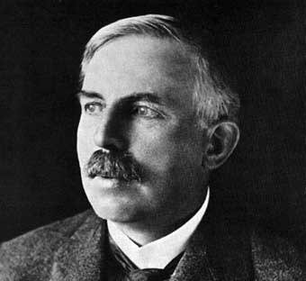
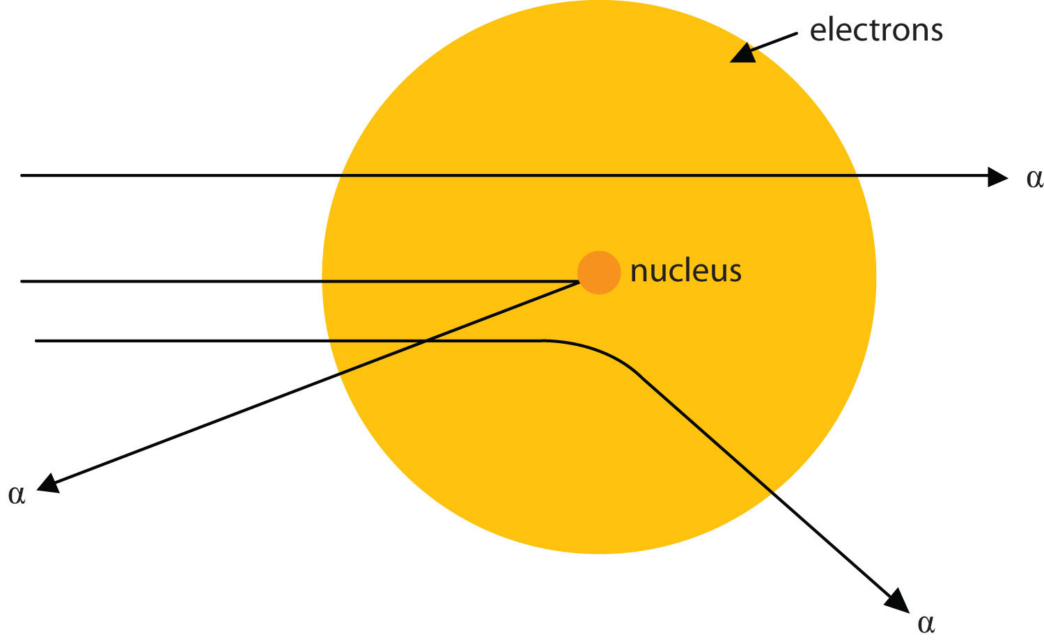
Ernest Rutherford
This Photo by Unknown Author is licensed under CC BY-NC-SA
This Photo by Unknown Author is licensed under CC BY-SA
The modern view of the atom was developed by Ernest Rutherford (1871-1937)
Gold foil experiment
Determined that atoms have a central positive nucleus
Also determined that electrons are outside the nucleus (deflection)

Slide 5
Gold Foil Experiment

Slide 6
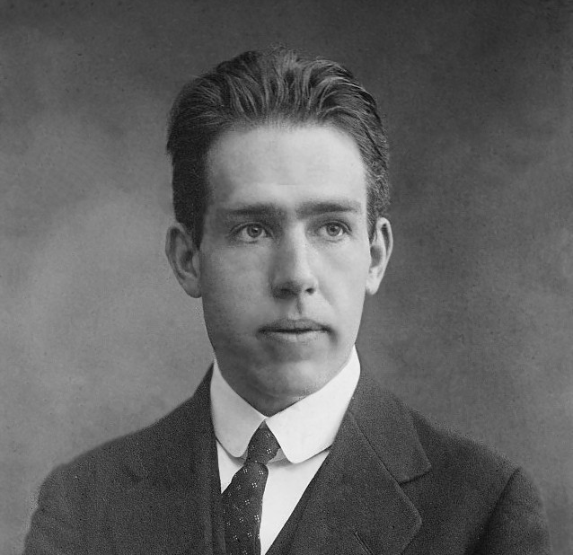
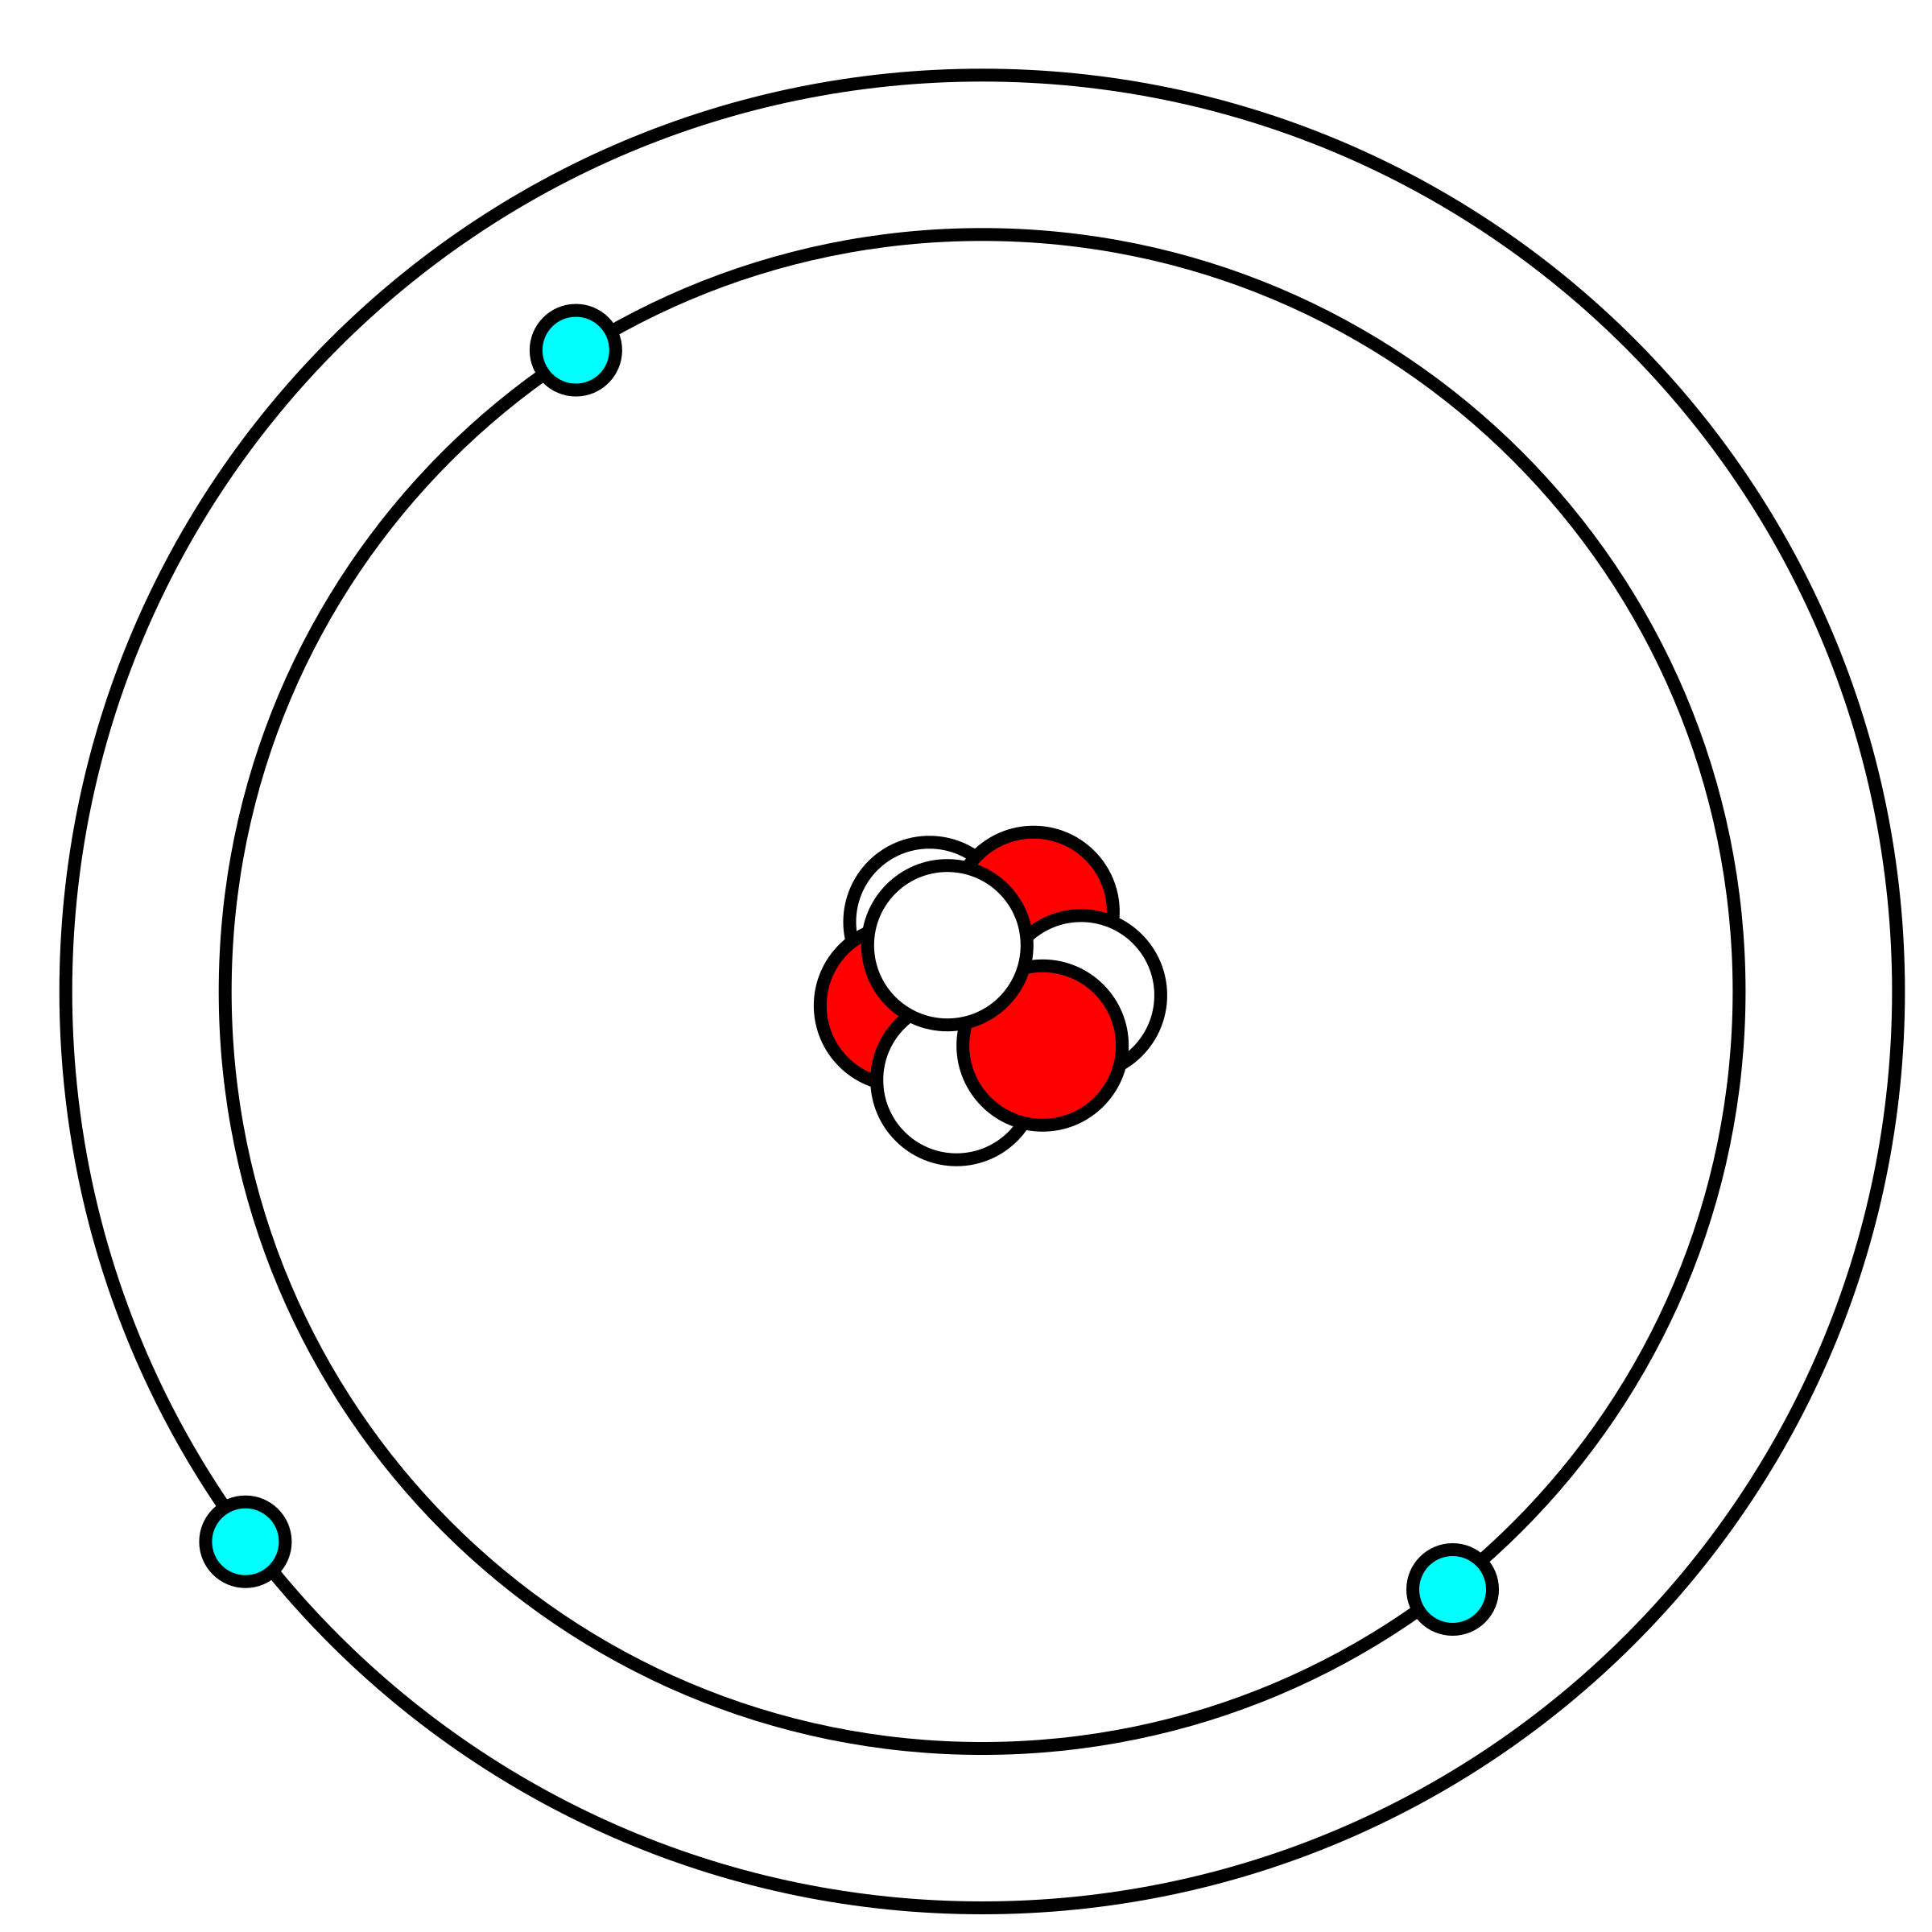
Niels Bohr and the Atom
Niels Bohr (1885-1962)
Proposed electrons are found in concentric orbitals around the nucleus called energy levels.
Originated the idea of quantum energy
This Photo by Unknown Author is licensed under CC BY-SA

Slide 7
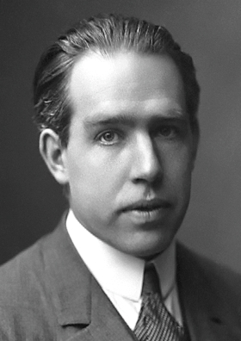
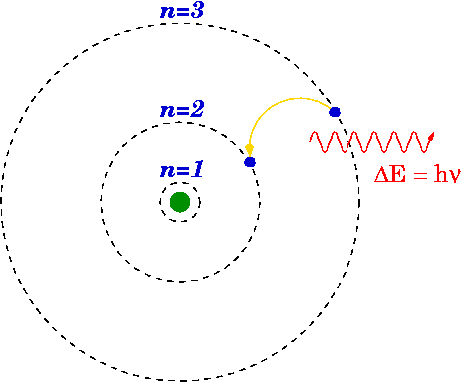
Atomic Line Spectra and Niels Bohr
This Photo by Unknown Author is licensed under CC BY-SA
Problem with the theory –
Theory only successful for H.
Introduced quantum idea artificially.
So, we go on to Quantum or Wave Mechanics.
This Photo by Unknown Author is licensed under CC BY-SA

Slide 9
Atomic Electron Configurations and Periodicity
This Photo by Unknown Author is licensed under CC BY-SA

Slide 10
Arrangement of Electrons in Atoms
Electrons in atoms are arranged as:
Principle Energy Levels (n)
SUBLEVELS (l)
ORBITALS (m_{l})

Slide 11
Principle Energy Levels
n = 1
n = 2
n = 3
n = 4

Slide 12
Learning Check

Slide 13
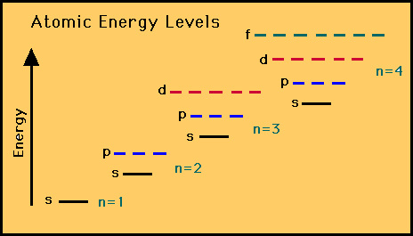
Assigning Electrons to Atoms
This Photo by Unknown Author is licensed under CC BY-SA
Electrons generally assigned to orbitals of successively higher energy. Aufbau Principle.
Aufbau is a German word which means “to build”
Principle states that no two electrons can have the same set of quantum numbers.
Hence they have to “pile up” or “build up” into higher energy level

Slide 14
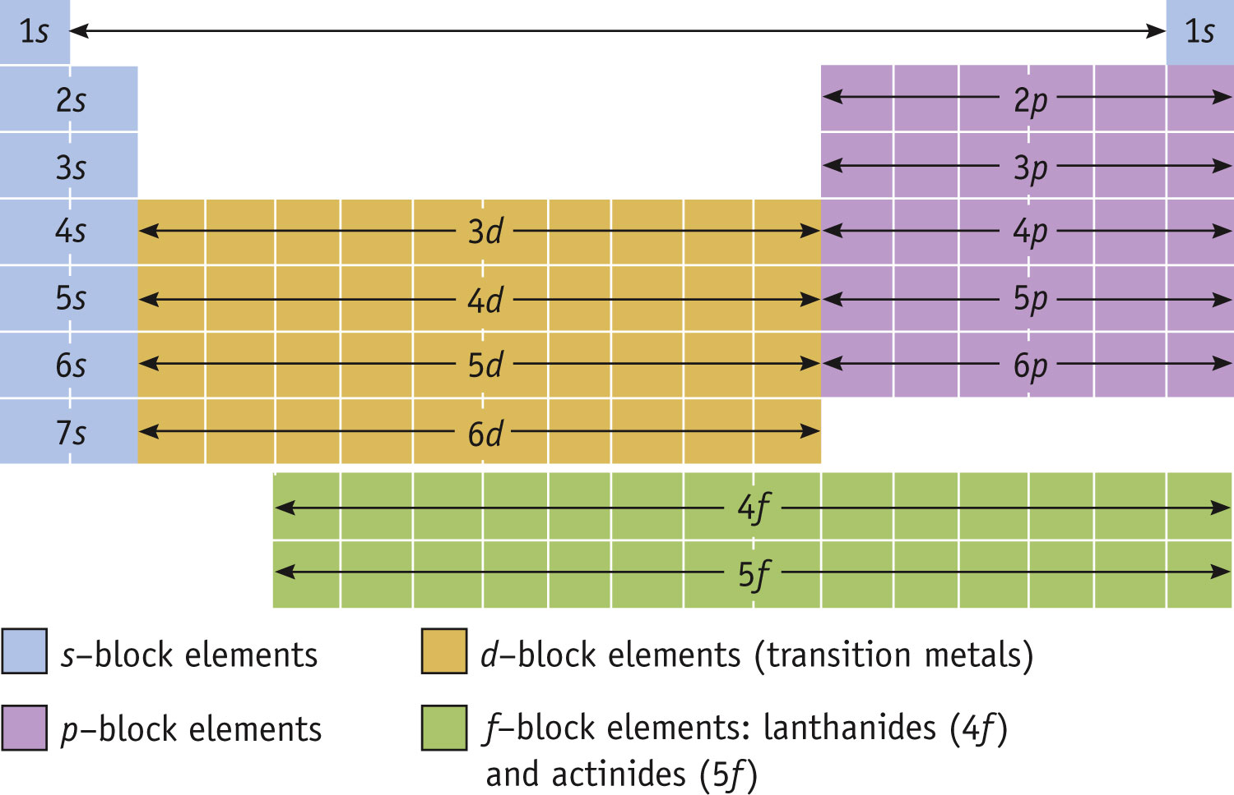
Sublevel filling of Electrons
Electrons fill orbitals from the bottom up → Aufbau Principle

Slide 15
Orbitals
Pauli Exclusion Principle
No more than 2 electrons assigned to an orbital
Orbitals grouped in s, p, d, (and f) sublevels
Write these sublevels on your periodic table
s sublevels
p sublevels
d sublevels

Slide 16
s orbitals
p orbitals
d orbitals
s orbitals
p orbitals
d orbitals
No.
orbs.
1
3
5
No. e-
2
6
10

Slide 17
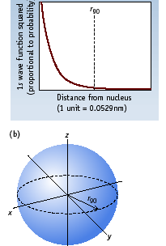
s Orbitals
All s orbitals are spherical in shape.

Slide 18
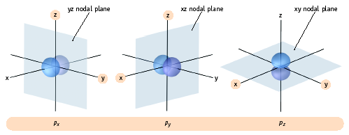
p Orbitals
The three p orbitals lie 90 degrees apart in space

Slide 19
Type of Atomic Orbitals

Slide 21
Exit Ticket
This Photo by Unknown Author is licensed under CC BY

