Slide 1
Please Take A seat and Grab your folder

Slide 2
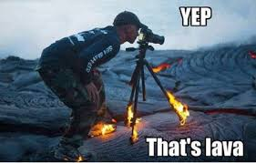
Welcome!

Slide 3
Objectives
Introduction/Welcome
About Ms. Murphy
Syllabus/Expectations
Routine and Procedures for Class
Class Website
Construction Zone Activity

Slide 4
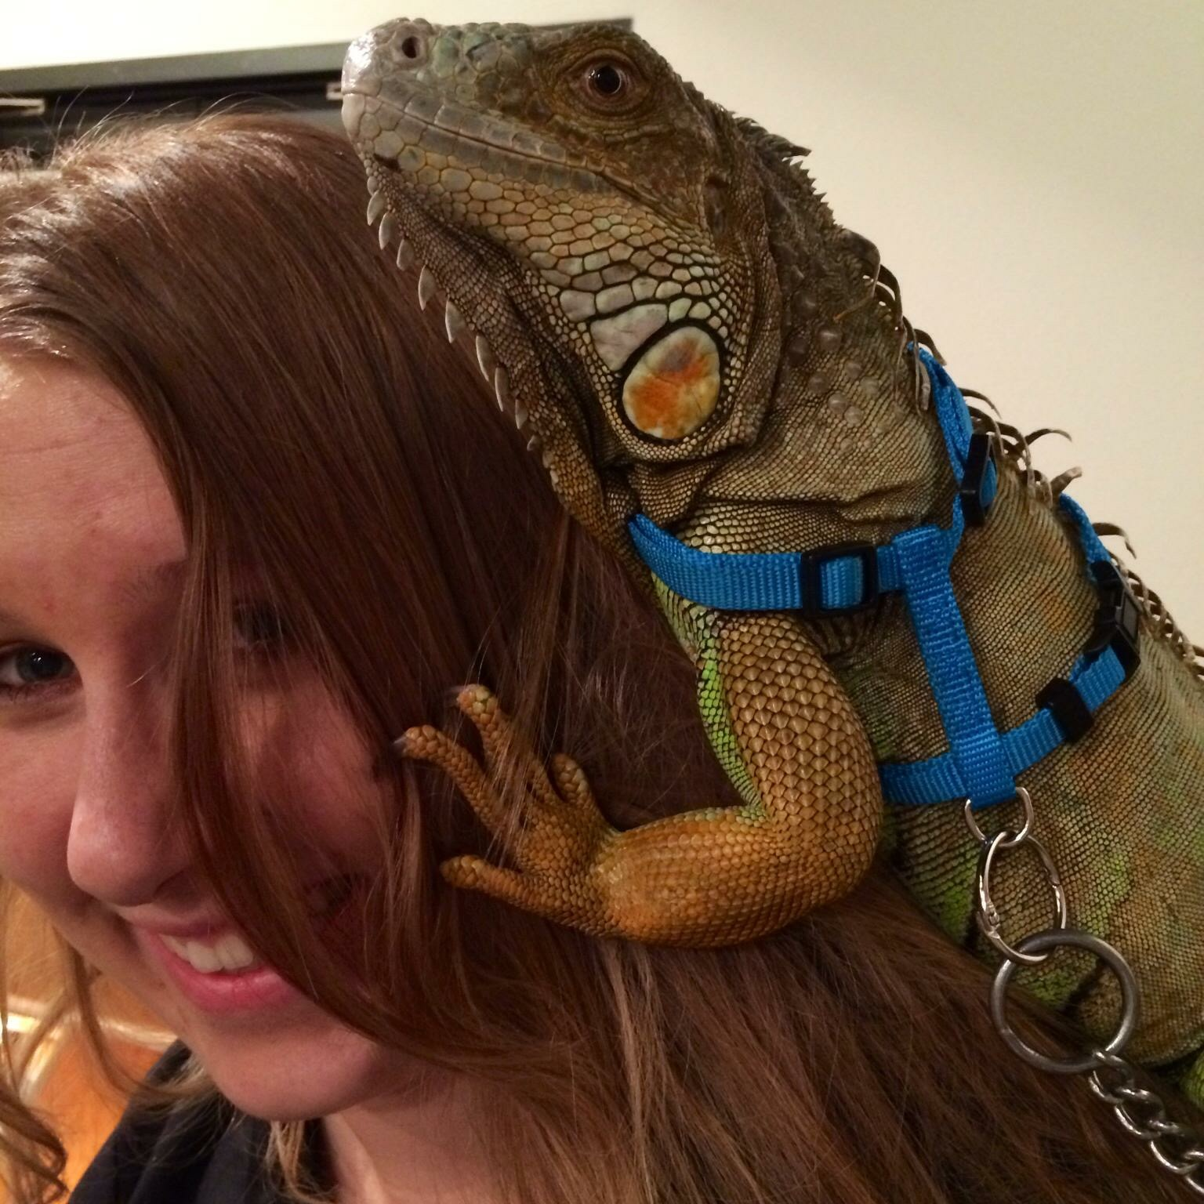
About Ms. Murphy
Graduated from ASU
Studied Biological Sciences
Emphasis on Neurobiology and Physiology
Teaching for 2 years
Rattlesnake Researcher (ASU)
Previous Jobs: Venomous Snake Curator, Crocodile Wrestler, Zookeeper, Lizard Researcher (Yuma)
One dog, one cat, two snakes, and one hedgehog, one tarantula
Goal for this year (2017): Hike the Grand Canyon

Slide 5
Syllabus

Slide 6
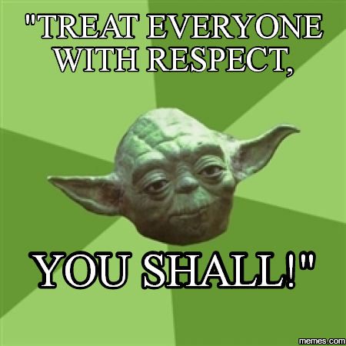
Routines and Procedures for Class
Entering class
Folders
Turning in Assignments
Bell Work
Pencils
Bathrooms
Hall passes
Exit Ticket
Food and Drink
RESPECT

Slide 7
Class Website
http://msmurphysscienceclass.weebly.com/

Slide 8
Construction Zone
Go to the table that has your number.
You and your team will have 20 mins to build a house out of the deck of cards on your table.
Your team can use all of the supplies that are on your table.
Goal:
Creative
Tallest
Tallest or most creative house wins a prize.
Catch: All team members have to be completely silent when building the house.
If your team is not silent, then your team will be disqualified.

Slide 9
Reflection: How does this relate to science?
This Photo by Unknown Author is licensed under CC BY-SA

Slide 10
Due Tomorrow
Notebook or Composition Notebook
Signed Syllabus Page
First grade in the gradebook!

