Slide 1
Bellwork #1 09/11/17
If a person walks 5 m/s north, stops and continues to walk 3 m/s south. How far did this person go?

Slide 2
Fluids and pressure
This Photo by Unknown Author is licensed under CC BY-SA
This Photo by Unknown Author is licensed under CC BY-NC-SA

Slide 3
Objectives
Identify and describe
Identify and describe how fluids exert pressure.
Identify and analyze
Identify and analyze how atmospheric pressure varies with depth.
Provide
Provide examples of fluids flowing from high to low pressure

Slide 4
What are Fluids?
The amount of mass it has per volume.
Density: the mass (m) of the substance divided by its volume (V).
Density = mass/volume
This Photo by Unknown Author is licensed under CC BY-SA
This Photo by Unknown Author is licensed under CC BY-SA

Slide 5
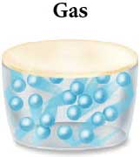
Practice
A certain gas occupies a volume of 0.28m and has a mass of 0.40 kg.
What is the density of the gas?
This Photo by Unknown Author is licensed under CC BY-SA

Slide 6
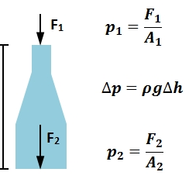
What causes the pressure to increase as a submarine dives?
Increase in pressure is due to the added weight of water pressing on the submarine as it goes deeper.
F1 = (Patmospheric)(A)
Downward force on the bottle
Need to also account for the weight (density) of the fluid)
W=mg=pVg=p(hA)g
m=mass
h= depth
g= acceleration due to gravity (9.81 m/s2)
F2=(Pbottom)(A)
This Photo by Unknown Author is licensed under CC BY-SA

Slide 7
What causes the pressure to increase as a submarine dives?
Dependence of Pressure on Depth
Pressure at depth h = (atmospheric pressure) + (density X acceleration due to gravity X depth)
P = Patmospheric + pgh
This equation holds not only for the bottom of the container, but for any depth below the surface.

Slide 8
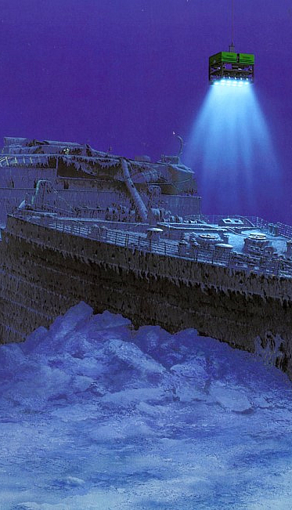
Practice
The Titanic was found in 1985 on the bottom of the North Atlantic Ocean at a depth of about 4000m (~2.5 mi). What is the pressure at this depth?
Applying P=Patmospheric + pgh with p = 1025 kg/m3 for seawater, we have
P=Patmospheric + pgh
=1.01 *10 Pa + (1025 kg/m3)(9.81 m/s2)(4000m)
=4.0*107 Pa
That’s roughly 6000lb/in2!
This Photo by Unknown Author is licensed under CC BY-NC-ND

Slide 9
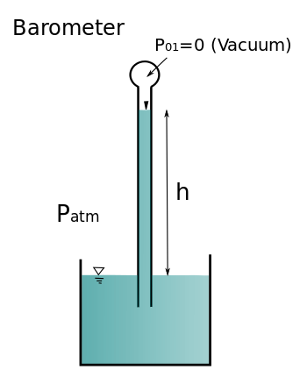
Barometers measure Atmospheric Pressure
Barometers are able to measure the difference in pressure at different depths
Determined that air pressure contributes to water pressure
Important for weather forecasting
1 atmosphere = Patmospheric
= 760 mmHg (definition)
= 14.7 lb/in2
= 101 kPa
= 101 kN/m2
1 atmosphere = Patmospheric = 760 mmHg
This Photo by Unknown Author is licensed under CC BY-SA

Slide 11
How Dense is air?
This Photo by Unknown Author is licensed under CC BY-SA

Slide 13
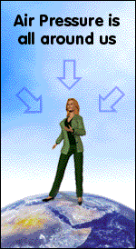
Atmospheric Pressure
Atmospheric pressure is due to the weight of air above our heads pushing downwards.
At higher elevations there is less air above us, and the air pressure is lower.
If we change elevation rapidly, as in a car or an airplane, the result is a rapid change in air pressure.
This often results in a “popping” in our ears as they adjust to the change.
This Photo by Unknown Author is licensed under CC BY-SA
This Photo by Unknown Author is licensed under CC BY-SA

Slide 14
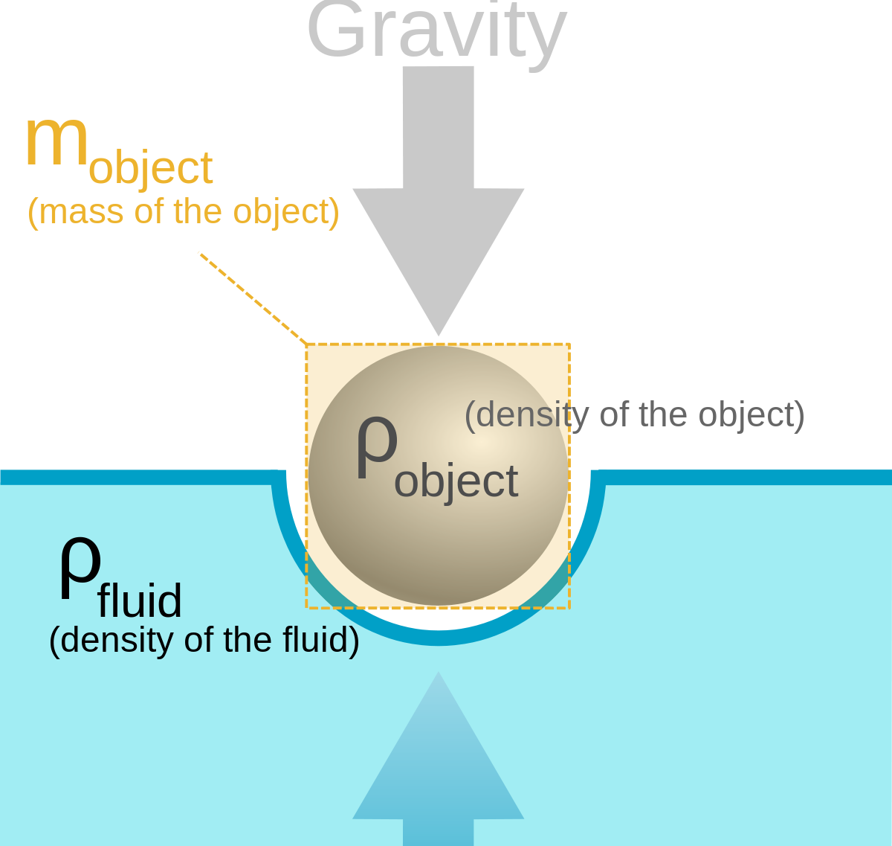
Buoyant force
A buoyant force acts on any object in a fluid
Buoyant force: an upward force due to a surrounding fluid
It can be shown that the buoyant force acting on an object is EQUAL to the weight of fluid(density) that the object displaces.
Archimedes’ principle
This Photo by Unknown Author is licensed under CC BY-SA
This Photo by Unknown Author is licensed under CC BY-SA

Slide 16
Exit Ticket
This Photo by Unknown Author is licensed under CC BY

