Slide 1
Fluid Forces

Slide 2
Force
Force– any push or pull upon an object
Example:
Lifting books
Pushing a car stuck in the snow
Pulling your little brother/sister in a
wagon
Pushing on a wall
Earth being pulled by the sun

Slide 3
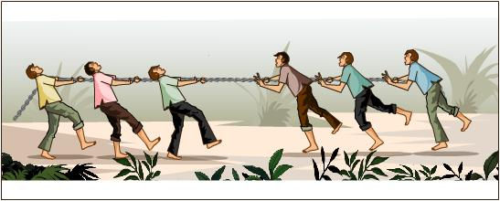
Inertia
Inertia—an object at rest stays at rest and an object that is moving at constant velocity will remain moving unless an outside unbalanced force acts upon it.
You catch a ball
Gravity pulls you down

Slide 4
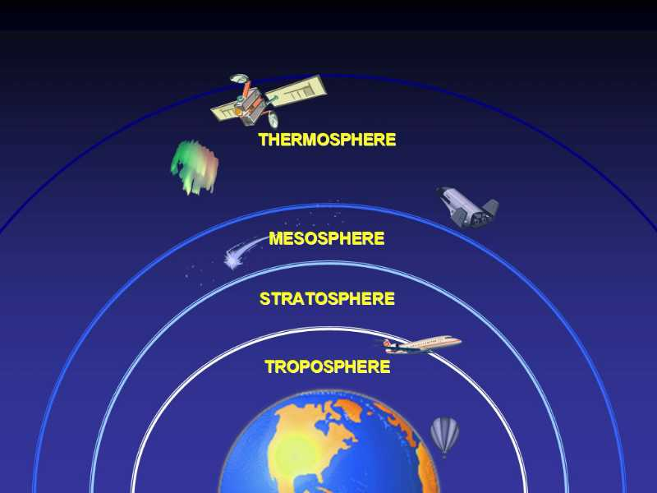
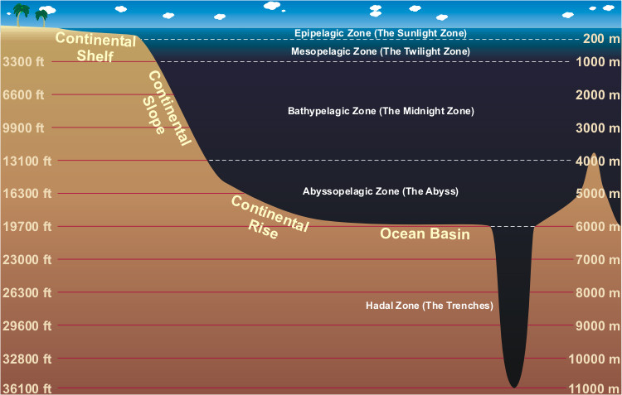
Pressure
Pressure-force pushing on a surface

Slide 5
Pressure

Slide 6
Pressure

Slide 7
Pressure
Why???

Slide 8
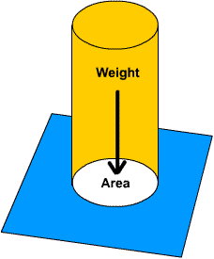
Pressure
Pressure equals force divided by area
Pressure = Force
Area

Slide 9
Pressure
Pressure = force
area
Pressure = 10 newtons
2 m²
Pressure = 5 newtons/m² = 5 pascal (Pa)

Slide 10
Pressure
Why???

Slide 11
Pressure
Increase area decrease pressure
Decrease area increase pressure
For example: If you apply 20 newtons of force in an area of 20 m² then you have a pressure of 1n/m² or 1 pascal.
If you apply 20 newtons of force in 5 m² then you have a pressure of 4n/m² or 4 pascal.
Same force but different area, different pressure

Slide 12
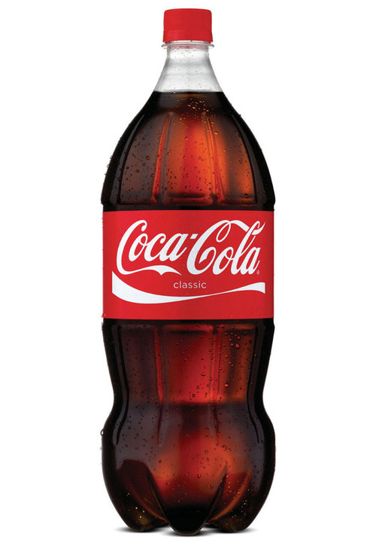
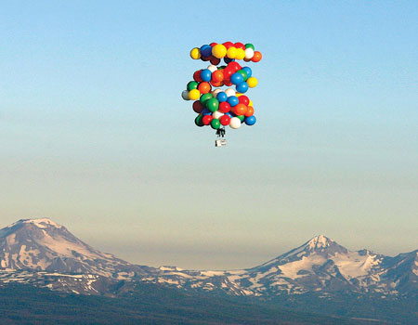
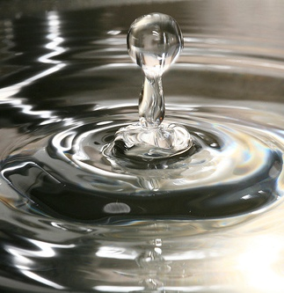
Fluid
Any substance that can easily flow.
For example: water, air, helium, oxygen, oil etc.

Slide 13
Fluid Pressure

Slide 14
Pressure

Slide 15
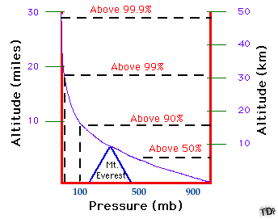
Pressure and Elevation/Depth
Pressure decrease as elevation increases

Slide 16
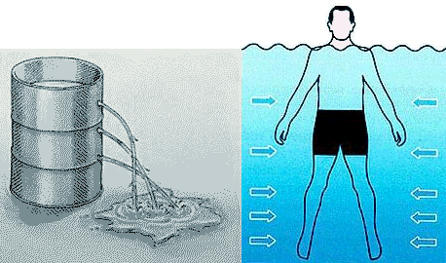
Pressure and Elevation/Depth
Pressure increases as depth increases

Slide 17
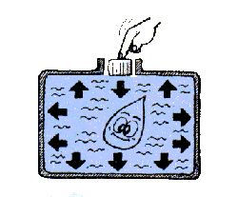
Pascal’s Principle
When a force is applied to a confined fluid, the increase of pressure is transmitted equally to all parts of the fluid.

Slide 18
Pascal’s Principle

Slide 19
Pascal’s Principle

Slide 20
Hydraulic System
A hydraulic system multiplies the force by applying the force to a smaller area transmitted through a confined fluid to a larger area.
Example;
Push with 10 N of force on a 5m² area.
Pressure = 10N/5m²= 2N/m²
Apply that pressure over a greater area
2N/m²= ?/10m²
2n/m²X10m²=Force
20N=Force

Slide 21
Pascal’s Principle Hydraulic System
10N
5m²
20N
10m²
2N/m²

Slide 22
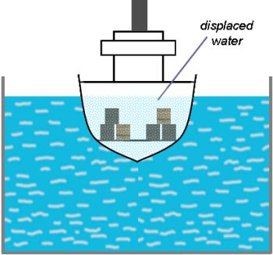
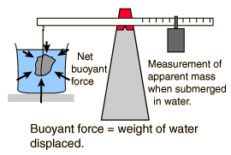
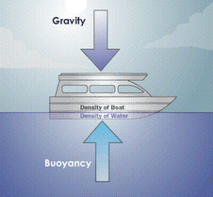
Floating or Sinking
Buoyant force—force exerted by water, upward direction-against gravity

Slide 23
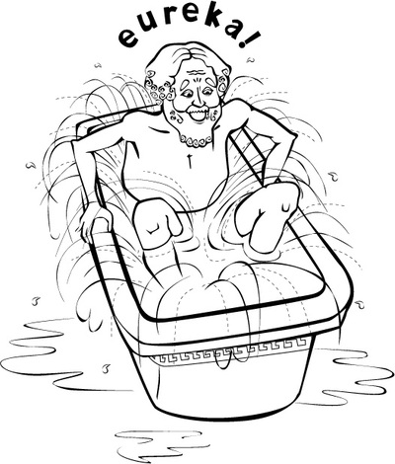
Archimedes Principle
Archimedes Principle—buoyant force equal to the weight of the fluid displaced by the object

Slide 24
Floating or Sinking
Gravity is always the downward force-which is the weight of the object.
If weight is greater than the opposite buoyant force then the object will sink
If weight is less than the buoyant force then the object will only sink until enough fluid is displaced with a weight equal to the object

Slide 25
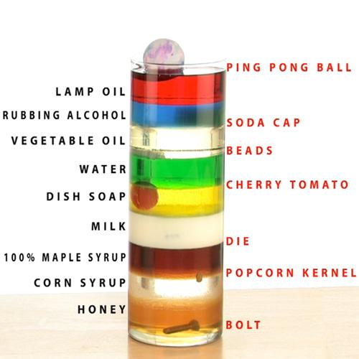

Slide 26
Density
Density is equal to mass divided by volume
The density of water is 1.0g/mL
Density = mass
volume
D = m
v

Slide 27
Density
Units of density is g/cm³
Or
g/mL
1cm³ = 1mL

Slide 28
Density
An object has a mass of 25g and takes up a volume of 26cm³
The density is .961g/cm³
D = m
v
.961g/cm³ = 25g
26cm³

Slide 29
You Try Density
An object has a mass of 300 g and a volume of 50mL
Reminder:
D = m
v
Answer:
300g/50mL = 6g/mL

Slide 30
One More
A regular shaped object has a mass of 20 grams.
The length of the object is 2 cm; the width is 3cm ; and the height is 3cm.
What is the density of the object?
Do you think it will sink or float in water?

Slide 31
Answer
Volume = 2cm X 3cm X 3cm
18cm³
Density = mass/volume
Density = 20grams /18cm³
Density = 1.1111g/cm³
Sinks in water

Slide 32
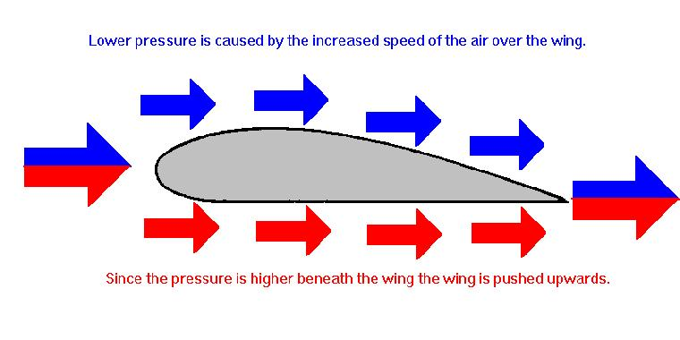
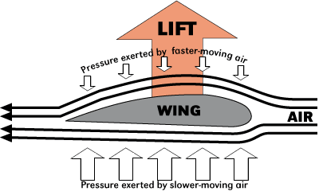
Bernoulli’s Principle
Pressure exerted by a moving fluid is less than the pressure of the surrounding fluid

