Slide 1
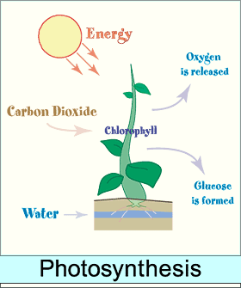
Bellwork #3 – 02/07/18
What factors are involved in the rate of photosynthesis?

Slide 2
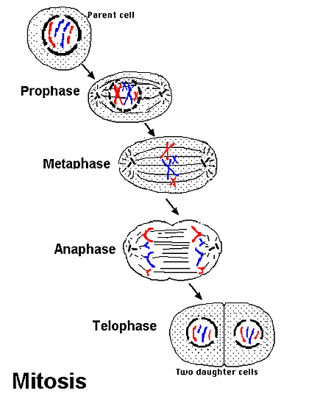
Cell Reproduction
DNA organization
The cell cycle
Mitosis

Slide 3
Objectives
Describe in writing and through illustration the main events in the cell cycle (interphase, mitosis, and cytokinesis), including the differences in plant and animal cell division.
List in order and describe, through writing and illustration in stages of mitosis (prophase, metaphase, anaphase, and telophase).

Slide 4
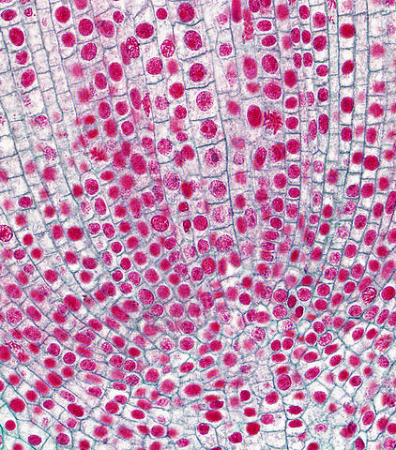
The Cell Cycle
When living cells reach a certain size, they must divide or stop growing.
Cells are limited in size; this is because of their surface area to volume ratio.
A number of cells in your body, such as nerve, red blood and muscle cells do not divide once they mature.
Other cells within multicellular organisms, such as skin or intestinal living divide regularly to grow in size and/or repair tissues.
This Photo by Unknown Author is licensed under CC BY-NC-SA

Slide 5
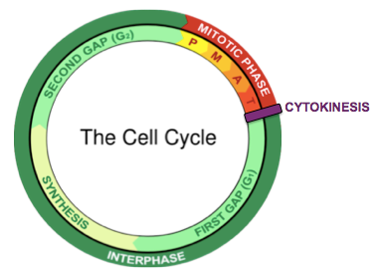
Cell Division
Cell division: the organized process of creating new cells.
Most cells do not divide constantly.
Cell Cycle: timeline of events that occur during the life of a cell.

Slide 6
Stop and Think
Why would it be bad to slice a cell in half?
Why does a cell approach cell division in a neat, step-wise manner?

Slide 7
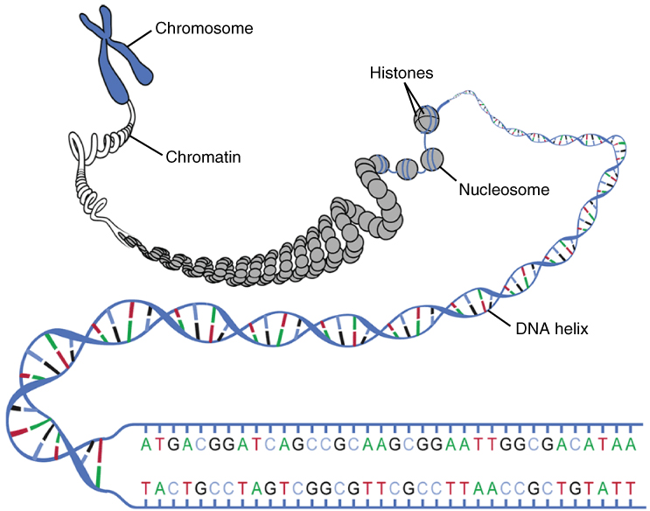
Organization of DNA
One of the ways that the cell ensures the correct amount of DNA makes it into two cells is by being able to “package” DNA in different forms.
Recall that DNA is a nucleic acid and one of the 4 types of macromolecules within cells.
DNA is composed of monomer units called nucleotides.
When a eukaryotic cell is not reproducing, its DNA is inside the nucleus as disorganized, long strands called chromatin.
Before a cell divides, the chromatin thickens and shortens into distinctly visible bodies called chromosomes.
Each chromosome is a single DNA molecule.

Slide 8
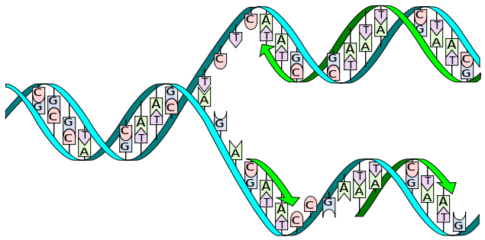
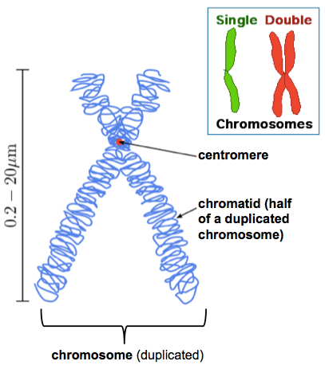
Organization of DNA
In order for a cell to divide, its chromosomes must first make a copy of themselves (DNA replication) so that each new daughter cell gets the original amount of chromosomes.
Just after chromosome replication occurs, the two chromosomes (old one and new one) are stuck together.
These 2 structures are referred to as sister chromatids.
They are joined together by a central protein bundle called the centromere.
The sister chromatids are exact copies of each other, and each one will be distributed to one of the new daughter cells.

Slide 9
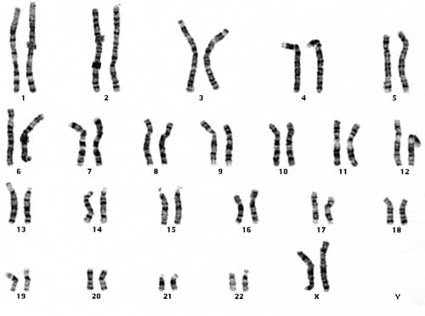
Chromosome Number
Each species has a characteristic number of chromosomes in the nucleus of all of its cells.
The number of chromosomes has nothing to do with the complexity of the organism.
For instance, a chicken has 78 chromosomes, a black mulberry plant has 308, and the human chromosome number is 46.

Slide 10
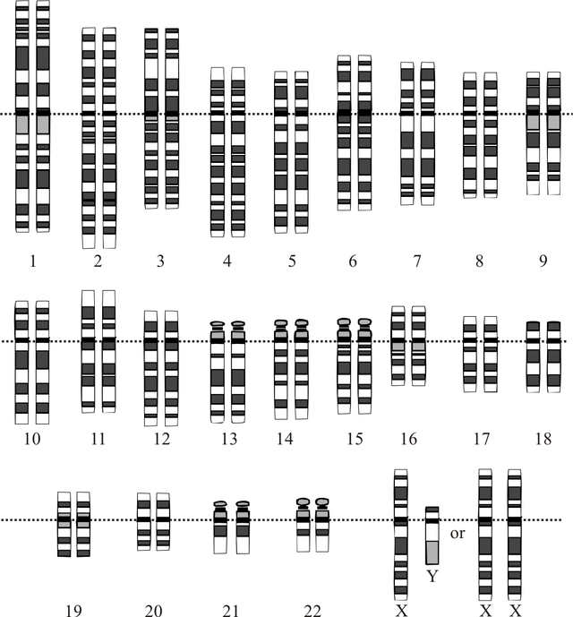
Chromosome Number
Humans have 2 sex chromosomes, X and Y, which determine the sex of the individual.
XY = Male
XX = Female
The other 44 chromosomes are called autosomes, and they carry genes for all of the other traits of an individual.
Can you find the sex chromosomes in this karyotype?

Slide 11
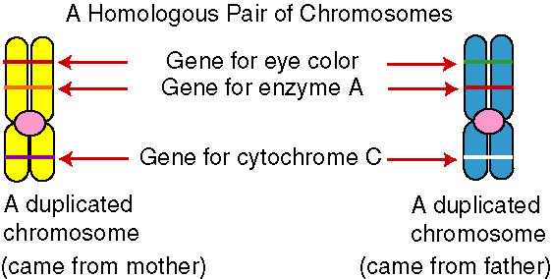
Chromosome Number
The 46 human chromosomes are arranged in 23 homologous pairs so that there are two of each type of chromosome.
Each chromosome of the pair is called a homolog, or homologous chromosome.
Each homolog carriers genes for a particular trait in the same place on its own chromosome.
For this reason, every individual has two alternate forms of each gene that are referred to as alleles.
Half of an individual genetic information comes form the mother and the other half comes from the father.

Slide 12
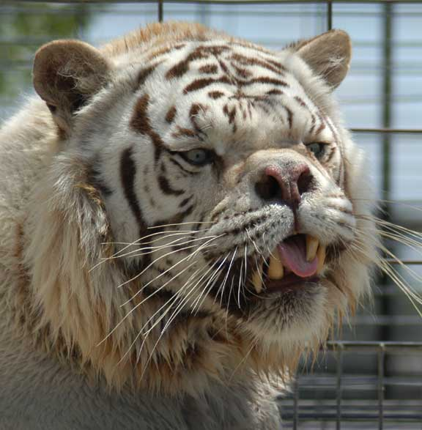
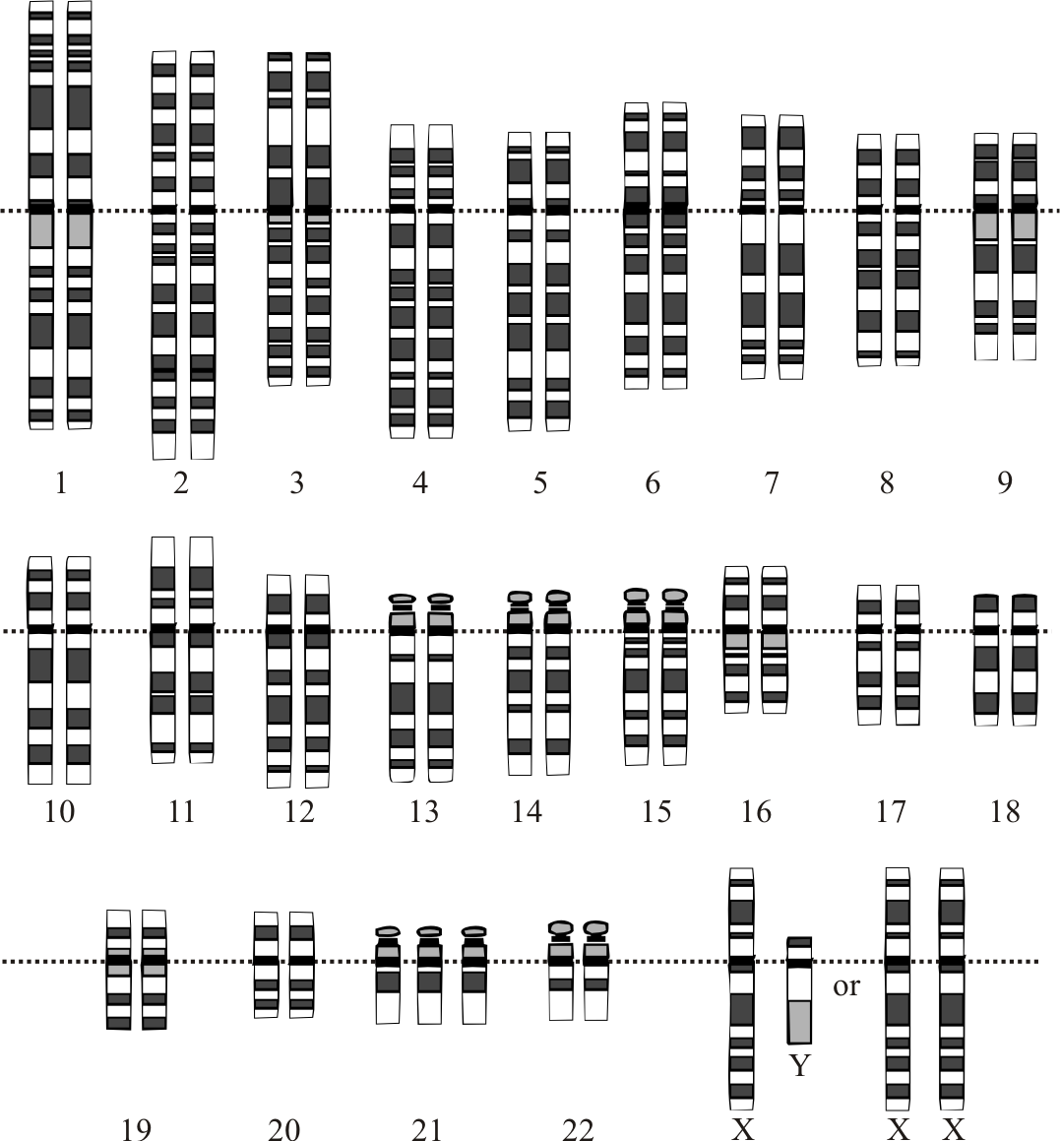
Chromosome Numbers
Take a look at the karyotype. This particular karyotype shows a condition called trisomy 21, meaning that there are 3 of the 21st chromosome.
An individual with trisomy 21 displays Down syndrome.

Slide 13
Cell Regulation/Cancer

Slide 14
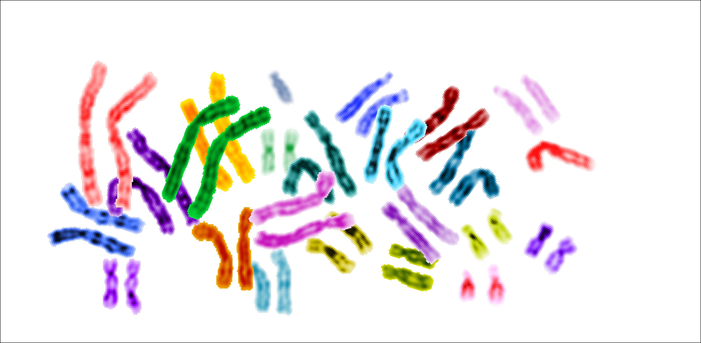
Exit Ticket

