Slide 1
Bellwork #1 08/10/17
INSTRUCTIONS
Please take a seat at your assigned number
Take out your bellwork from your folder and SILENTLY answer the following questions below.
QUESTIONS
What do you think physical science is? Please answer with complete sentences.
List 3 everyday tasks that you think involve physical science.

Slide 2
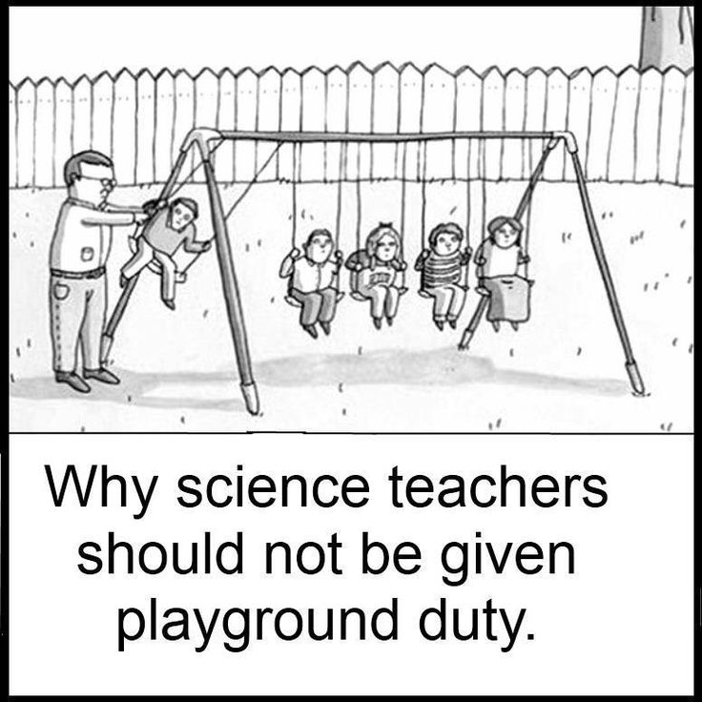
objectives
Pre-test
Introduction to Physical Science

Slide 3
Pre-TEST
Not graded!!!!
However, the number of correct questions will turn into extra credit points for ONE of your exams.
Try your best!
Don’t worry if you don’t know a question.
40 mins to complete the test

Slide 4
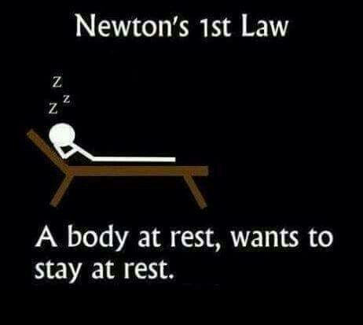
Introduction to Physical Science

Slide 5
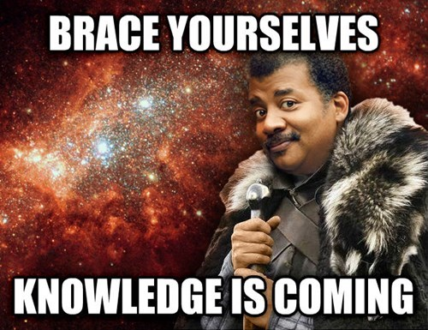
What is Physical Science?
Physical Science: the sciences concerned with the study of inanimate natural objects, including physics, chemistry, astronomy, and related subjects.
Examples:
Time
Energy
Force
Pressure
Changes
Movement

Slide 6
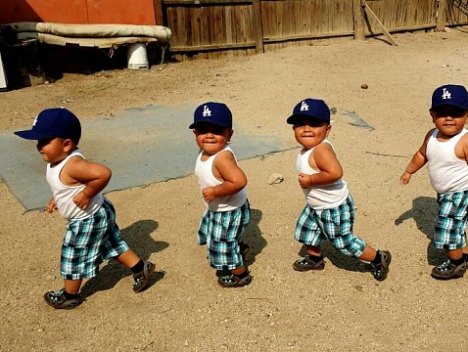
Are you moving?
You are sitting down, reading a book…
Are you moving?
Object is in motion when its distance from another object is changing.
All depends on the “Point of Reference.”
Therefore object is in motion if it changes position relative to a reference point.

Slide 7
Why do you get motion Sickness?

Slide 8
How can we measure motion?
“SI”
Based on the number 10
Distance (length) uses meter (about 39 inches)
Mass (how much matter) uses gram ( ex. A nickel is about 5 grams)
Volume (how much space)
Liquid volume – uses liter
Solid volume – uses cm3
1mL=1cm3
Weight (affect gravity has on object) uses newton (an apple weighs about 1 newton) (1 pound is about 4.4 newtons)
Density = Mass/Volume= grams/mL
REFERNCE SHEET FOR CONVERSIONS WILL BE ON THE WEBSITE

Slide 9
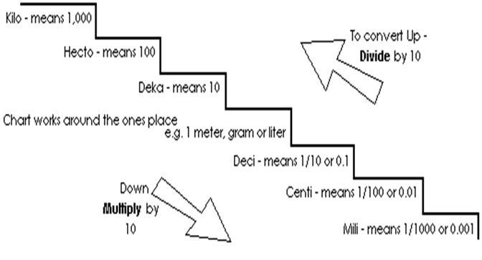
Metric Stairs
You should be comfortable with converting from [cm] to [m], [mm] to [km] and so on.
Practice:
Convert: 1527 centigrams into hectograms – going four steps up means you move the decimal 4 places to the left.
1527 centigrams =
0.1527 hectograms
9.8712345 kg =
9871234.5 mg

Slide 10
Why should we care about this?

Slide 11
Exit Ticket – 08/10/17
Please pull out your exit ticket sheet and complete the questions stated.
Make sure to following the questions directions (i.e. write with complete sentences).
Once you have finished your exit ticket please turn in to the basket by the window.
Also turn in your folder to your class holder by the window.

