Slide 1
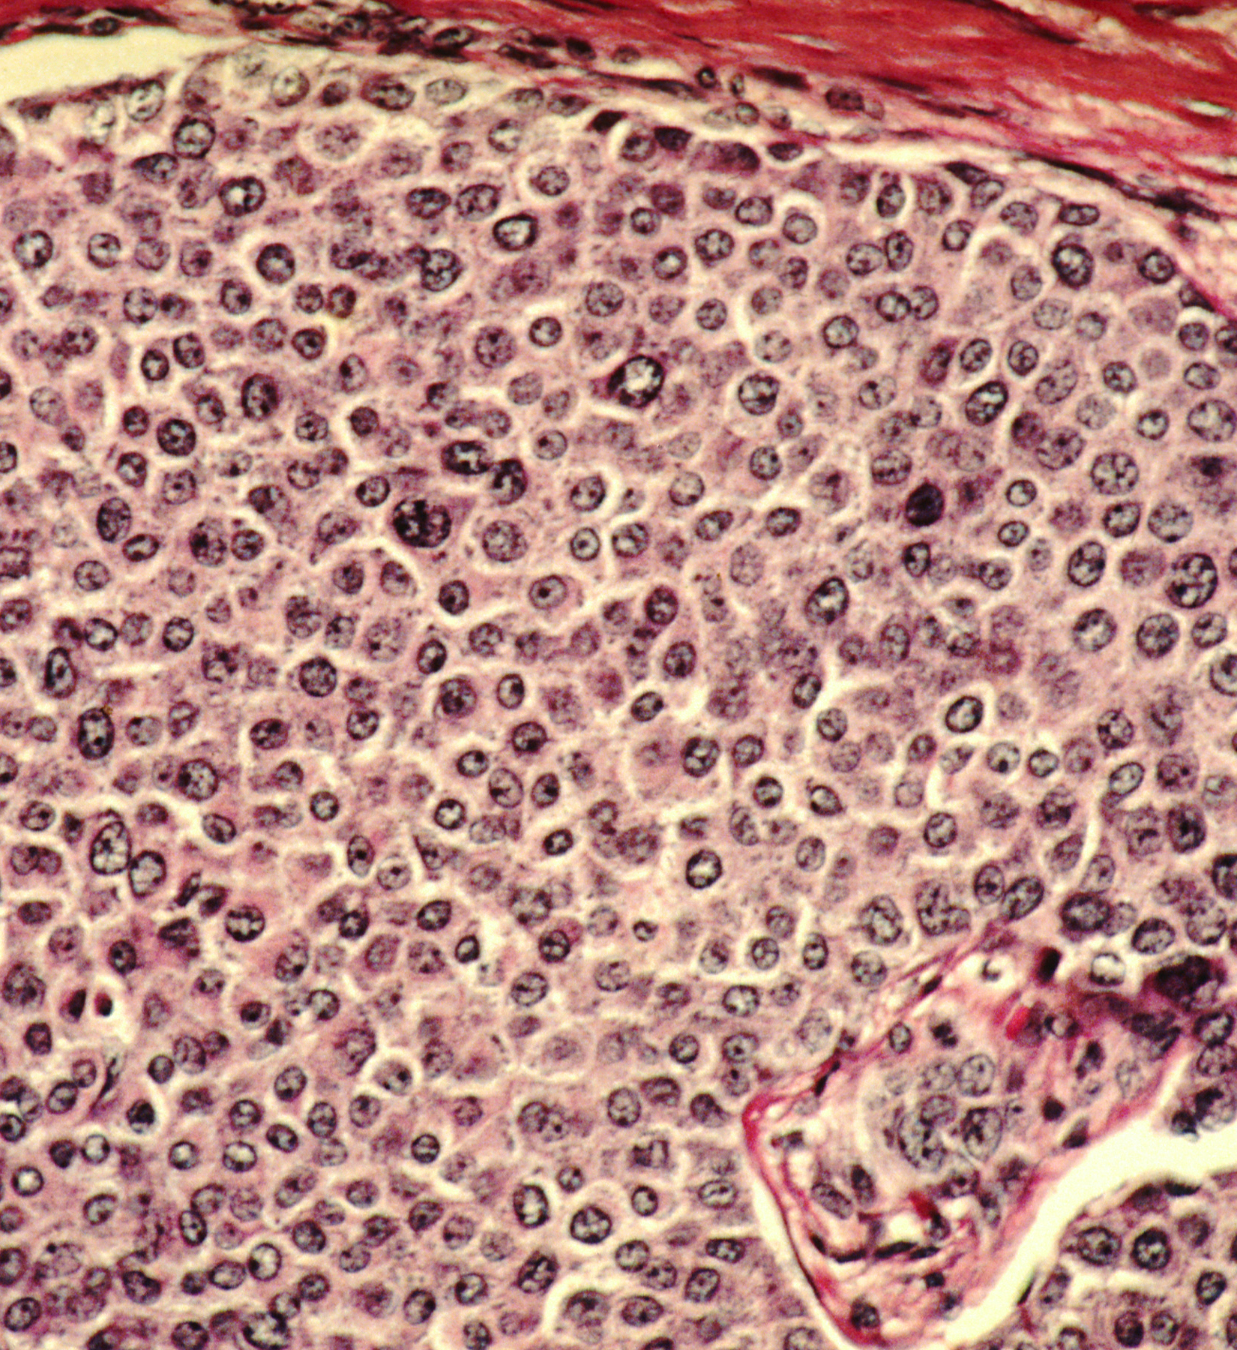
Bellwork #1 – 02/13/18
Describe what cancer is.
This Photo by Unknown Author is licensed under CC BY-SA

Slide 2
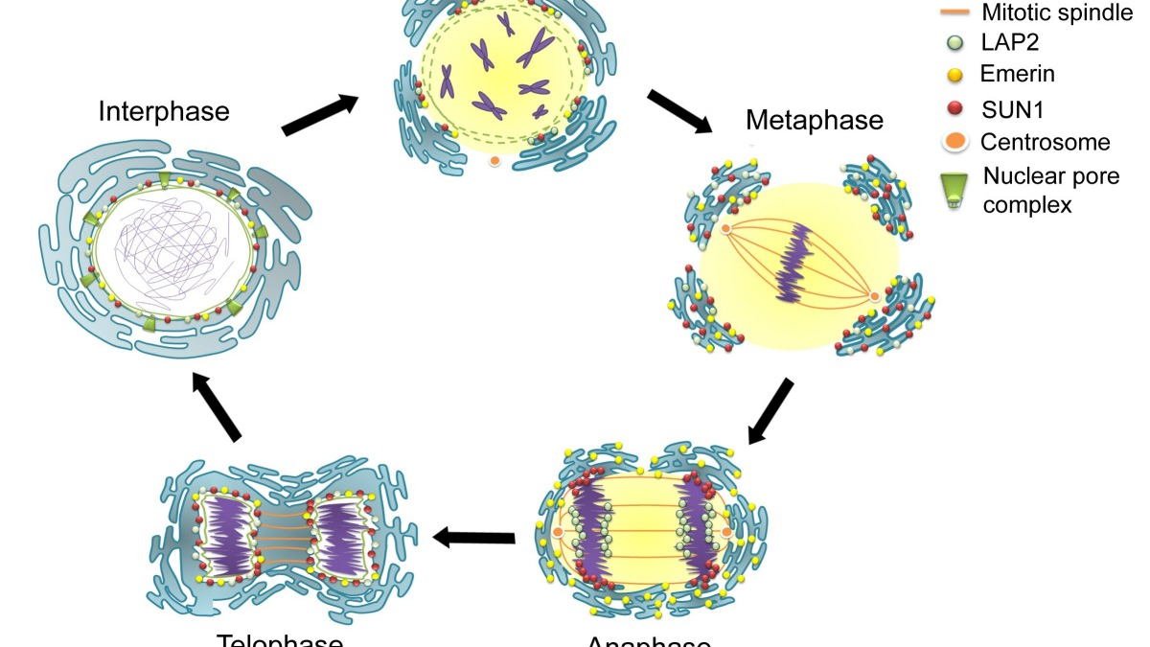
Mitosis
This Photo by Unknown Author is licensed under CC BY-SA

Slide 3
Objectives
Describe in writing and through illustration the main events in the cell cycle (interphase, mitosis, and cytokinesis), including the differences in plant and animal cell division.
1
List in order and describe, through writing and illustration the stages of mitosis (prophase, metaphase, anaphase, and telophase).
2

Slide 4
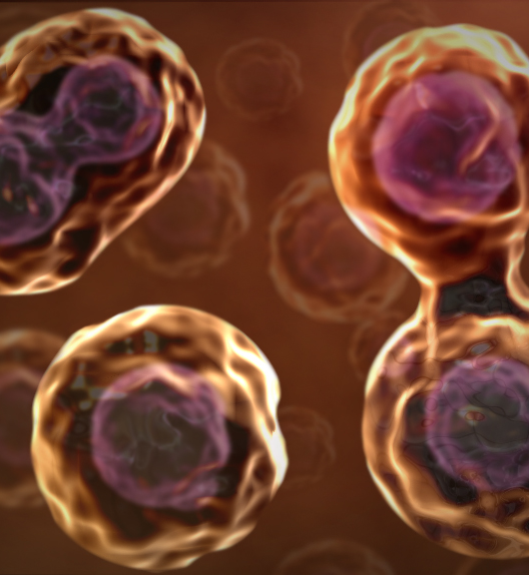
Cell Division is “Multiplication”
Each of us began life as a cell smaller than the period at the end of this sentence.
All of the cells in our body have the same DNA, so each are essentially clones of each other.
How did we multiply from one to many cells?
The answer is cell division

Slide 5
Mitosis Video

Slide 6
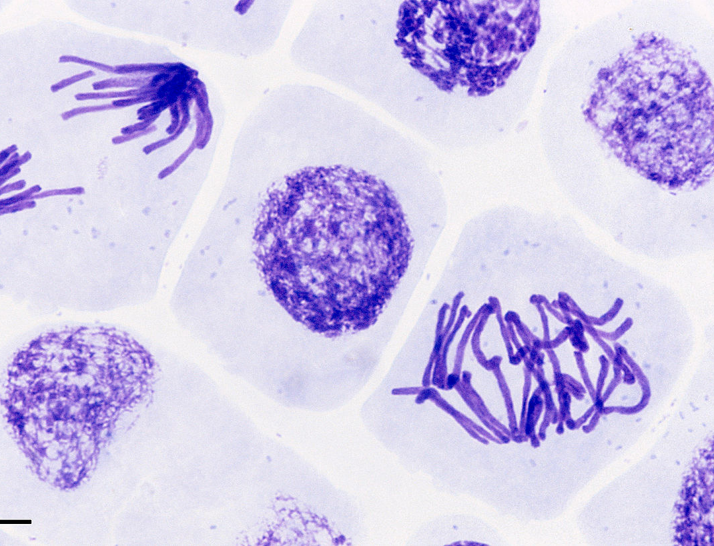
Stop and Think
In the time it took you to watch this video clip, you lost 40,000 skin cells, yet you are not skinless.
How does the information contained in the video clip explain why this is so?
Your cells are constantly dividing because of mitosis!!

Slide 7
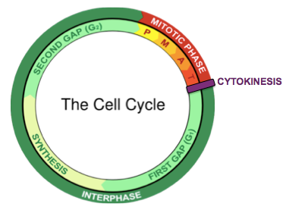
Mitosis
Mitosis is a highly organized process that divided the nuclei of a cell into two nuclei.
It aims to produce two daughter cells that have identical DNA.
Keeping track of that DNA requires organization and cooperation in all parts of the cell.
There are 4 stages that we recognize in Mitosis:
Prophase
Metaphase
Anaphase
Telophase
Cytokinesis: the separation of the cytoplasm, occurs after mitosis.

Slide 8
Events in Mitosis and Cytokinesis

Slide 9
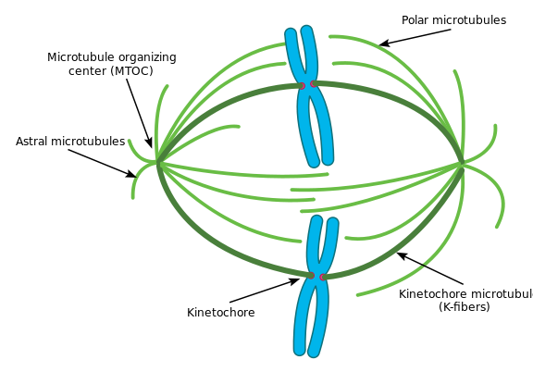
Events in Mitosis and Cytokinesis
What is a spindle fiber?
The spindle fibers are thin protein filaments that are constructed by the centrioles in prophase.
Their role is pivotal in mitosis.
Spindle fibers attach to chromosomes at their centromeres.
During mitosis, the centromere has a protein kinetochore attached that helps spindle fibers control the chromosomes.

Slide 10
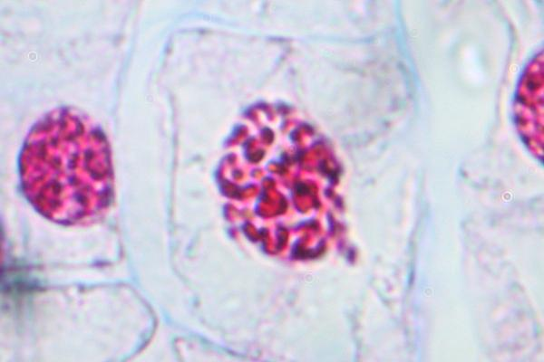
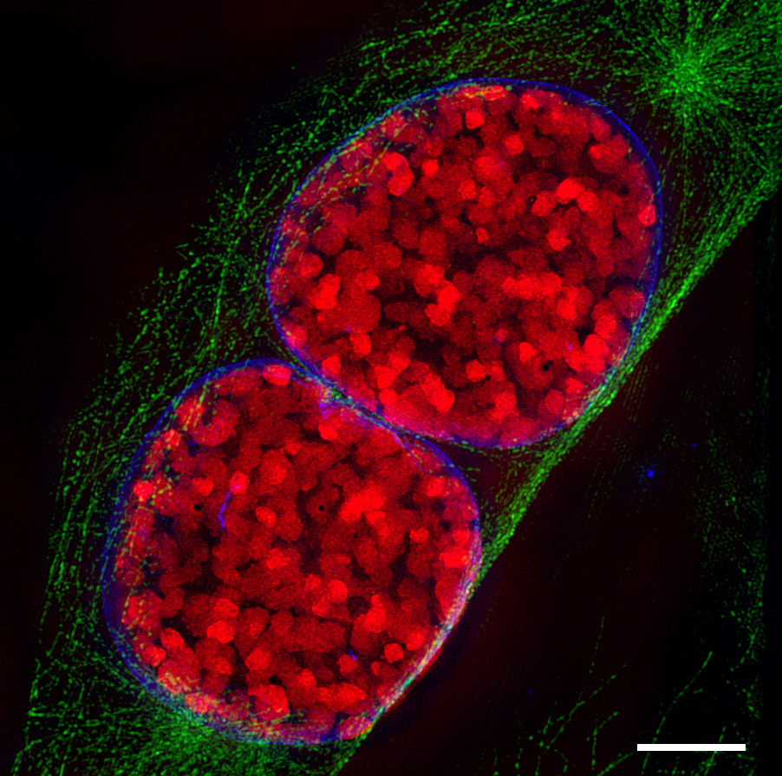
Events in Mitosis – Stage 1
Prophase
Chromosomes condense and become visible
Spindle fibers emerge form the centromeres
Nuclear envelope breaks down
Centrosomes move toward opposite poles

Slide 11
Events in Mitosis – Stage 2
Prometaphase
Chromosomes continue to condense
Kinetochores appear at the centromeres
Mitotic spindle microtububles attach to kinetochores.
This Photo by Unknown Author is licensed under CC BY-SA

Slide 12
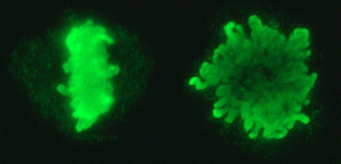
Events in Mitosis – Stage 3
Metaphase
Chromosomes are lined up at the metaphase plate
Each sister chromatid is attached to a spindle fiber originating from opposite poles

Slide 13
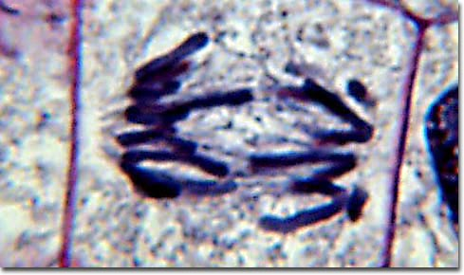
Events in Mitosis – Stage 4
Anaphase
Centromeres split in two
Sister chromatids (now called chromosomes) are pulled toward opposite poles
Certain spindle fibers begin to elongate the cell

Slide 14
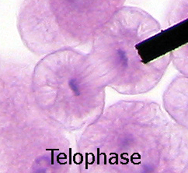
Events in Mitosis – Stage 5
Telophase
Chromosomes arrive at opposite poles and begin to decondense
Nuclear envelope material surrounds each set of chromosomes
The mitotic spindle breaks down
Spindle fibers continue to push poles apart

Slide 15
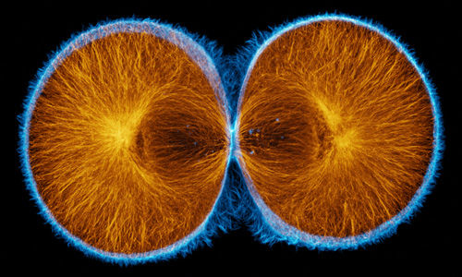
Events in Cytokinesis – Stage 6
Animal cells: a cleavage furrow separates the daughter cells
Plant cells: a cell plate, the precursor to a new cell wall, separates the daughter cells

Slide 16
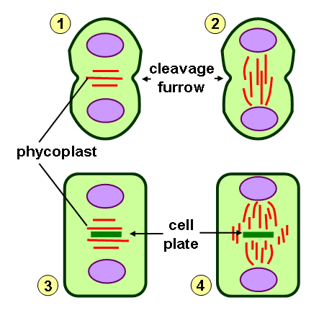
Comparing Plant and Animal Cell Division
There are two important differences between cell division in animals cells and plant cells:
In plant cells, cytokinesis occurs as a cell plate (i.e. cell wall) begins to grow out from the center and merely separates the two daughter cells.
In animal cells you would see a cleavage furrow during cytokinesis instead
Plant cells do not have centrioles that form spindle fibers.

Slide 17
Exit Ticket

