Slide 1
BellWork #1 08/14/17
Describe what movement is with complete sentences.
If someone is deceased on Earth, are they still considered to be moving. Explain your answer.

Slide 2
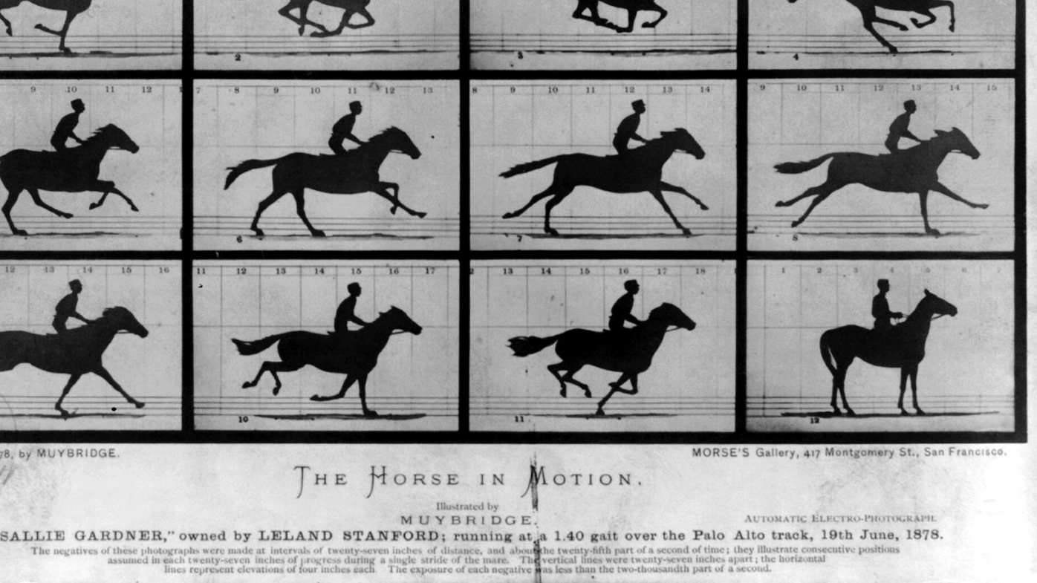
Motion, Speed, and Velocity
This Photo by Unknown Author is licensed under CC BY-SA

Slide 3
Objectives
Determine the frame of reference used to describe motion.
1
Know the difference between speed and velocity.
2
Determine the speed of an object.
3

Slide 4
Motion
An object’s change in position relative to a reference point.
This Photo by Unknown Author is licensed under CC BY-SA

Slide 5
Reference Point
The Earth’s surface is used as a common reference point.
A moving object can be used as a reference point as well.
This Photo by Unknown Author is licensed under CC BY

Slide 6
Speed
Speed: the distance traveled divided by the time interval during with the motion occurred.
Normally, objects do not travel at a constant speed.
Average speed = total distance/total time
This Photo by Unknown Author is licensed under CC BY-NC-SA

Slide 7
Which Distance?
Farmer Jones drives 6 miles down a straight road. She turns around and drives 4 miles back. What was her average speed for this trip if it took 1 hour?

Slide 8
Your answer to this problem depends on your interpretation of "distance traveled". You could say:
The total distance traveled by Farmer Jones is 10 miles. Therefore her average speed is 10 mi/hr.
The net distance traveled by Farmer Jones is 2 miles. Therefore, her average speed is 2 mi/hr.
There are good reasons to use either interpretation - it's mostly a matter of preference. We will interpret "distance traveled" to be net distance (also called displacement). Farmer Jones' average speed was 2 mi/hr.

Slide 9
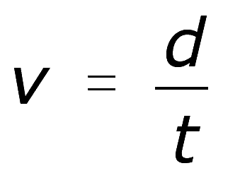
Velocity
Velocity appears to be very similar to speed, however, when describing the velocity of an object you need to provide a magnitude and a direction
Magnitude – the speed of the object
Direction – the direction the object is moving
North, South, East, West

Slide 10
Velocity
Ex) A bus has a velocity of 35miles/hr heading west
This Photo by Unknown Author is licensed under CC BY-SA

Slide 11
Resultant Velocity
An object can have a resultant velocity if it is experiencing more than one motion.
For example if a person walks down the center of a bus while it is in motion there are two velocities occurring.
1. The movement of the bus
2. The movement of the person inside the bus
This Photo by Unknown Author is licensed under CC BY-SA

Slide 12
Example
15 m/s
+
1 m/s
=
14 m/s

Slide 13
Example
15 m/s
+
1 m/s
=
16 m/s

Slide 14
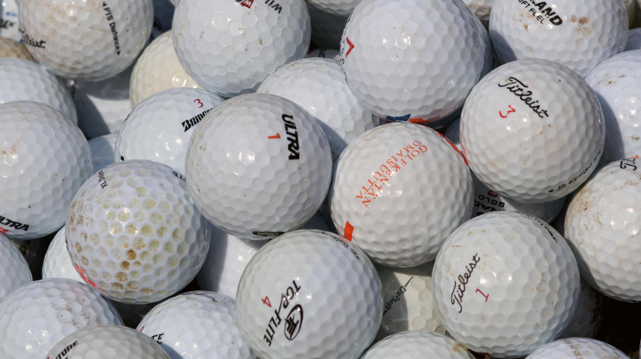
Changing Motion Activity
Give me some examples of objects that are changing their motion.
Three tasks:
Change the speed of a golf ball without changing the direction it moves.
Change the direction a golf ball moves without changing its speed.
Change both the direction the golf ball moves and the speed at which its moving.
Record your methods in the sheet provided
Turn in sheet after you have completed the activity
This Photo by Unknown Author is licensed under CC BY-SA

Slide 15
Exit Ticket
This Photo by Unknown Author is licensed under CC BY

