Slide 1
Bellwork #1 10/30/17
What is science?

Slide 2
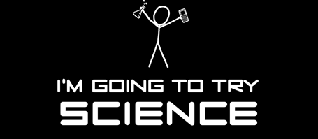
Nature of Science
This Photo by Unknown Author is licensed under CC BY-NC

Slide 3
Objectives
Describe
Describe the scientific method of problem solving.
List
List some values of the scientific method of problem solving.
Explain
Explain what an experimental control is.

Slide 4
NOS Example
Write an account
of what you think
happened based
on what you see
here.

Slide 5
NOS Example
continued
How does your story change?

Slide 6
NOS Example
How does your story change?

Slide 7
NOS Example
continued
What do you observe?
What do you infer?
Compare what you think now
to your earlier written accounts.

Slide 8
The steps of the Scientific Method are:
Question/ Problem
Research Information
Hypothesis
Experiment Procedure/Materials
Observations/Data
Conclusion

Slide 9
Scientists develop a question about a problem. They need to be very specific in defining what they are trying to explain or solve.

Slide 10
Research Information
Next they gather information about the problem/question. They can use:
books
magazines
reports
experts
your past experiences or prior knowledge
This Photo by Unknown Author is licensed under CC BY-NC-ND

Slide 11
Develop a Hypothesis
What is a hypothesis?
-what you think the answer is based upon your gathered information and prior knowledge
-an educated guess

Slide 12
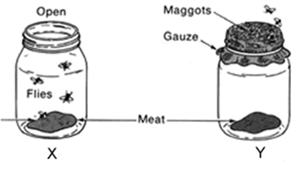
Experiment: The next step scientists take is to create and conduct an experiment to test their hypothesis.
This should include a materials list and a procedure with step-by-step directions.
This Photo by Unknown Author is licensed under CC BY-NC

Slide 13
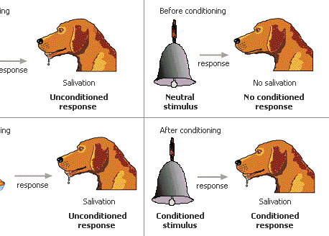
Every experiment has variables!
A variable is anything that changes or could change in an experiment.
Three types of variables in an experiment.
This Photo by Unknown Author is licensed under CC BY-SA

Slide 15
Three types of variables:
1. Independent variable ~ the scientist changes this variable
2. Dependent variable ~ part of the experiment that changes as a result of some other action, it is measured
3. Control ~ the part of the experiment that is not changed by the scientist

Slide 16
Scientist have to take the time to think logically when they are investigating a question or problem.
They break things down into many steps that make sense.

Slide 17
Observations A key to experiments is observing what happens and writing it down.
It may be charts, graphs, or written work.
This is WHAT HAPPENED!!!!!
Gathering information or data and documenting it so it is readable and makes sense to others is really important.

Slide 18
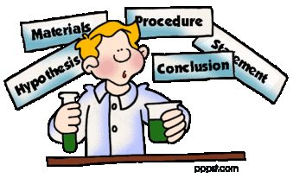
Conclusion
What did you find the answer to the question was?
It is OK if it turns out that your hypothesis was not correct. You learned!!!!!!!!!
This Photo by Unknown Author is licensed under CC BY-SA

Slide 19
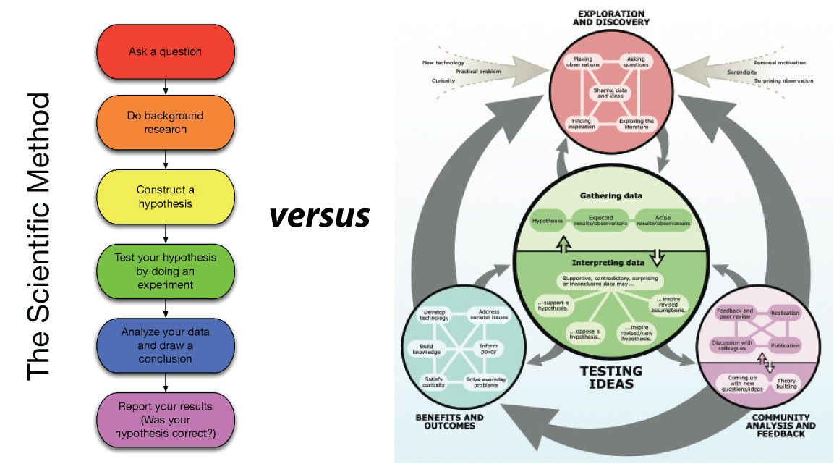
Once a scientist completes an experiment, they often repeat it using the exact same materials and procedure to see if they get the same findings and results.
This is really what we call verification, or checking things out to make sure everything was valid and will happen again and again.
This Photo by Unknown Author is licensed under CC BY-NC-ND

Slide 20
Scientists share their experiments and findings with others.
Because they share their experiments and findings, scientists can learn from each other and often use someone else’s experiences to help them with what they are studying or doing.

Slide 22
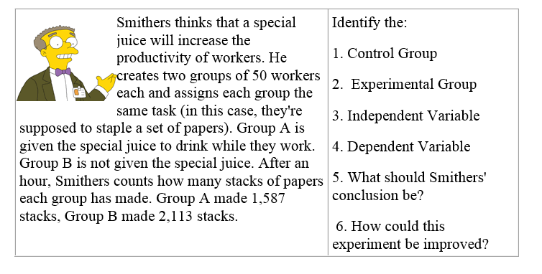
Practice! Simpson’s

Slide 23
Exit Ticket
This Photo by Unknown Author is licensed under CC BY

