Slide 1
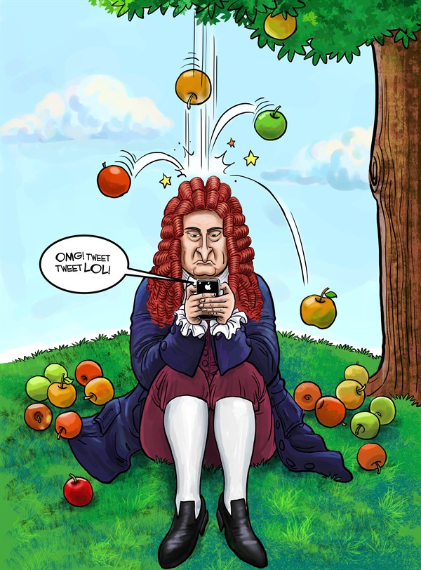
Bellwork #2 – 08/22/17
What is the main difference between velocity and speed?
This Photo by Unknown Author is licensed under CC BY-NC-SA

Slide 2
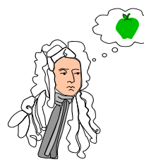
Newton’s Laws of Motion
This Photo by Unknown Author is licensed under CC BY-SA

Slide 3
Objectives
Describe the following laws: Newton’s 1st, 2nd, 3rd, and Friction
Describe how the following laws mention are applied in every day life.

Slide 5
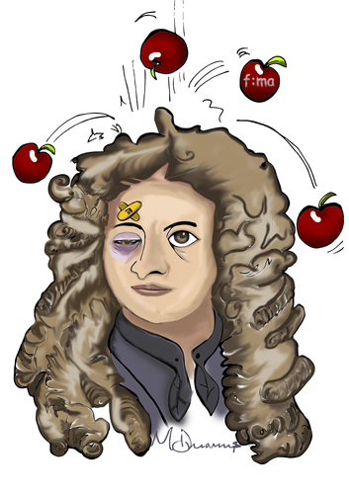
Sir Isaac Newton
Described 3 laws that relate forces to motion
Force-a push or a pull, all forces have size and direction

Slide 6
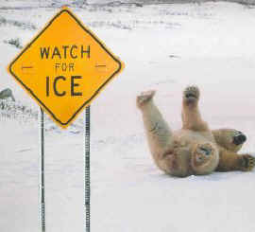
Vocabulary
Friction- a force that opposes motion between 2 objects that are touching
Inertia-tendency of all objects to stay at rest or in motion
Mass- the amount of matter an object is made of

Slide 7
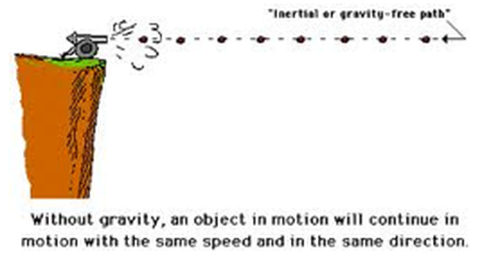
Newtown’s 1st Law of Motion “Law of Inertia”
An object at rest remains at rest and an object in motion remains in motion at constant speed and in a straight line unless acted on by an unbalanced force

Slide 8
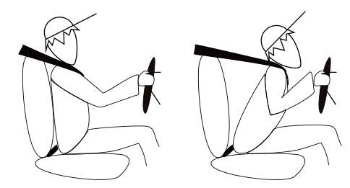
Examples of Newton’s 1st Law of Motion
Car suddenly stops and you strain against the seat belt
Car turns left and you appear to slide to the right
The difficulty of pushing a car that won’t start

Slide 9
Examples of Newton’s 1st Law of Motion

Slide 10
Examples of Newton’s 1st Law of Motion

Slide 11
Write about it!
Write down one example of inertia you see in the room.

Slide 12
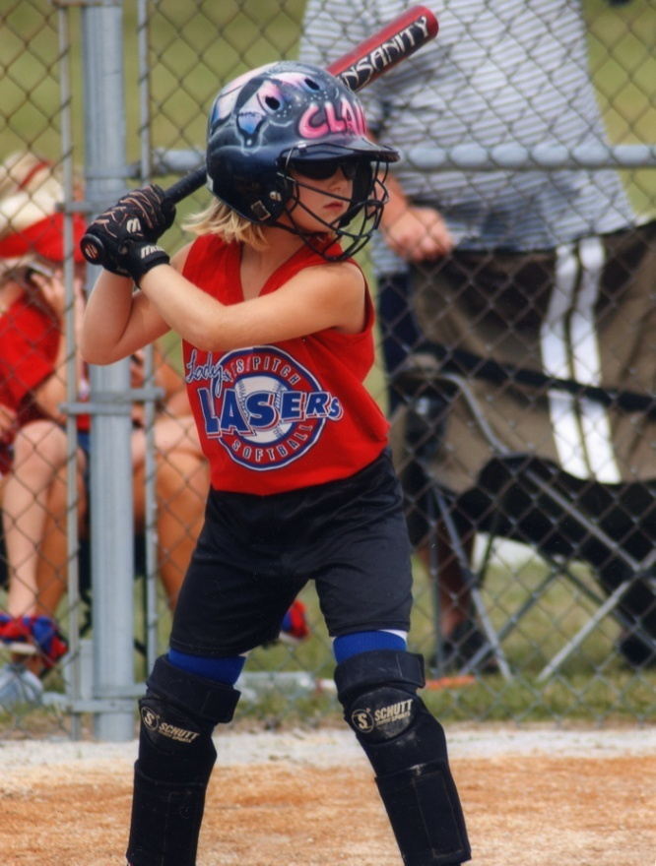
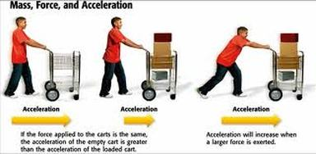
Newton’s Second Law of Motion
The acceleration of an object depends on the mass of the object and the amount of the force applied

Slide 13
Newton’s Second Law of Motion
1. Force = mass x acceleration F=m x a
2. Force- a push or pull, all forces have size and direction
3. Mass- the amount of matter an object is made of
4. Acceleration-the rate at which velocity changes; and object accelerates if its speed changes, if its direction changes and if both speed and direction changes

Slide 14
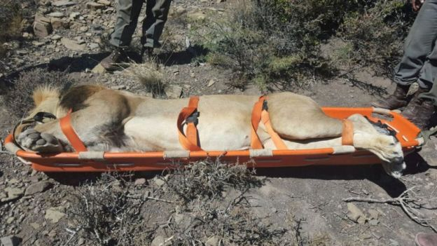
Practice Problem
Zoo keepers lift a stretcher that holds a sedated lion. The total mass of the lion and stretcher is 175 kg, and the upward acceleration of the lion and stretcher is 0.657 m/s2. What force is needed to produce this acceleration of the lion and the stretcher?

Slide 15
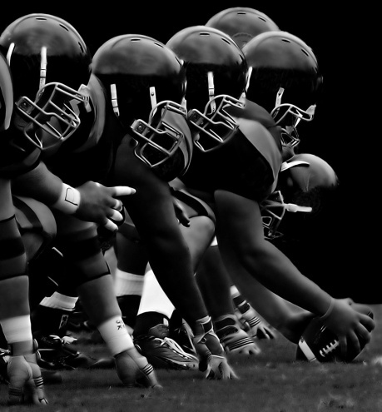
Examples of Newton’s 2nd Law
1. Hitting a softball, the harder the hit, the faster the ball goes
2. Football players and their positions
3. Loaded versus an unloaded truck

Slide 16
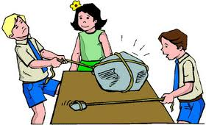
Examples of Newton’s 2nd Law

Slide 17
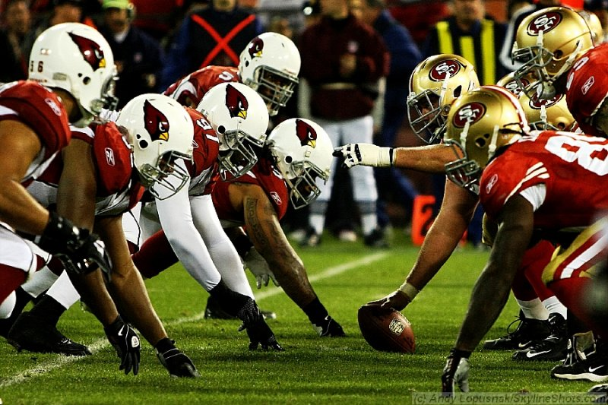
Examples of Newton’s 2nd Law

Slide 18
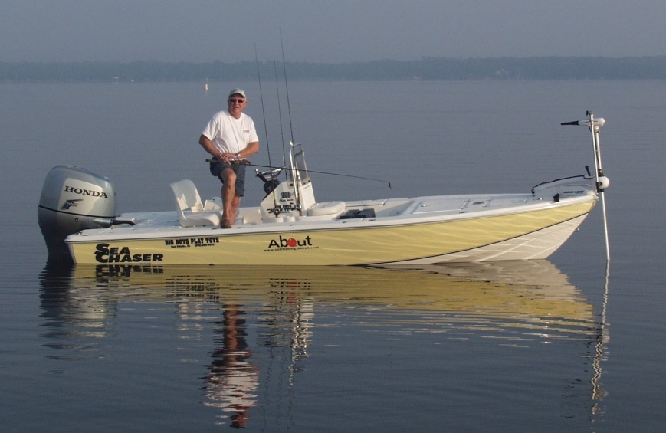
Newton’s Third Law of Motion
For every force, there is an equal and opposite force
Action and Reaction

Slide 20
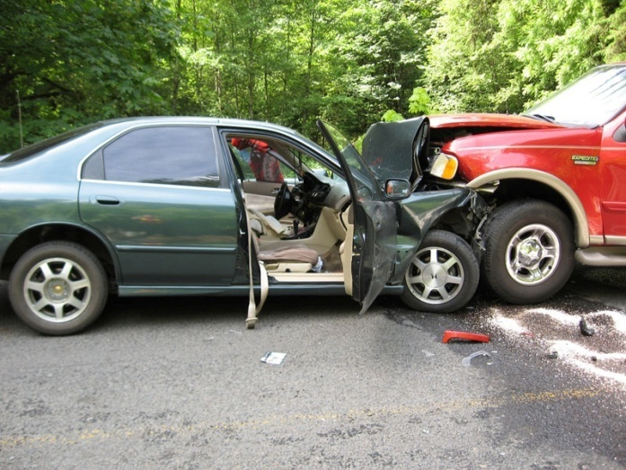
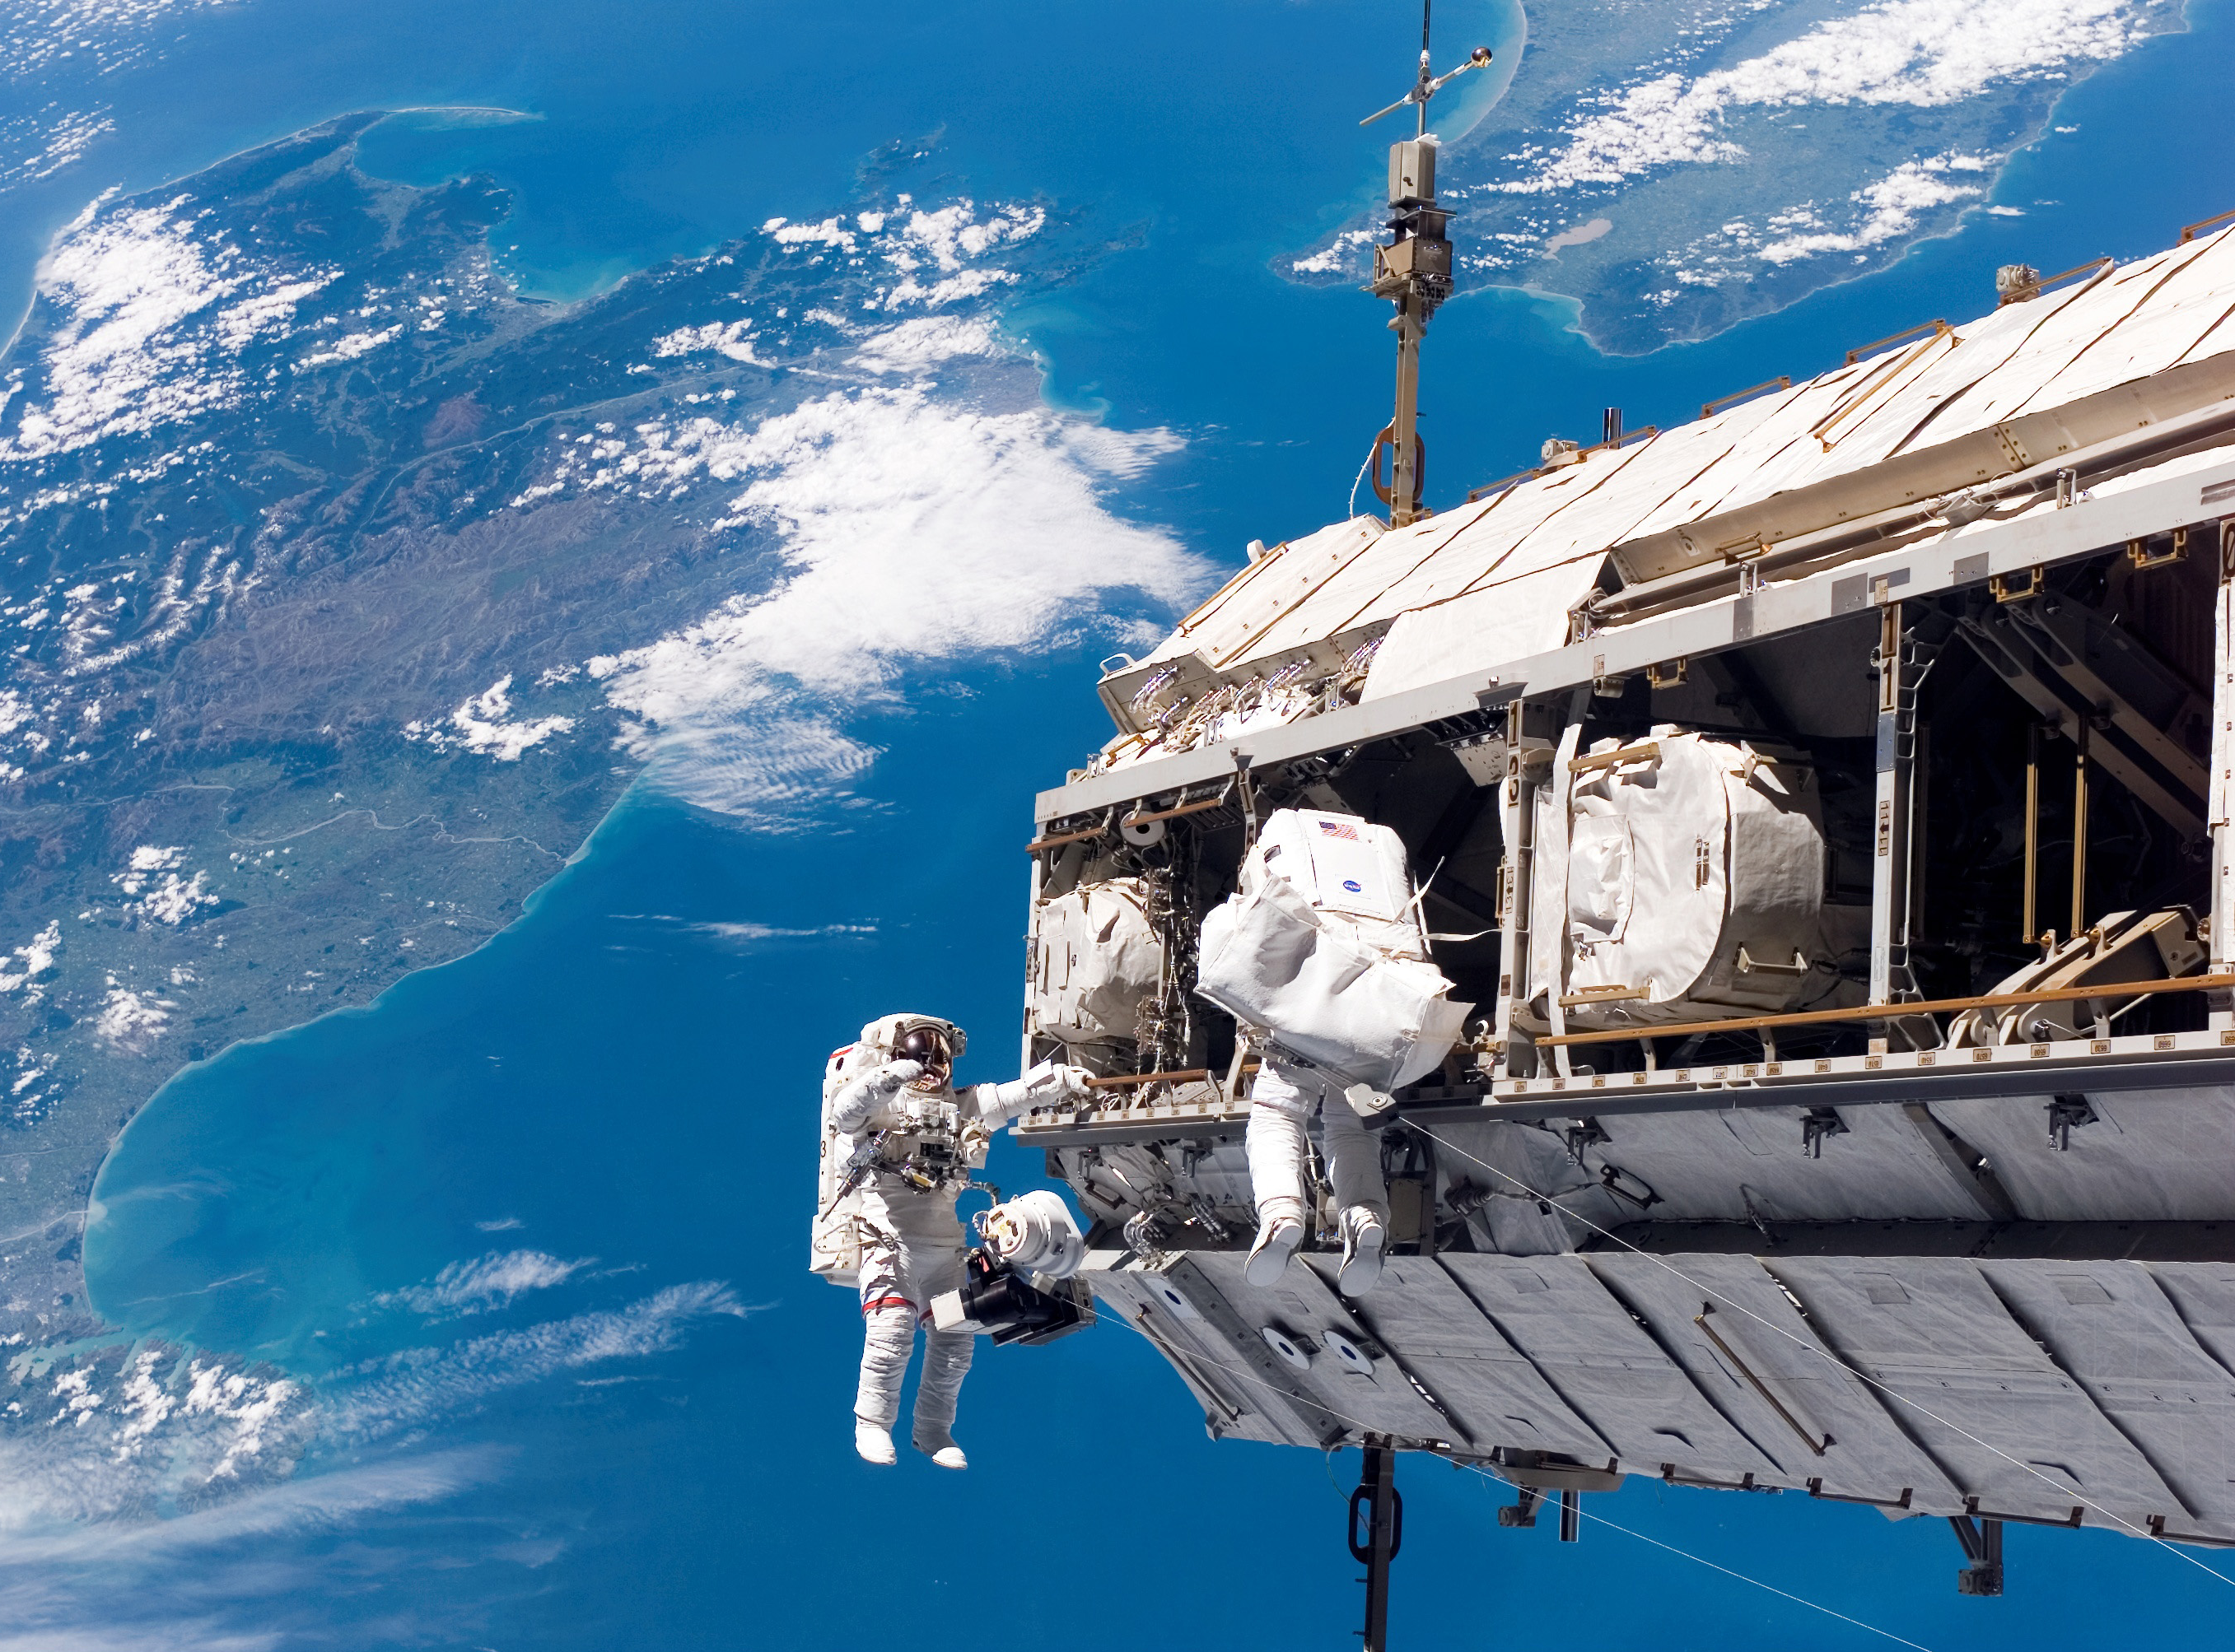
Examples of Newton’s 3rd Law
2 cars hit head on
Jumping out of a boat onto a dock
Astronauts in space

Slide 22
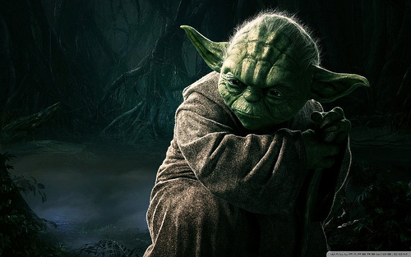
Exit Ticket
This Photo by Unknown Author is licensed under CC BY-NC-ND

