Slide 1
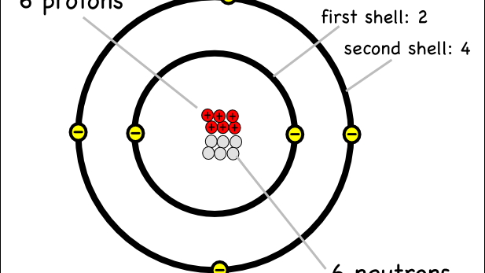
Bellwork #1 – 01/24/18
What element has 32 neutrons in an atom with a mass number of 58?
This Photo by Unknown Author is licensed under CC BY-NC-SA

Slide 2
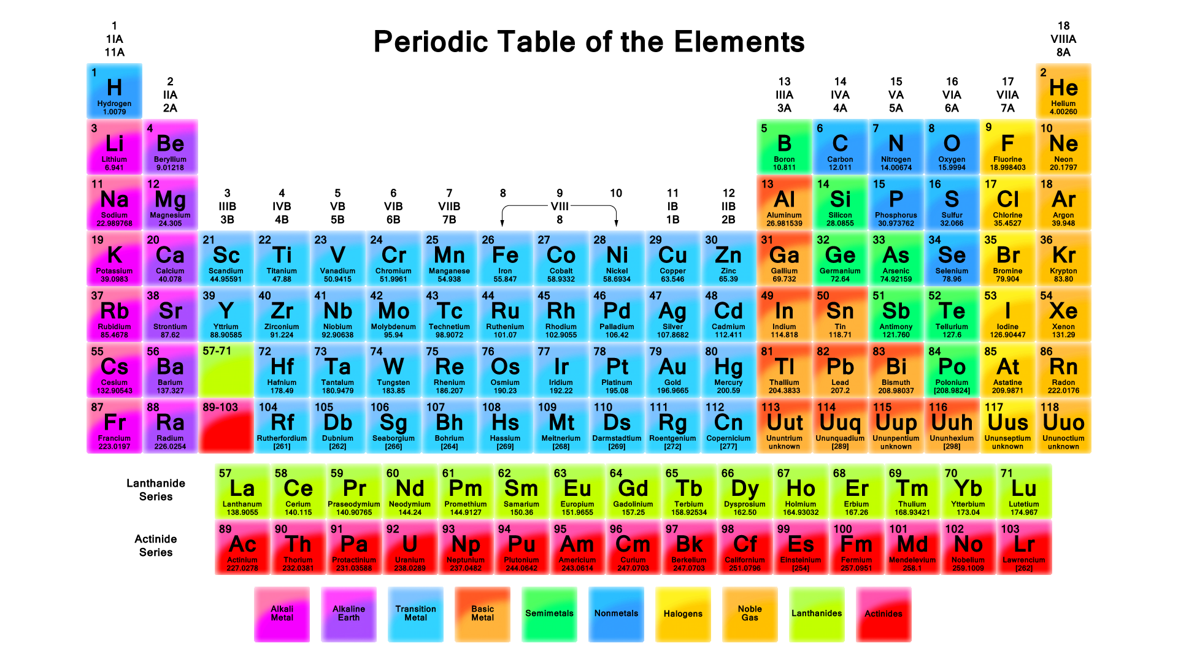
Periodic Table of elements
This Photo by Unknown Author is licensed under CC BY-SA

Slide 3
Objectives
Define
Define atomic number and mass number, and describe how they apply to isotopes.
Determine
Given the identity of a nuclide, determine its number of protons, neutrons, and electrons.
Identify
Identify the person credited for organizing the periodic table
Calculate
Calculate the number of valence electrons found in a series of elements

Slide 4
Creating the Periodic Table
The periodic table is a tabular arrangement of the chemical elements according to atomic number.
In 1869, Dmitri Mendeleev developed a table of the elements that showed a relationship between the chemical properties of elements and their atomic masses.
Organized the table based on how they reacted to water.
Similar chemical characteristics (solid, liquid, gas, etc.)
This Photo by Unknown Author is licensed under CC BY-SA

Slide 6
What is the Periodic Table?
Shows all known elements in the universe.
Organizes the elements by chemical properties
This Photo by Unknown Author is licensed under CC BY-SA

Slide 7
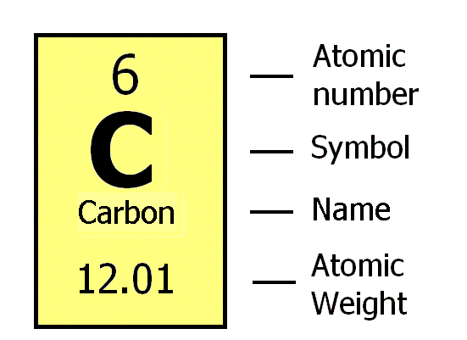
How do you read the periodic table?

Slide 8
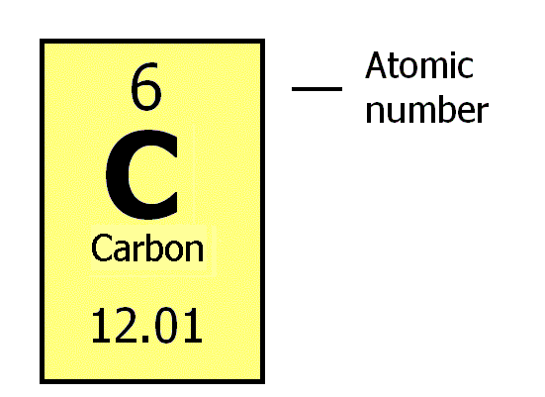
What is the atomic number?
The number of protons found in the nucleus of an atom.
The number of electrons surrounding the nucleus of an atom.

Slide 9
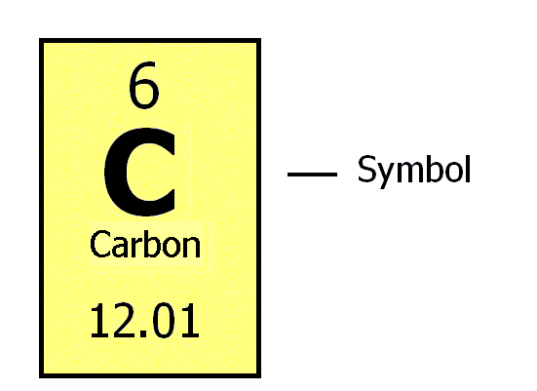
What is the Symbol?
An abbreviation of the element name.

Slide 10
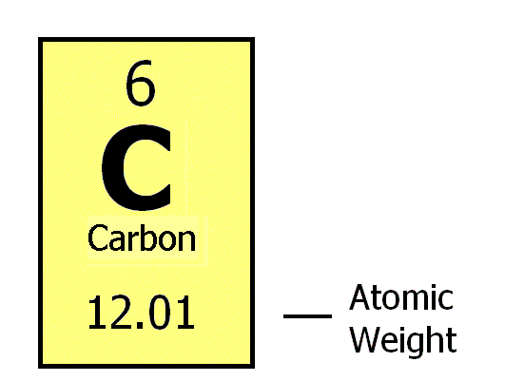
What is the atomic weight?
The number of protons and neutrons in the nucleus of an atom.

Slide 11
How do I find the number of protons, electrons, and neutrons in an element using the periodic table?
# of protons = atomic number
# of electrons = atomic number
# of Neutrons = atomic weight – atomic number

Slide 12
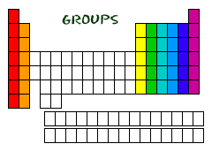
Groups or Families of the Periodic table
Each column is called a “group” or family.
Each element in a group has the same number of electrons in its outer orbital, also know as its outer shell.
The electrons in the outer shell are called valence electrons.
Hint. Your family tree is vertical

Slide 13
1
8
2
3
4
5
6
7
Except for He, it has 2 electrons

Slide 14
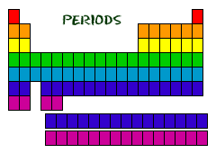
Periods of the Periodic Table
Each row is called a “period”
The elements in each period have the same number of electron shells
1st period = 1 shell (red)
2nd period = 2 shells (orange)
3rd period = 3 shells (Yellow)
4th period = 4 shells (Green)
Hint. A period comes at the end of a sentence – a horizontal line.

Slide 15
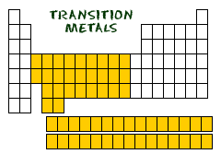
Transition Metals
Transition metals have slightly different rules for shells and valence electrons.
For now, assume they each have two valence electrons.

Slide 16
Practice
What period are the following elements in?
a. He _______________ b. Ge _________________
c. Rb _______________ d. I __________________
What group are the following elements?
a. Sulfur _______________ b. Ca _________________
c. Iodine _______________ d. Fe _________________

Slide 17
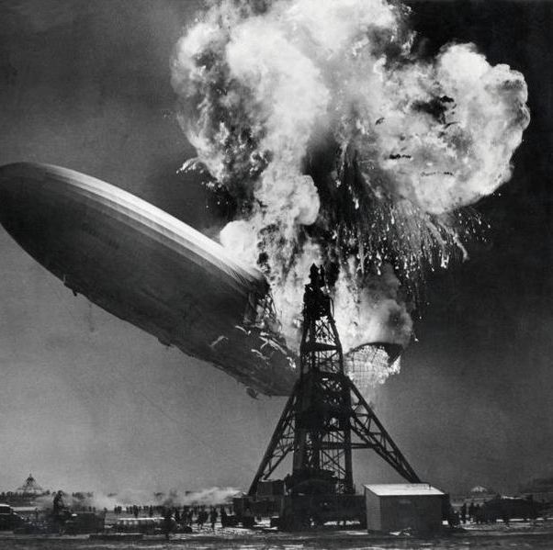
Hydrogen
Hydrogen belongs to a family of its own.
Hydrogen is a diatomic (two hydrogens together), reactive gas
Hydrogen was involved in the explosion of the Hindenburg.
Hydrogen is promising as an alternative fuel source for automobiles.
This Photo by Unknown Author is licensed under CC BY-SA
This Photo by Unknown Author is licensed under CC BY-SA

Slide 18
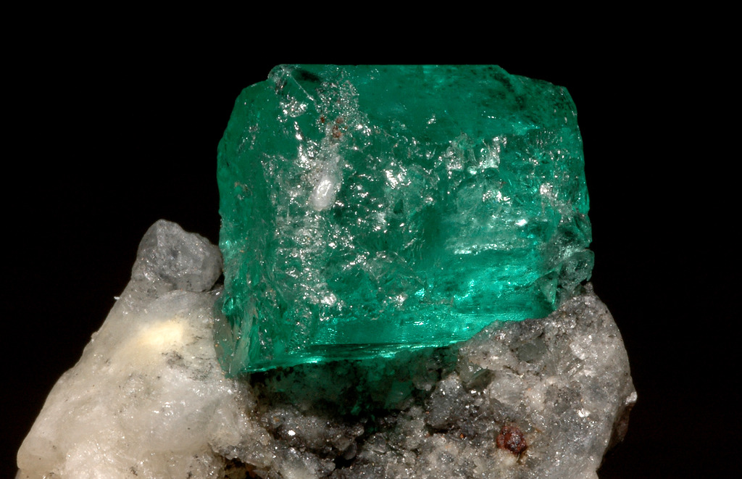
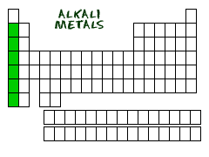
Alkali Metals
1st column on the periodic table (group 1) not including hydrogen.
Very reactive metals, always combined with something else in nature (like in salt).
Soft enough to cut with a butter knife.
This Photo by Unknown Author is licensed under CC BY-SA
This Photo by Unknown Author is licensed under CC BY-SA

Slide 20
Bellwork #2 – 01/25/18
From inside to out, describe the components of an atom.
This Photo by Unknown Author is licensed under CC BY-NC-SA

Slide 21
Periodic Table of elements
This Photo by Unknown Author is licensed under CC BY-SA

Slide 22
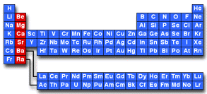
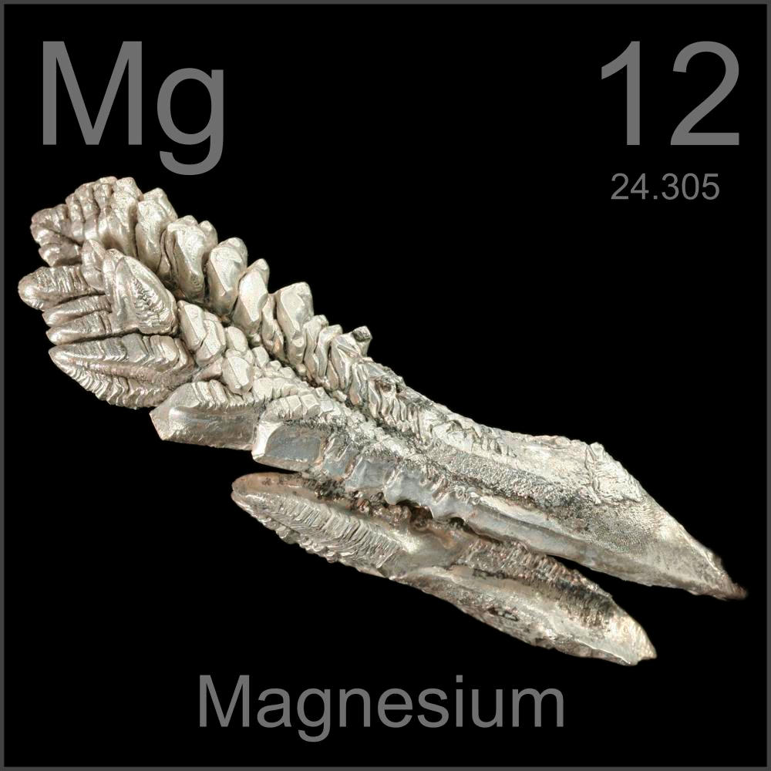
Alkaline Earth metals
Second column on the periodic table (group 2).
Reactive metals that are always combined with nonmetals in nature.
Several of these elements are important mineral nutrients (such as Mg and Ca).
This Photo by Unknown Author is licensed under CC BY-SA
This Photo by Unknown Author is licensed under CC BY-SA

Slide 23
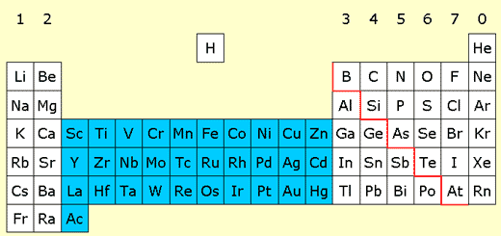
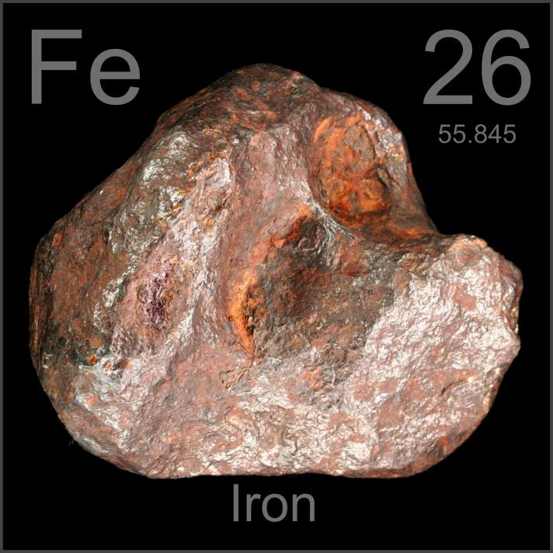
Transition Metals
Elements in groups 3-12.
Less reactive harder metals.
Includes metals used in jewelry and construction.
Metals used “as metal.”
This Photo by Unknown Author is licensed under CC BY-NC-SA
This Photo by Unknown Author is licensed under CC BY-SA

Slide 24
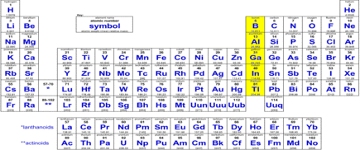
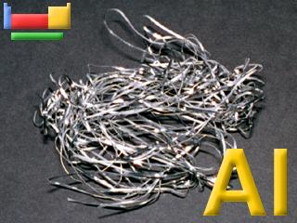
Boron Family
Elements in group 13.
Aluminum metal was once rare and expensive, not a “disposable metal.”
This Photo by Unknown Author is licensed under CC BY-SA
This Photo by Unknown Author is licensed under CC BY-SA

Slide 25
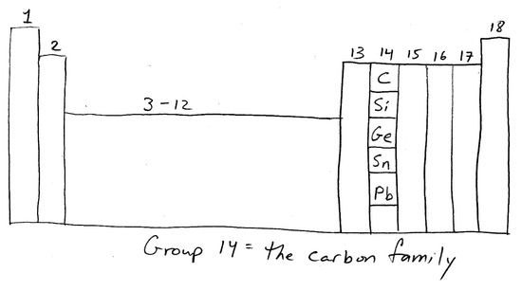
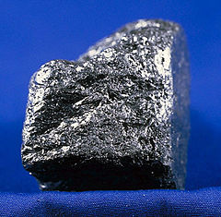
Carbon family
Elements in group 14.
Contains elements important to life and computers.
Carbon is the basis for an entire branch of chemistry.
Silicon and Germanium are important semiconductors
This Photo by Unknown Author is licensed under CC BY-SA
This Photo by Unknown Author is licensed under CC BY-NC-SA

Slide 26
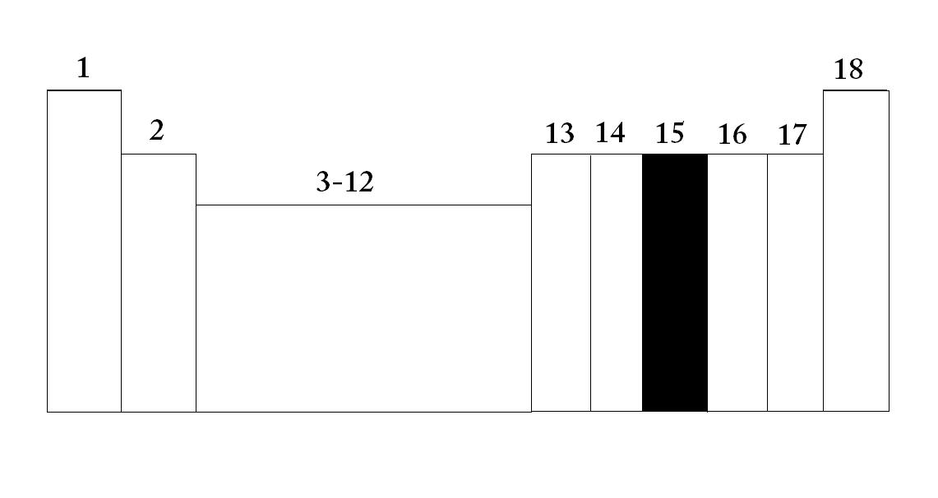
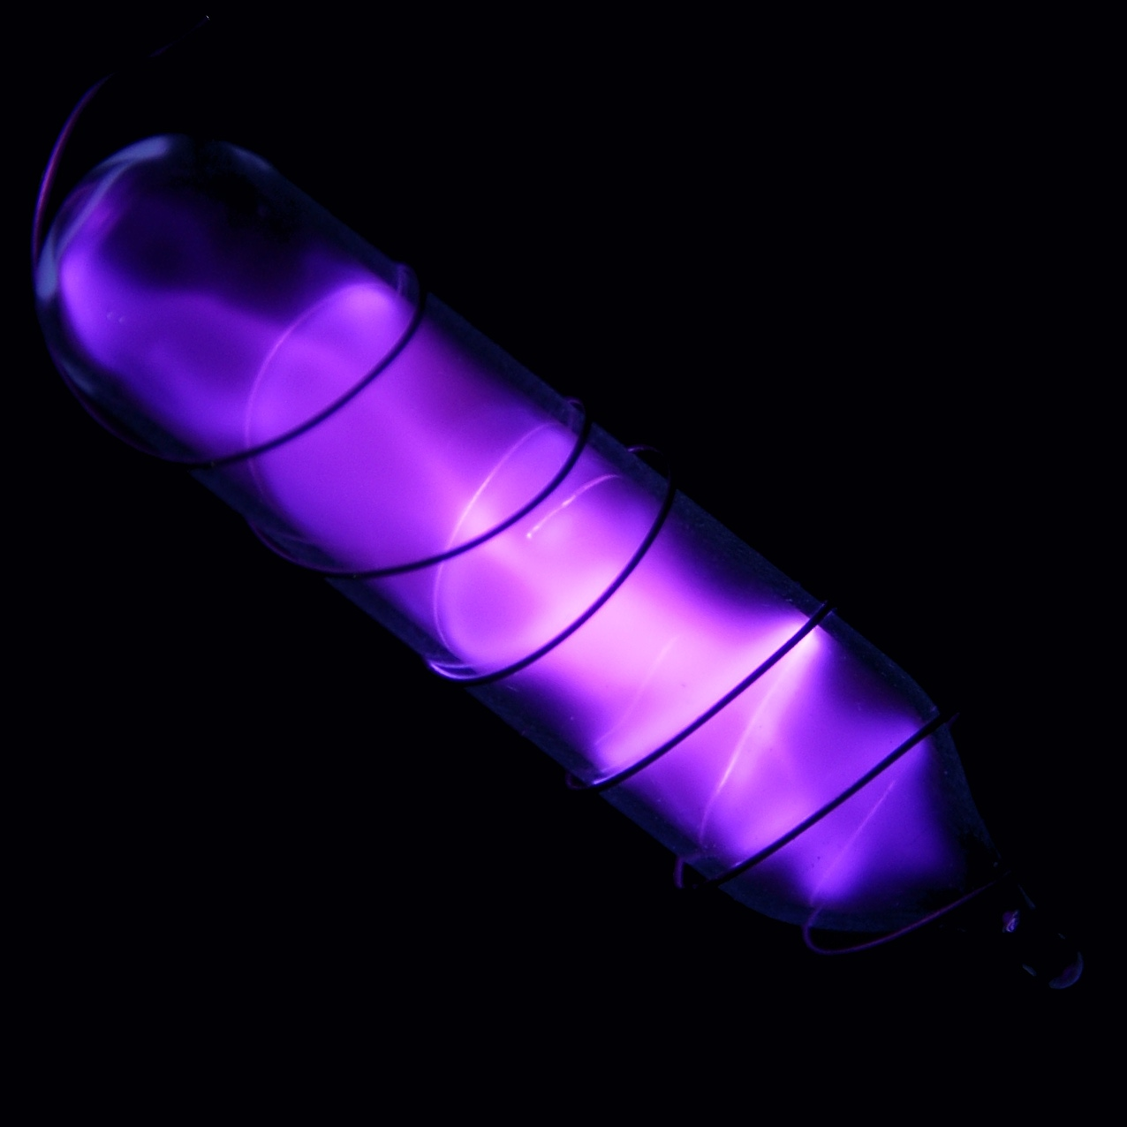
Nitrogen Family
Elements in group 15.
Nitrogen makes up over 75% of the atmosphere.
Nitrogen and phosphorus are both important in living things.
Most of the world’s nitrogen is not available to living things.
The red stuff on the top of matches is phosphorus.
This Photo by Unknown Author is licensed under CC BY
This Photo by Unknown Author is licensed under CC BY-NC-SA

Slide 28
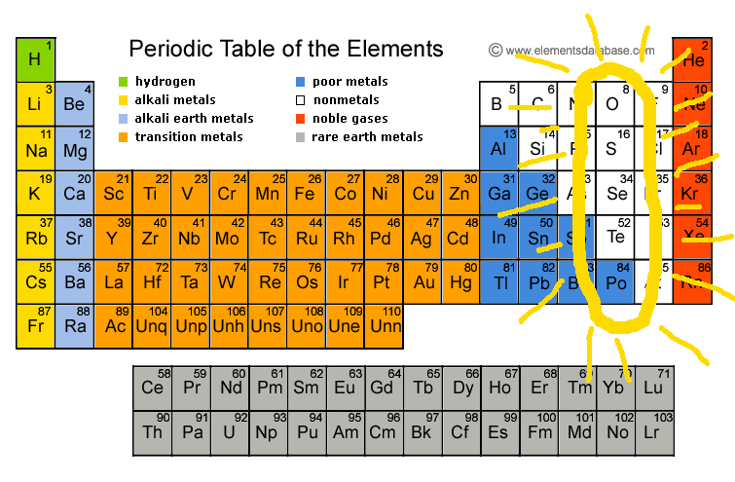
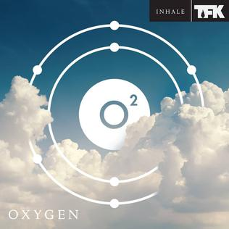
Oxygen Family or Chalcogens
Elements in group 16.
Oxygen is necessary for respiration (breathing).
Many things that stink, contain sulfur (rotten eggs, garlic, skunks, etc.)
This Photo by Unknown Author is licensed under CC BY-SA
This Photo by Unknown Author is licensed under CC BY-SA

Slide 29
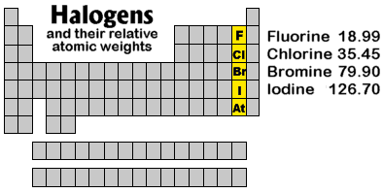
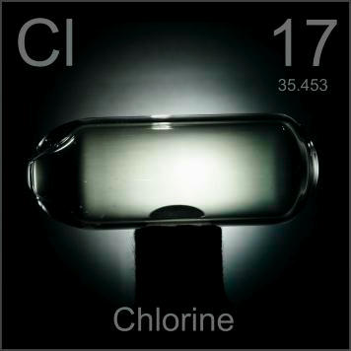
Halogens
Elements in group 17.
Very reactive, volatile, diatomic, nonmetals.
Always found combined with other element in nature.
Used as disinfectants and to strengthen teeth.
This Photo by Unknown Author is licensed under CC BY-SA
This Photo by Unknown Author is licensed under CC BY-SA

Slide 30
Fluorine – Breaking Bad

Slide 31
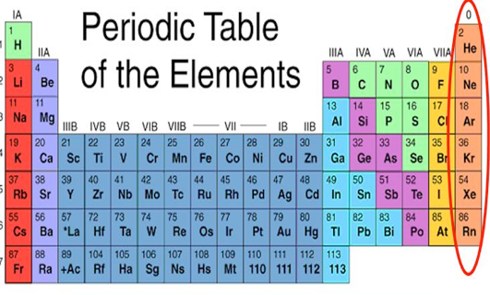
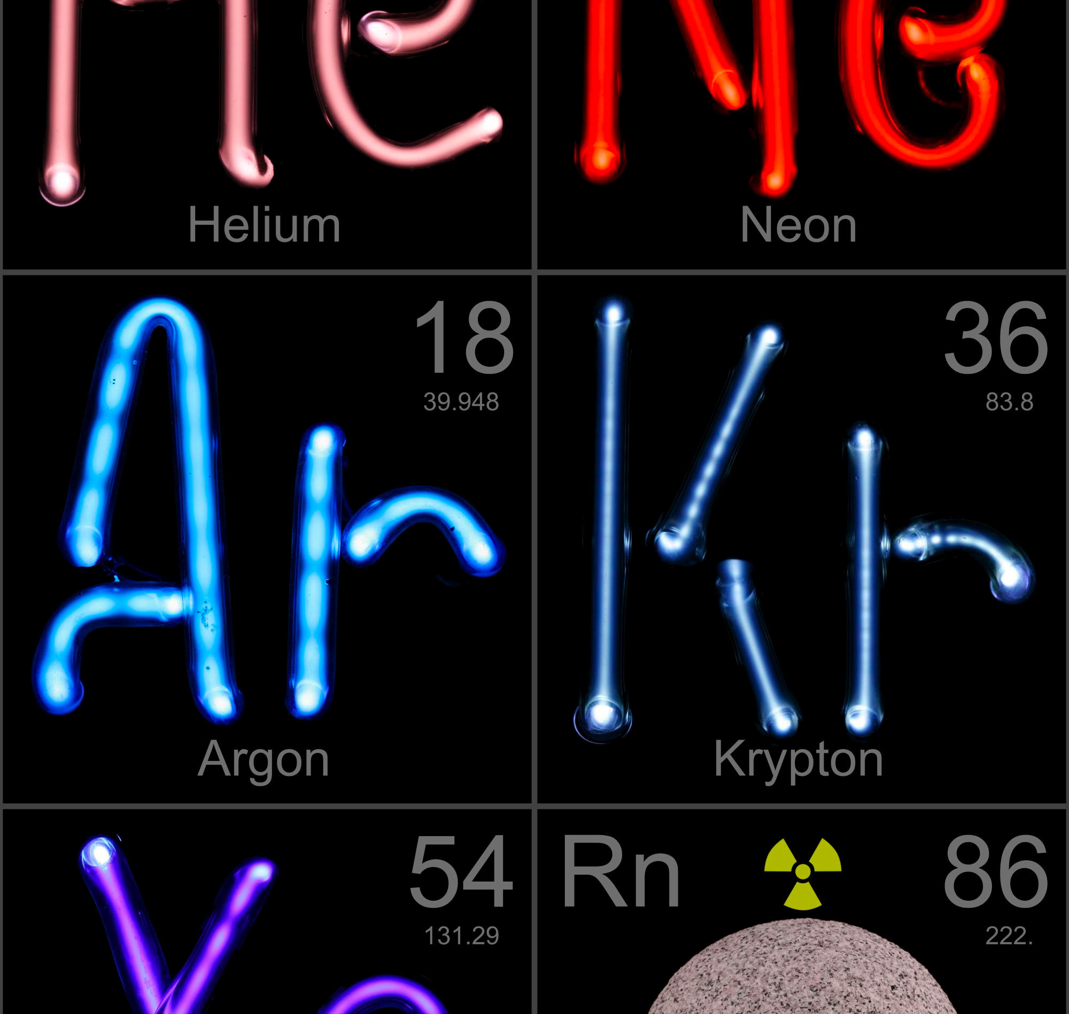
Noble gases
Elements in group 18.
Very unreactive, monatomic gases.
Used in lighted “neon” signs.
Used in blimps to fix the Hindenburg problem
Have a full valence shell.

Slide 32
Exit ticket
This Photo by Unknown Author is licensed under CC BY-SA

