Slide 1
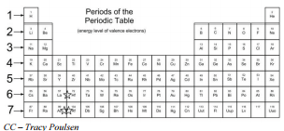
Bellwork #1 – 02/13/18
Describe how the atomic radii change from left to right across period 2, and explain this change in atomic size.
This Photo by Unknown Author is licensed under CC BY-NC-SA

Slide 2
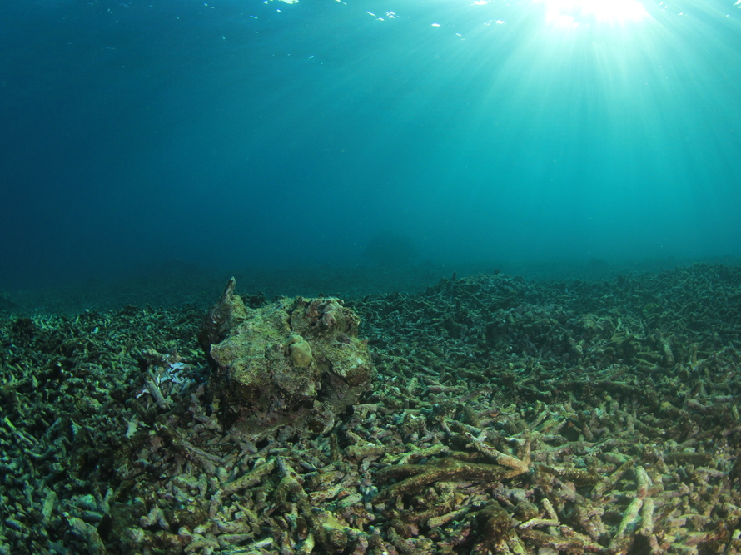
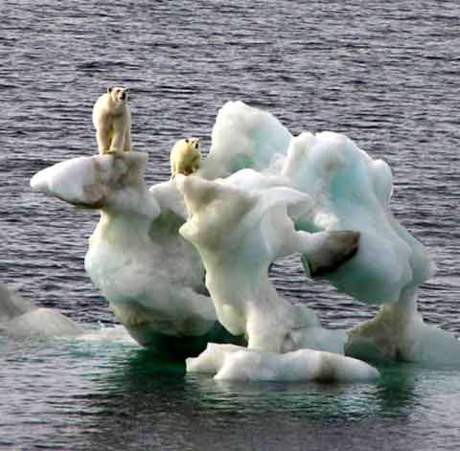
Physical and Chemical Changes

Slide 3
Objectives
Understand
Understand the movement of particles of a solid, liquid, and gas.
Distinguish
Distinguish the properties that affect the movement of particles.
Determine
Determine whether a substance is undergoing a chemical or physical change.

Slide 4
What is a physical change?
A physical change alters the form of a substance, but does not change it to another substance.
Example: making orange juice

Slide 5
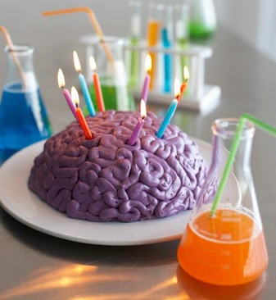
What is a chemical change?
When a substance undergoes a chemical change, it is changed into a different substance with different properties.
Example: Baking a cake

Slide 6
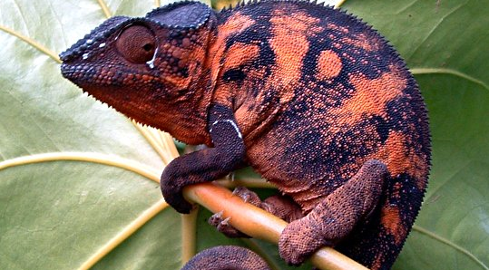
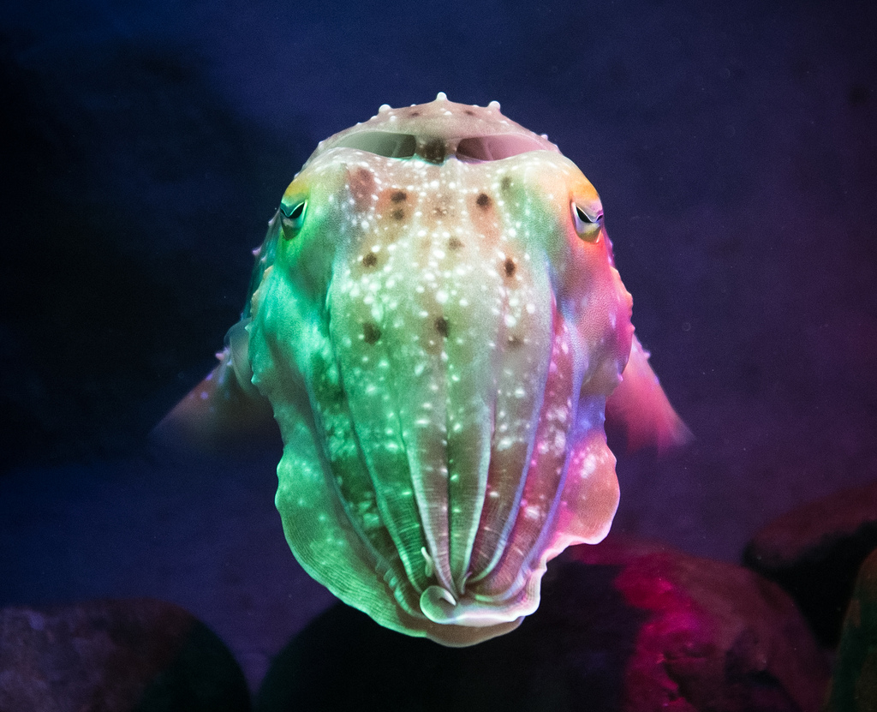
5 signs of a chemical change
Color change
Precipitation

Slide 7
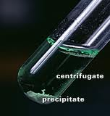
Precipitation
Precipitation: the solid that forms from a solution during a chemical reaction.
It look like a cloudy solid in an other clear solution.

Slide 8
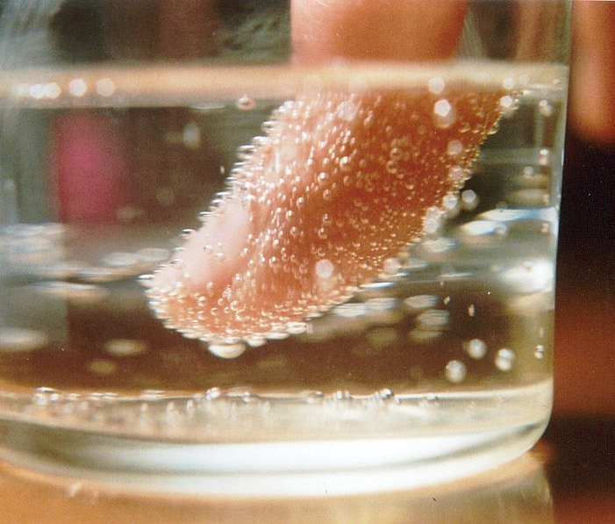
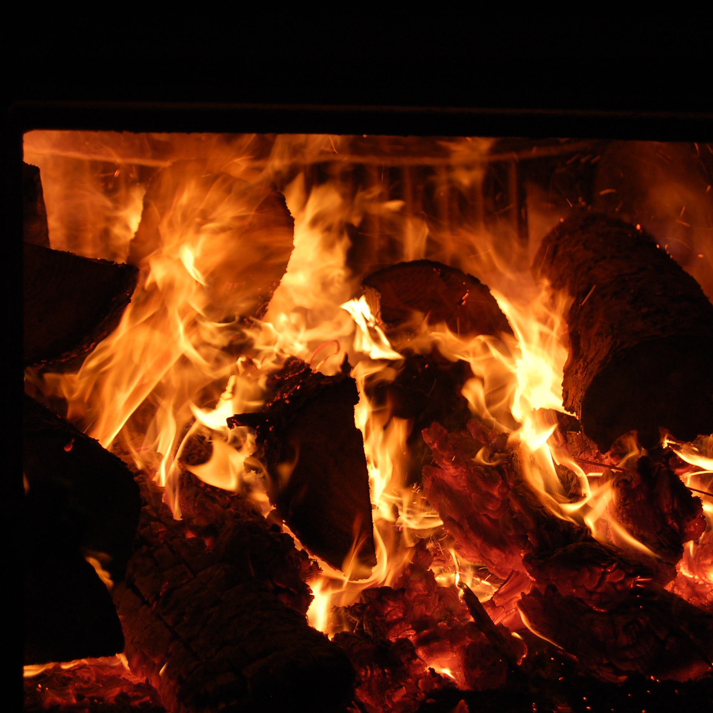
5 signs of a chemical change
3. Gas production
4. Temperature change
This Photo by Unknown Author is licensed under CC BY-SA
This Photo by Unknown Author is licensed under CC BY-NC-ND
This Photo by Unknown Author is licensed under CC BY-ND

Slide 9
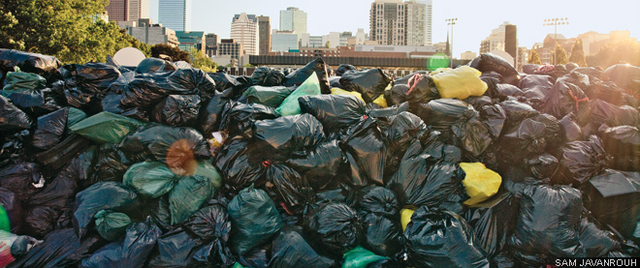
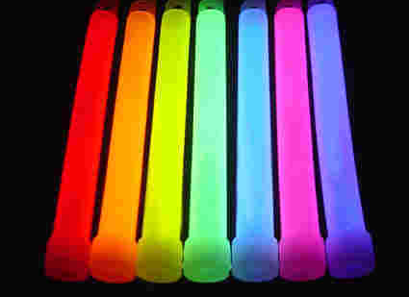
5 signs of a chemical change
5. Changes in characteristic properties (odor, light given off)

Slide 10
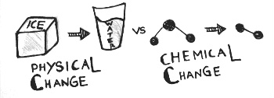
Chemical or Physical Change? Write in notebook
Cutting paper
Ice Melting
Toast Burning
Rocket fuel burning
Sawing wood
Melting rusting
Disappearing puddle
Candle burning
Dry Ice
Physical
Physical
Chemical
Chemical
Physical
Chemical
Physical
Chemical
Physical

Slide 11
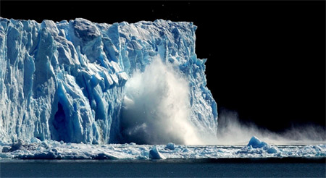
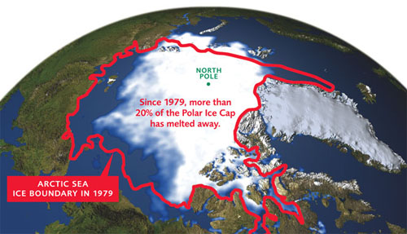
Ice Melting: Physical Change How?
This Photo by Unknown Author is licensed under CC BY-SA
This Photo by Unknown Author is licensed under CC BY-SA
This Photo by Unknown Author is licensed under CC BY-SA

