Slide 1
Bellwork #3 – 08/30/17
Give an example of something experiencing Newton’s 3rd law of motion.
This Photo by Unknown Author is licensed under CC BY-SA

Slide 2
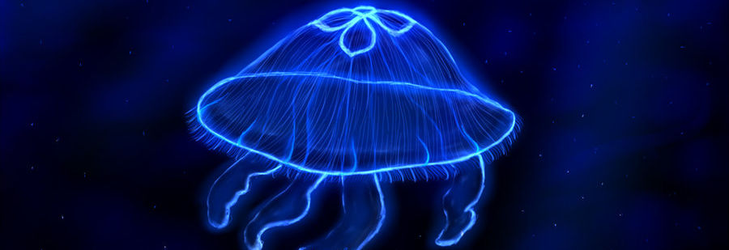
Pressure and Force
This Photo by Unknown Author is licensed under CC BY-NC-ND

Slide 3
Objectives
Describe the relationship between pressure and fluid speed.
1
Calculate the force and pressure with given variables.
2
Explain how surface area contributes to pressure
3

Slide 4
Essential Question
How do animals survive at 5000m below the ocean’s surface?

Slide 5
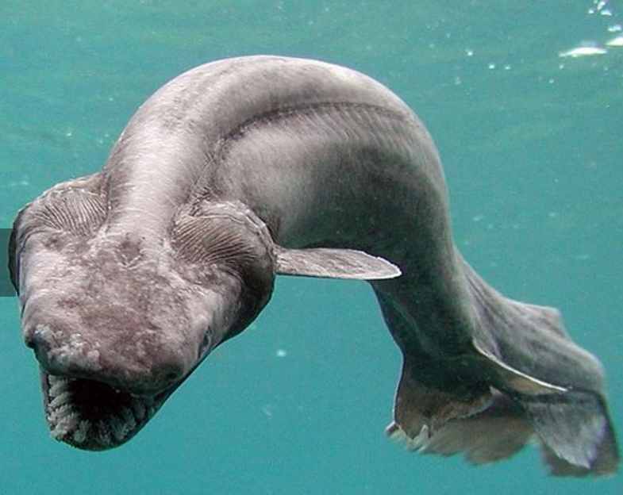
The Frilled Shark - REAL
Humans rarely encounter frilled sharks, which prefer to remain in the oceans' depths 1,500 meters below the surface.
It reaches a length of 2 m.
It is a ‘cartilaginous fish’ - this means its bones are made of cartilage.

Slide 6
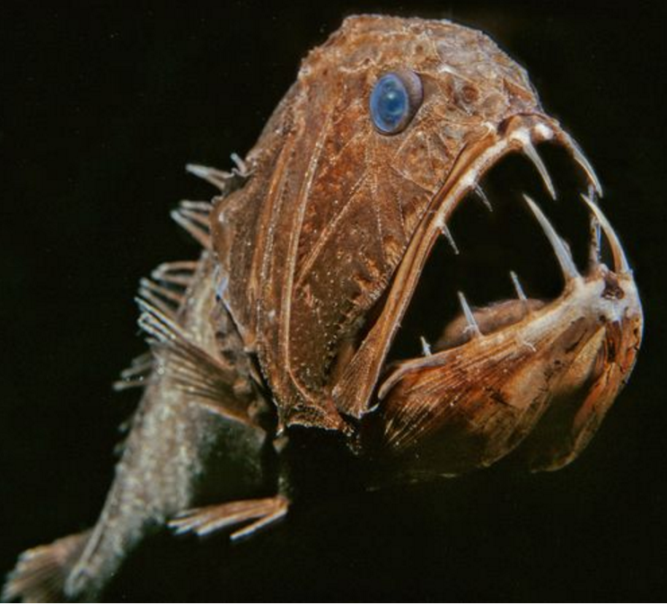
Fangtooth Fish
The nightmarish fangtooth is among the deepest-living fish ever discovered. The fish's normal habitat ranges as high as about 2,000 meters, but it has been found swimming at icy, crushing depths near 5,000 meters. Fangtooth fish reach only about 16cm long.
They are around 16cm in length. They are are bony fish.

Slide 7
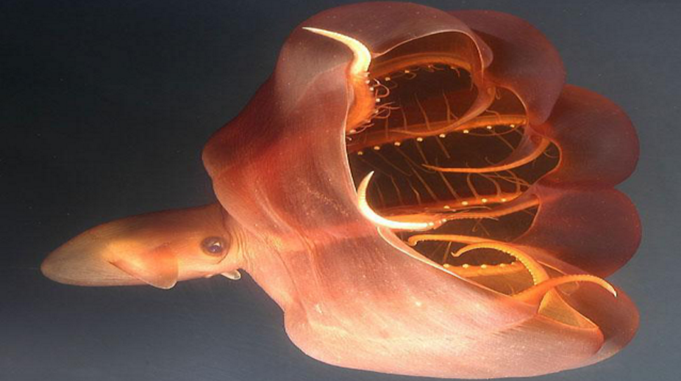
Vampire Squid
Vampire squid is an apt name for a creature that lurks in the lightless depths of the ocean. Comfortable at 3,000 meters below the surface, these diminutive cephalopods navigate the blackness with eyes that are proportionately the largest of any animal on Earth.
They are soft bodied.
They are small "squids" reaching maximum lengths of 28 cm

Slide 8
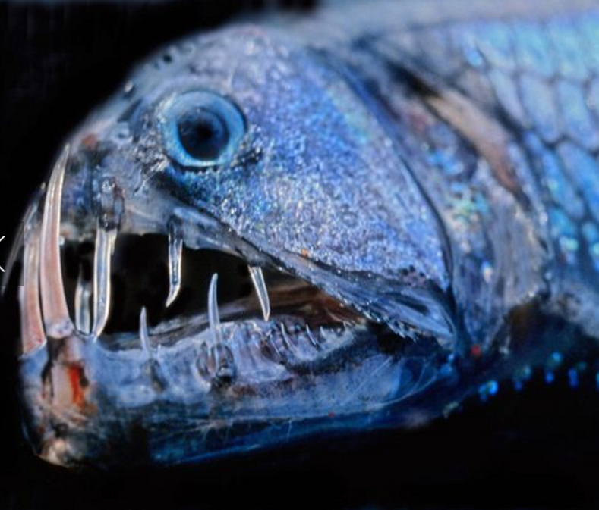
Pacific Viperfish
The Pacific viperfish has jagged, needlelike teeth so outsized it can't close its mouth. These deep-sea demons reach only about 25 cm long. They troll the depths up to 4,400 meters below, luring prey with bioluminescent photophores on their bellies.
They are bony fish.

Slide 9
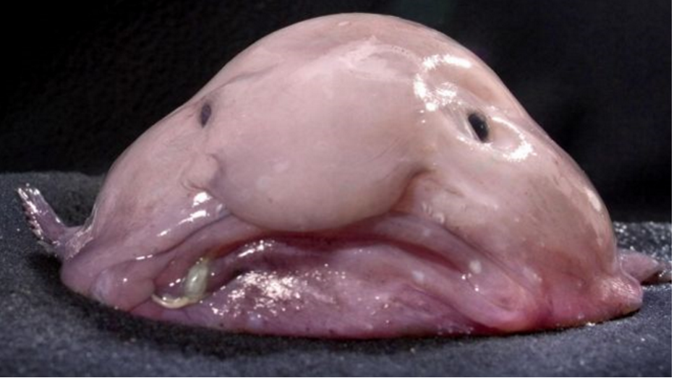
Blob fish
Primarily found in the deep water off of Australia and New Zealand the blobfish lives at depths of over 1200 meters. The pressure here is several dozen times higher than at the surface and as a result its body is little more than a gelatinous mass.
They are soft bodied.

Slide 10
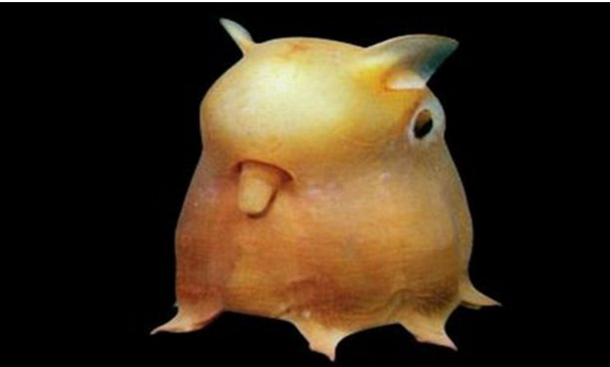
Dumbo octopus
All species of Grimpoteuthis are bathyal creatures, living at extreme depths of 3,000 to 4,000 metres with some living up to 7,000 metres below sea level, which is the deepest of any known octopus.
Octopuses are soft bodied.

Slide 11
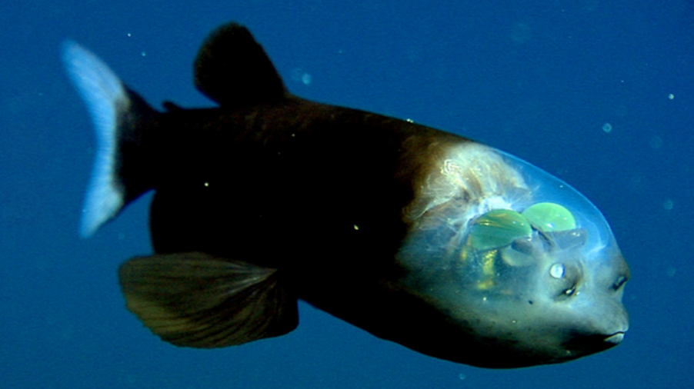
Barreleye
Live 600-800m below the ocean’s surface.
Also known as spook fish, these strange looking creatures are similar to hatchetfish in that they have two upward facing eyes to scan for prey. Their distinctive feature, however, is the transparent dome that encases them.
They are bony fish.

Slide 12
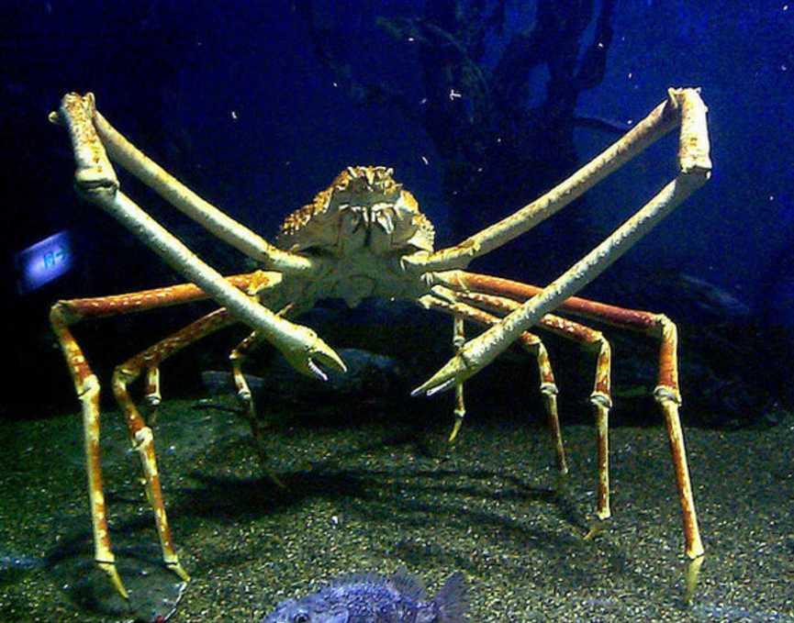
Giant spider crab
The largest crab on earth lives up to 300m below sea level, and can measure up to 365cm across
They have a hard exoskeleton.

Slide 13
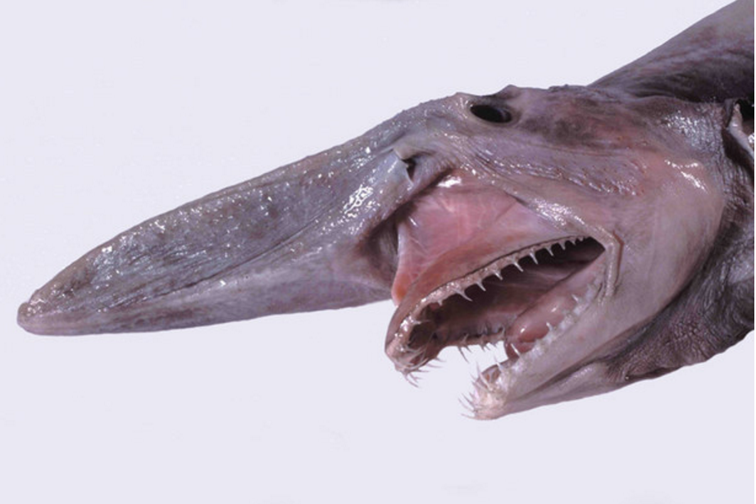
Goblin sharks live up to 1,300 metres below sea level. They have eel-like tails similar to frilled sharks, and grow to around 3.5 metres long. They scan the seabed with super-long snouts, detecting the tiny electrical currents given off by all living things.
They are cartilaginous fish (this means their bones are made out of cartilage).

Slide 14
Essential Question
How do animals survive at 5000m below the ocean’s surface?

Slide 15
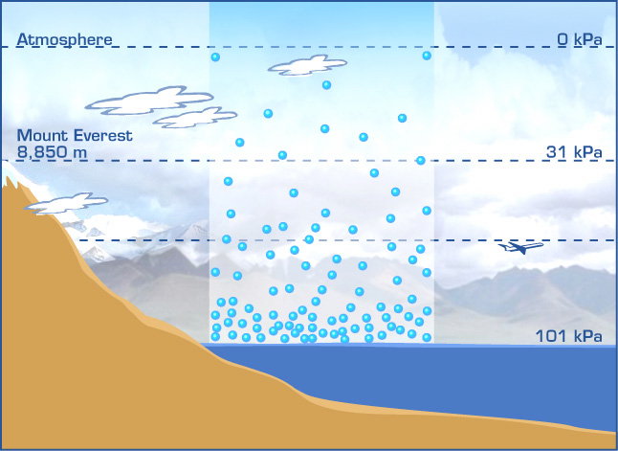
What is pressure?
A force exerted on or against an object by something in contact with it. It is usually measured in N/m², Pascals (Pa) or atmospheres
EQ: How do animals survive at 5000m below the ocean’s surface?

Slide 16
How do we calculate pressure?
Pressure can be calculated by dividing the force by the area
Pressure is measured in Pascals (Pa)
We sometimes see pressure being measured in N/m2 or n/cm2.
1Pa is the same as 1n/m2
Pressure = force
area
This Photo by Unknown Author is licensed under CC BY-SA

Slide 17
Practice using the formula for pressure
A box weighs 500n. It’s base has an area of 5m2. What pressure does it exert?
Another identical box is placed on top of the first box. What is the pressure now?
A snowboarder weighs 600N. The area of the snowboard is 0.5m2. What is the pressure on the snow?

Slide 18
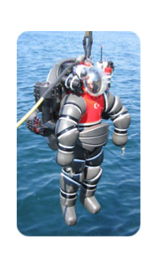
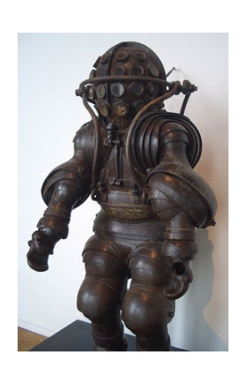
Deep sea divers
So, why do you think deep sea divers need to wear suits like this?
EQ: How do animals survive at 5000m below the ocean’s surface?

Slide 20
Liquid Pressure
Liquids are made up of particles.
The particles can move in all directions.
The pressure exerted by a liquid acts in all directions too.
Liquids with a high density will exert a higher pressure.
As you go deeper, the pressure increases.
This is due to the weight of all the water above pushing down.

Slide 21
Water pressure and body pressure
Water pressure acts in all directions on this fish
The fish’s body pushes back with an equal and opposite pressure

Slide 22
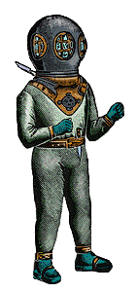
Water pressure and scuba diving
When this deep sea diver goes
deeper, the water pressure on
his body increases. This will cause
his blood pressure to increase. The
increased pressure inside his body
causes gas exchange in his lungs to
happen at a greater rate. It also
causes nitrogen to go into the blood
with the oxygen. This can cause problems like euphoria, and the diver
Can’t think clearly and can forget basic safety rules.

Slide 23
Problems for scuba divers
As a diver ascends the water pressure will decrease, and the diver’s blood pressure will decrease.
The nitrogen which dissolved in the blood easily under high pressure will come back out.
If the diver decompresses too quickly the nitrogen leaves the blood so quickly it will bubble and fizz like carbon dioxide from a bottle of pop.
This is known as the ‘bends’.

Slide 24
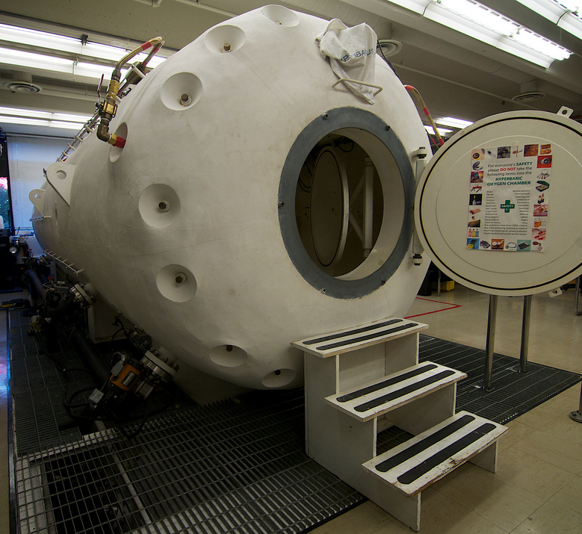
A cure for the bends
A diver can go into a decompression chamber to avoid getting the “bends”.
The pressure in the chamber is controlled to change slowly from high pressure to a low pressure.
This allows the diver’s pressure to decrease slowly to avoid nitrogen leaving the blood so quickly.
This Photo by Unknown Author is licensed under CC BY

Slide 25
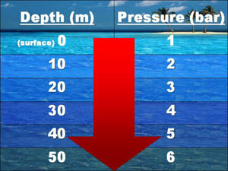
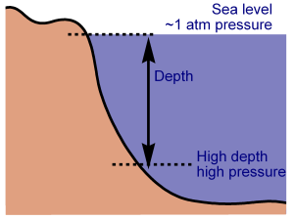
Increasing depth = increasing pressure
Pressure in liquids behave much like pressure in gases. The deeper you go in liquids, the higher the pressure gets.
This is why deep sea divers need to wear really thick suits, to withstand the high pressure at great depths.
EQ: How do animals survive at 5000m below the ocean’s surface?

Slide 26
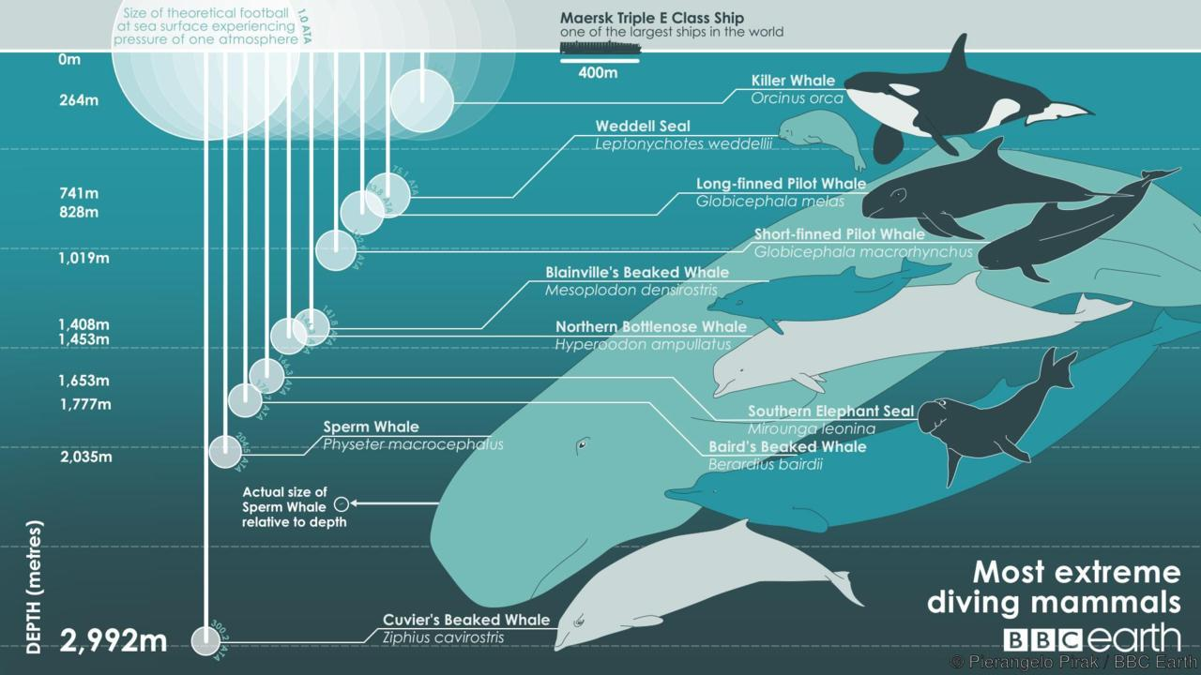
Can you draw the graph… what is the relationship between depth and pressure?
Depth below surface (m) | Pressure (in atmospheres)
0 | 0
1000 | 100
2000 | 200
3000 | 300
4000 | 400
5000 | 500
6000 | 600
7000 | 700
8000 | 800
9000 | 900
10000 | 1000
Draw the graph using the information given to you.
LO: Draw a graph to show the relationship between pressure and depth
EQ: How do animals survive at 5000m below the ocean’s surface?

Slide 27
Giant spider crab
Max depth: 300m
Size: 365cm
Skeleton: Hard exoskeleton
Barreleye
Max depth: 10000m
Size: 4.4cm
Skeleton: bony fish
Goblin shark
Max depth: 1300m
Size: 3.5m
Skeleton: Cartilaginous
Pacific Viperfish
Max depth: 4400m
Size: 25cm
Skeleton: Bony fish
Frilled Shark
Max depth: 1500m
Size: 2m
Skeleton: Cartilaginous
Fangtooth fish
Max depth: 2000m
Size: 16cm
Skeleton: Bony fish
Blob fish
Max depth: 1200m
Size: 30cm
Skeleton: Soft bodied
Dumbo octopus
Max depth: 7000m
Size: 20cm
Skeleton: Soft bodied
Vampire Squid
Max depth: 3000m
Size: 28cm
Skeleton: Soft bodied

Slide 28
Exit ticket
This Photo by Unknown Author is licensed under CC BY-ND

