Slide 1
Bellwork #2 – 02/14/18
Certain compounds are used in ceiling tiles because they do not catch fire even when heated to extreme temperatures. This is an example of a property of matter.

Slide 2
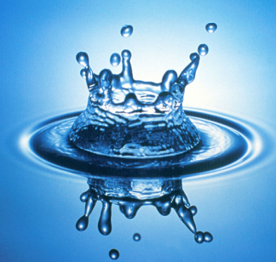
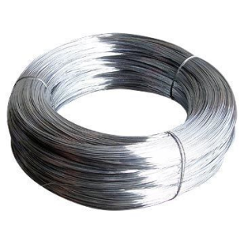
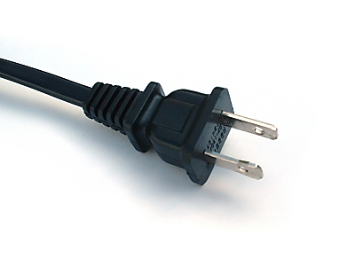
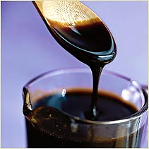
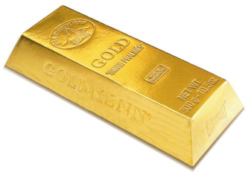
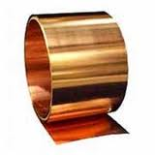
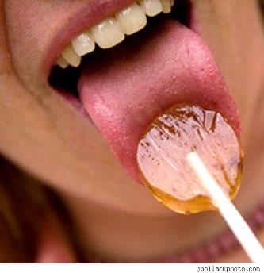
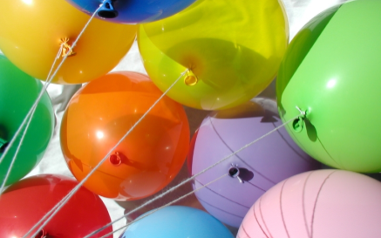
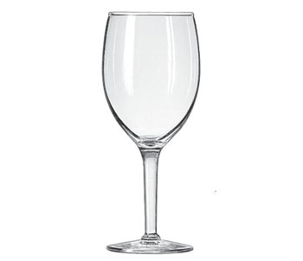
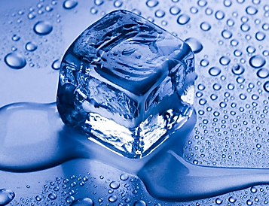

Slide 3
CONCEPTS EXPLORED IN THIS LESSON
1) Introduction to Properties
2) Physical Properties vs. Chemical Properties
3) Physical Properties of Matter
State
Taste
Odor
Color
Luster
Clarity
Texture
Hardness
Solubility
Viscosity
4) Chemical Properties of Matter
Combustibility
Reactivity with water
Malleability
Ductility
Density
Electrical conductivity
Melting point
Boiling point
Crystal form
Magnetism

Slide 4
INTRODUCTION TO PROPERTIES
odor
clarity
solubility
color
state
texture
taste
luster
PROPERTIES OF MATTER
viscosity
malleability
ductility
reactivity to water
hardness
crystal form
combustibility
magnetism
melting point
density
boiling point
electrical conductivity

Slide 5
PHYSICAL PROPERTIES VS. CHEMICAL PROPERTIES
Physical Property:
Chemical Property:
A property of a substance
that can be observed or
measured ______________
the chemical identity of the
substance.
A property of a substance
that describes ___________
to other substances
how it reacts
without changing
and
_________________
______ as a result.
changes its chemical
identity
e.g. color, state of matter
e.g. combustibility
Which properties can you detect with only your senses?
taste
touch
sight
smell
taste
texture
color
odor
hardness
clarity
texture
luster/shininess

Slide 6
RECALL: A PHYSICAL PROPERTY of a substance can be observed or measured _______________ the chemical identity of the substance.
without changing

Slide 7
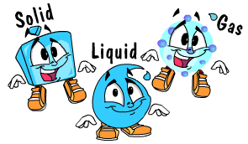
PHYSICAL PROPERTIES
State of Matter:
The property of a substance that determines whether or not it is a _____ , ____ or ___.
liquid
solid
gas
There are three states of matter. Water in a lake is found in the _____________ state, water in your ice cube tray is found in the _____________ state, and water in steam is found in the _____________ state.
liquid
solid
gas

Slide 8
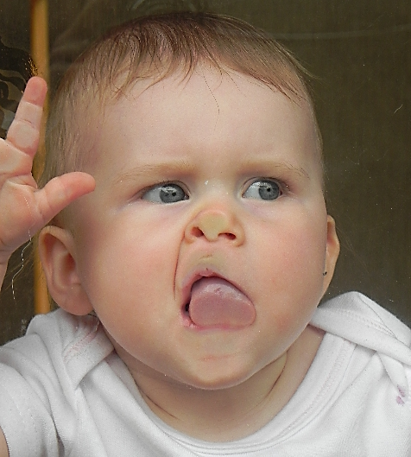
PHYSICAL PROPERTIES
Taste:
The property of a substance that describes how it affects the _____________ otherwise known as _________.
taste receptors
taste buds
Sugar tastes _____________ and lemons taste _____________. Nothing in a chemistry lab should ever be _____________. Even if one of the ingredients is a common food item, once it is used for a lab, it is considered potentially _____________.
sweet
sour
tasted
contaminated

Slide 9
PHYSICAL PROPERTIES
Odor:
The property of a substance that describes how it affects the _______________________.
olfactory (smell) receptors
Old dirty gym socks smell _____________ and roses smell _____________. Never _____________ anything in a chemistry lab unless instructed to do so. If smelling a substance, the _____________ method should be used to sniff it.
bad
good
smell
hand-waving

Slide 10
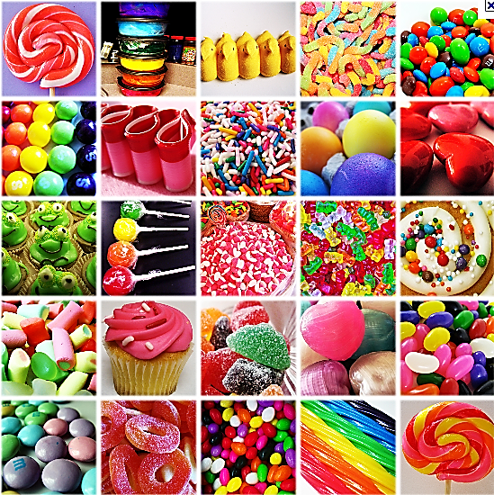
PHYSICAL PROPERTIES
The property of a substance that describes how it affects the ___________________ in your ___________ when that substance _______ different ___________ of light.
Color:
light sensing receptors
eyes / retina
reflects
wavelengths
red
A fire truck is _____________ but the sky on a sunny day is _____________. The leaves on the trees in the summer are _____________, but the color of the sun is _____________. The color of an orange is _____________!
blue
green
yellow
orange

Slide 11
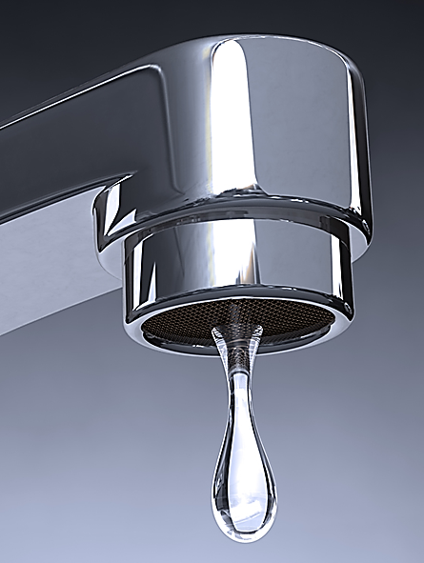
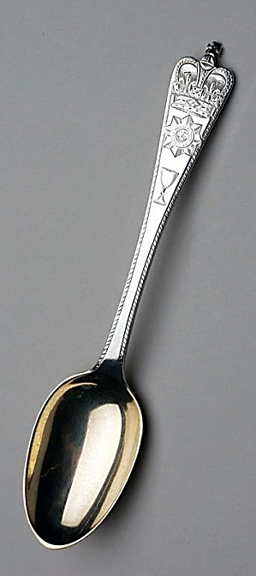
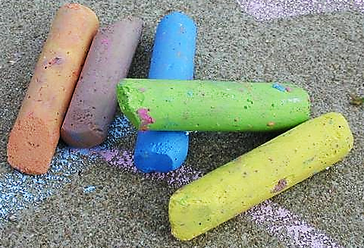
PHYSICAL PROPERTIES
Luster:
shiny
The property of a substance that describes how _____ or _______ it is.
lustrous
dull
A piece of paper is _____________ because it does not reflect much light, but the chrome on a car is _____________ because it reflects a lot of light. Another dull thing is _______________ and another shiny thing is _____________.
lustrous / shiny
an eraser
a spoon

Slide 12
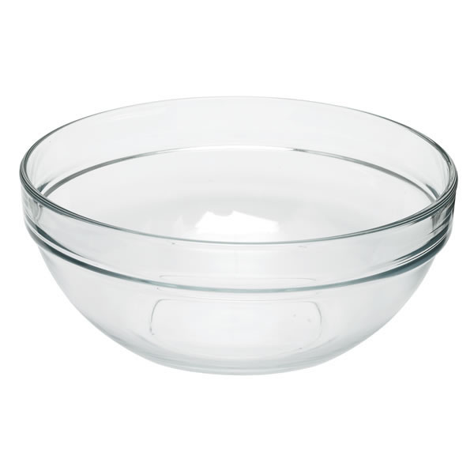
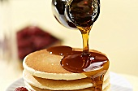
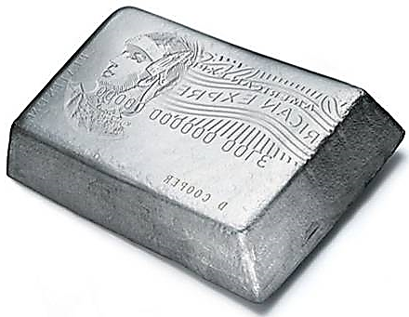
PHYSICAL PROPERTIES
Clarity:
The property of a substance that describes how much ____ can pass through it.
light
A piece of glass is _____________ , meaning that it lets all the light pass through it, maple syrup is _____________ because it lets some light through it, and mud is _____________ because it lets no light pass through it.
transparent
translucent
opaque

Slide 13
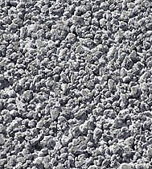
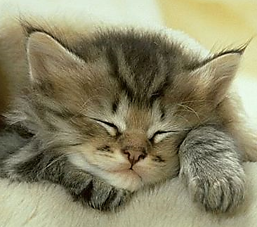
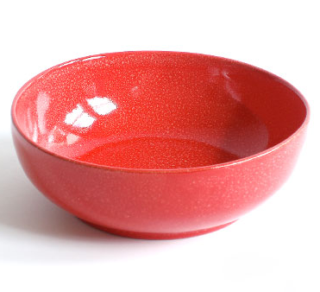
PHYSICAL PROPERTIES
Texture:
The property of a substance that describes how the ______ of a substance ____.
surface
feels
smooth
The surface of a bowl feels _____________ but the surface of the cement sidewalk feels _____________. The fur of a cat feels _____________ . The surface of an eraser feels _____________ .
rough
soft/fluffy
rough/tacky

Slide 14
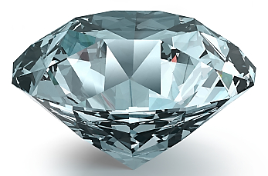
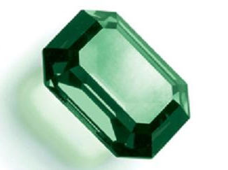
PHYSICAL PROPERTIES
Hardness:
The property of a substance that describes how difficult it is to ______ its surface.
scratch
diamond
On Mohs hardness scale of minerals, a _____________ is the hardest known substance on Earth with a hardness level of _____________. An emerald is also hard but it has a hardness level of _____________ .
10
7.5

Slide 15
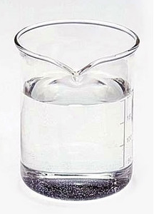
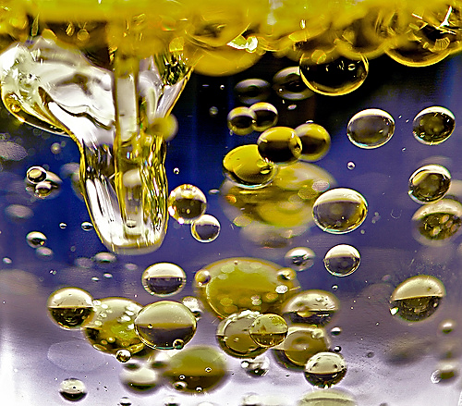
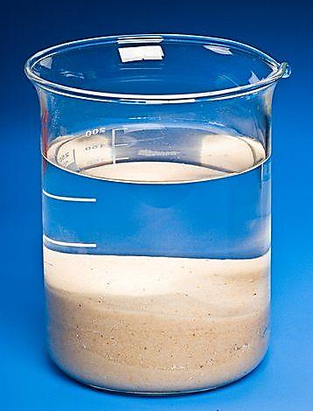
PHYSICAL PROPERTIES
Solubility:
The property of a substance that describes how easily it ________ when mixed with another substance.
dissolves
Water and vinegar mix together completely and therefore, vinegar is _____________ in water. Salt is also _____________ in water because it will dissolve completely in water. Neither oil nor sand will dissolve in water, and that is why they are considered _____________ in water.
soluble
soluble
insoluble

Slide 16
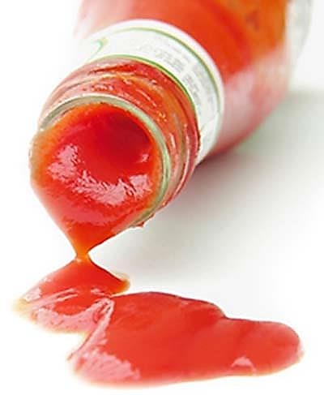
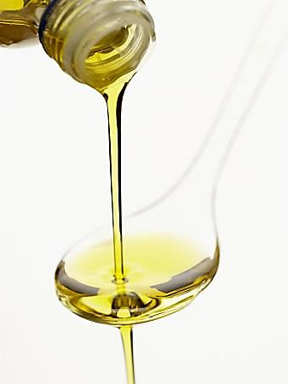
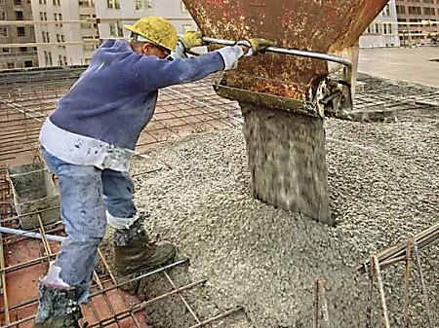
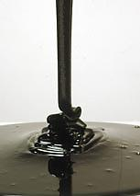
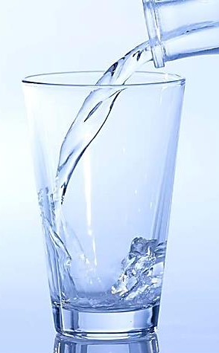
PHYSICAL PROPERTIES
Viscosity:
The property of a substance that describes how easily it can ____ or how _____ it is.
pour
thick
less
Water is _____________ viscous than oil, and that is why it pours out of its container more easily than oil does. Ketchup is _____________ viscous than oil, and that is why it’s _____________ for it to pour out of its container.
more
harder

Slide 17
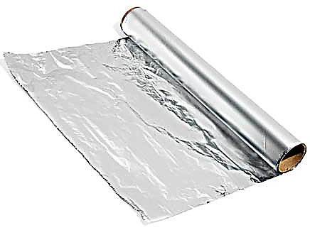
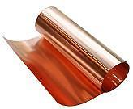
PHYSICAL PROPERTIES
The property of a substance that describes its ability be _____ or _________ into a ________ without ________.
Malleability:
bent
hammered
thin sheet
breaking
Aluminum
_____________ is very malleable and that is why we use it to make foil to wrap our food. Other substances, like glass, are _____________ malleable because it would break instead of change shape. Wood is _____________ , while copper is _____________.
not
not malleable
malleable

Slide 18
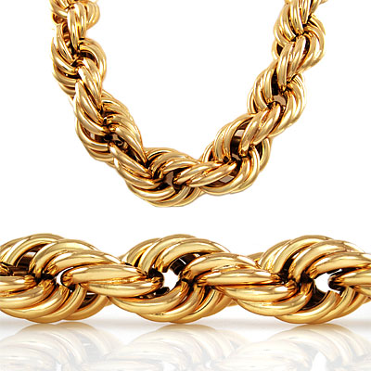
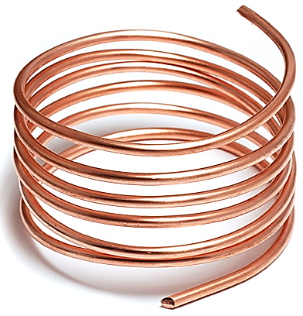
PHYSICAL PROPERTIES
Ductility:
The property of a substance that describes its ability to be drawn into a ________ without ________.
thin wire
breaking
gold
Many metals like _____________ and _____________ can easily be drawn into a thin wire. Substances like water and cement are not _____________ .
copper
ductile

Slide 19
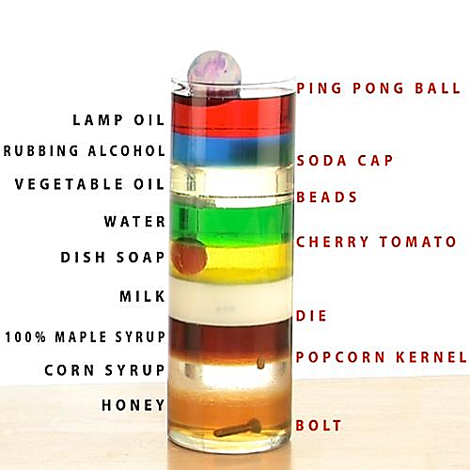
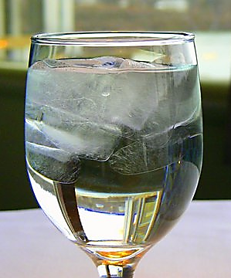
PHYSICAL PROPERTIES
Density:
The property of a substance that describes how much _____ of a substance is contained in a given _______ of space of that substance.
mass
volume
less
Rubber is _____________ dense than water and that is why it will float on water. A penny is _____________ dense than water and that is why it will sink to the bottom of the water. Water in its _____________ state is less dense than water in its _____________ state. That is why ice floats on water.
more
solid
liquid

Slide 20
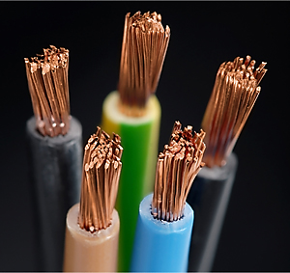
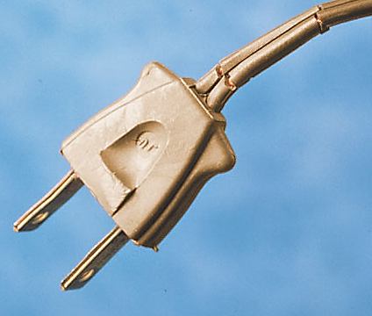
PHYSICAL PROPERTIES
Electrical
Conductivity:
The property of a substance that is a measure of its ability to conduct an _______________.
electrical current
Copper
good
_____________ is a _____________ electrical conductor, and that is why it is used as the main material for the wiring found in most homes and electronics. Plastic is _____________ a good conductor of electricity and that is why it is used to _____________ electrical wires.
not
insulate

Slide 21
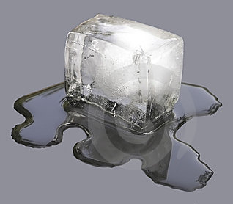
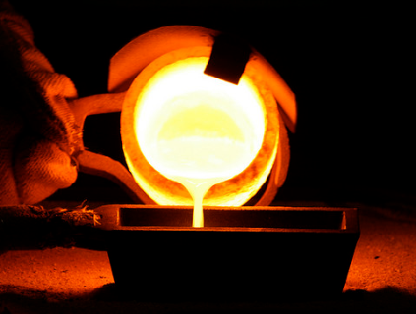
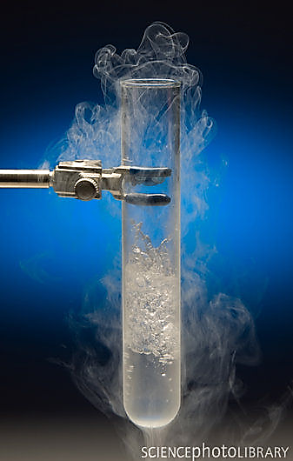
PHYSICAL PROPERTIES
The property of a substance that is the ___________ at which it transforms from the ____ state into the _____ state.
Melting Point:
temperature
solid
liquid
Boiling Point:
The property of a substance that is the ___________ at which it transforms from the _____ state into the ____ state.
temperature
liquid
gas
The melting point of water is ____ °C and the boiling point of water is ____ °C. The melting point of _____________ is 1063 °C and the _____________ point of gold is 2856 °C.
0
100
gold
boiling

Slide 22
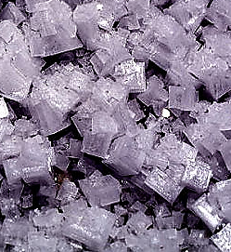
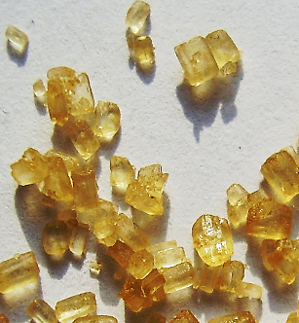
PHYSICAL PROPERTIES
Crystal Form:
The property of a substance that describes the ________________ that it takes when it forms crystals in its _____ state.
geometrical shapes
solid
If you look with a high powered microscope, you can observe that sugar crystals are oblong and slanted at the sides, but the crystal form of salt is shaped more like a _____________.
cube

Slide 23
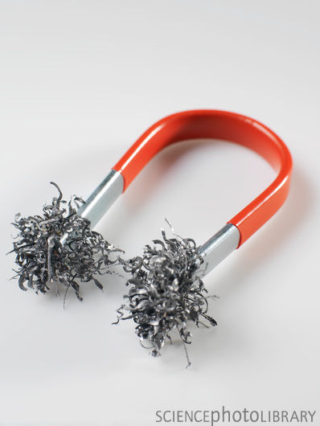
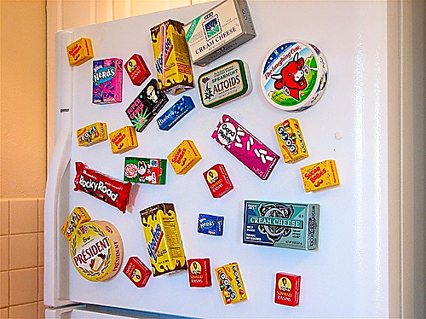
PHYSICAL PROPERTIES
Magnetism:
The property of a substance that describes if it is attracted to a ____________.
magnetic field
attracted
Some substances like steel are _____________ to a magnet and therefore are considered _____________. Substances like glass are _____________ attracted to magnets and are called _____________ .
magnetic
not
non-magnetic

Slide 24
RECALL: A CHEMICAL PROPERTY of a substance describes ___________ to other substances and how it ________________________ as a result.
how it reacts
changes its chemical identity

Slide 25
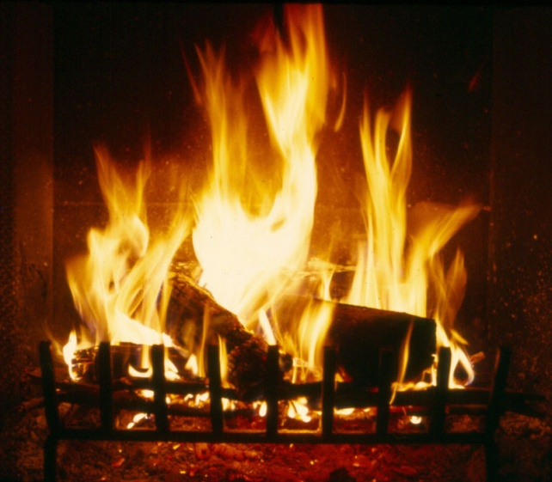
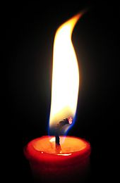
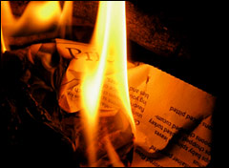
CHEMICAL PROPERTIES
The property of a substance that describes whether or not it will catch on ___ in the presence of ______ and ____.
Combustibility:
fire
oxygen
heat
combustible
more
Glass is not _____________. Dry wood is _____________ combustible than wet wood. _____________ fuels like coal, natural gas, and gasoline are all combustible.
Fossil

Slide 26
CHEMICAL PROPERTIES
Reactivity with Water:
The property of a substance that describes whether or not it is reactive with ______.
water
sodium
water
sodium
Some substances like _____________ are very reactive with water, and so they have to be stored in a water-free environment. Even the water vapor in the air can cause a reaction, so these substances must be stored under _____________.
mineral oil

Slide 27
Exit Ticket

