Slide 1
BellWork #2 – 08/15/17
A sailboat is traveling north at 10 km/h, relative to the water. The water is flowing north at 5 km/h. What is the velocity of the boat relative to ground?

Slide 2
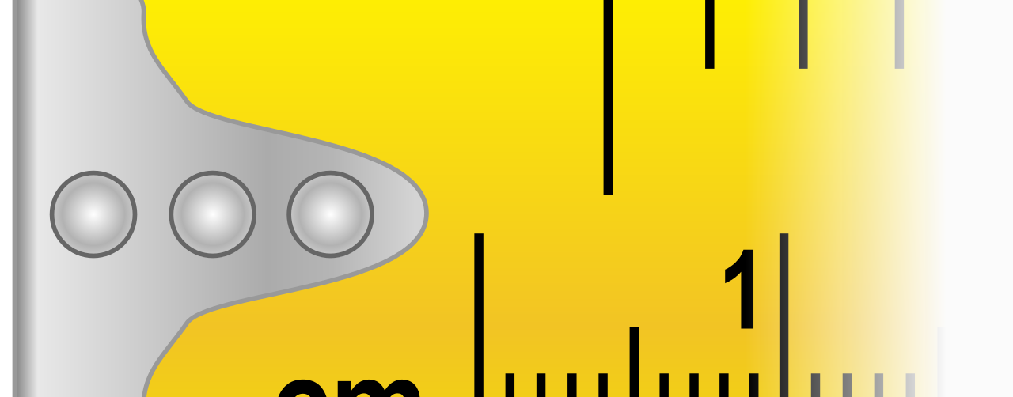
The SI System of Measurement
This Photo by Unknown Author is licensed under CC BY-SA

Slide 3
Objectives
Explain the difference between mass and weight.
Identify SI units of mass, distance (length), volume, temperature, and time.
Define derived unit.
Describe absolute zero.

Slide 4
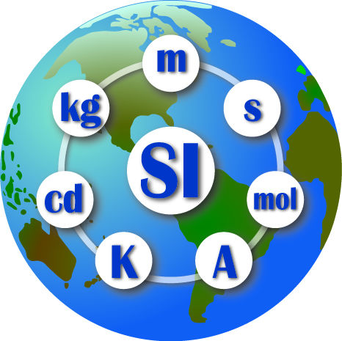
International System of Units (SI)
Main system of measurement units used in science.
Since the 1960s, the International System of Units has been agreed upon internationally as the standard metric system.
SI base units are based on physical standards.
Each SI base unit, except the kilogram, is described by stable properties of the universe.

Slide 5
Mass and its SI Unit
MASS AND WEIGHT ARE NOT THE SAME THING!
Mass: an object is a measure of the amount of matter in it and remains the same regardless of where the object is placed.
Matter: anything that has mass and takes up space.
For example, moving a brick to the moon does not cause matter in the brick to disappear or to be removed.
Weight: an object is the force of attraction between the object and the Earth (or whatever large, gravity-producing body the object is located on).
Attraction is due to the force of gravity.
Since the force of gravity is not the same at every point on the Earth’s surface, the weight of an object is not constant.
For example, a man who weighs 180 pounds on Earth would weight only 45 pounds if he were in a stationary position 4,000 miles above the Earth’s surface.

Slide 7
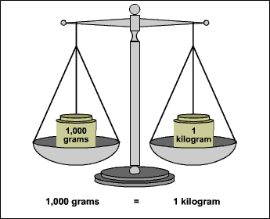
Mass and its SI Unit
Basic unit of mass = kilogram
Kilogram (kg) = 1,000 grams.
A gram is a relatively small amount of mass
1 paperclip = 1 gram

Slide 8
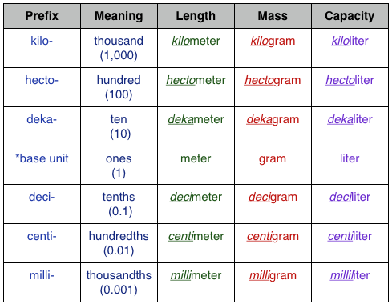

Slide 9
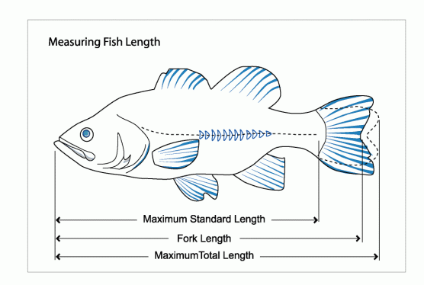
Length and its SI unit
Length: the measurement of anything form end to end.
In science, length usually refers to how long an object is.
Inches, feet, yards, and miles are examples of units that measure length.
However, most of the world measures distance in meters (m) and kilometers (km) for longer distances.
Centimeters (cm) and millimeters (mm) for shorter distances.
Meter: SI unit of length
This Photo by Unknown Author is licensed under CC BY

Slide 10
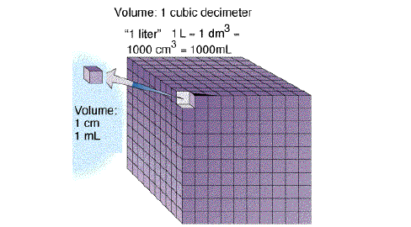
Volume: A Derived Unit
Volume: the amount of space it takes up.
Cubic meter: the SI unit of volume for a solid.
Liter (L): the SI unit of volume for a liquid.

Slide 11
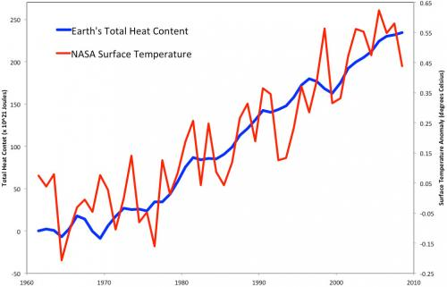
Measuring Temperature
HEAT AND TEMPERATURE DO NOT MEAN THE SAME THING.
Temperature: the average movement energy of the particles making up a material.
Heat: the movement of thermal energy form a warmer object to a cooler object.

Slide 12
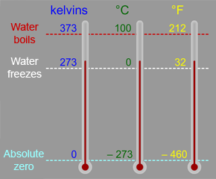
Measuring Temperature
Thermometer is a device that measures temperature
Absolute zero: the temperature that molecules stop moving and have zero kinetic energy.
Kelvin temperature scale: its zero at absolute zero and uses the same degree size as a degree on the Celsius scale.

Slide 14
Exit Ticket
This Photo by Unknown Author is licensed under CC BY

