Slide 1
Bellwork #3 – 08/16/17
Why is identifying the frame of reference important in describing motion?

Slide 2
Bellwork #3 – 08/16/17
Describe what you observe when a candle burns. Please answer with complete sentences.

Slide 3
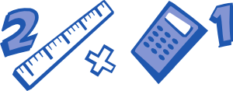
MEASURING in SCIENCE
Math in Science
Manipulating those pesky numbers!
SI Units and Unit Conversions

Slide 4

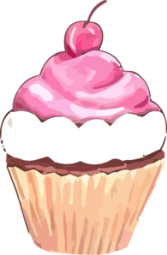


Measuring in Science
Measure Twice, Cut Once.
Measuring in science is very important!
Doing an experiment is a lot like cooking! It’s important to know the ingredients and the amounts.
Working on your car requires specific tools, in exact sizes.
A small difference in the concentration or amount of medication a pharmacist gives you may have significant effects on your health.

Slide 5
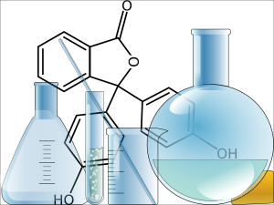
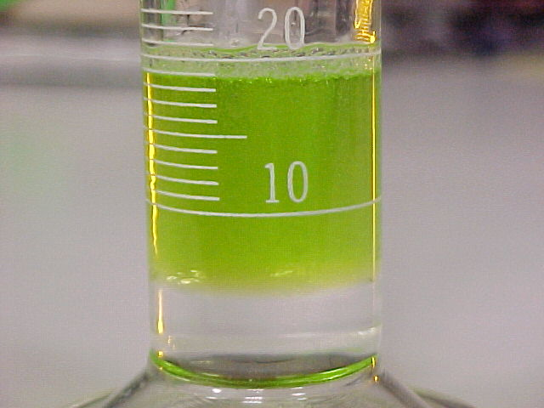
Why Measure?
It is important to obtain measurements because when appropriate calculations are used, experimental results can be compared.

Slide 6
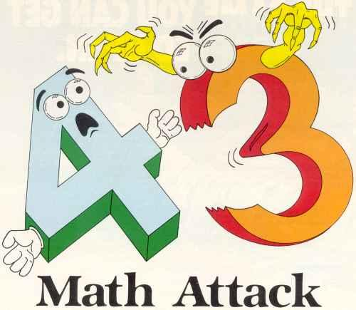
In order to understand some aspects of science, it is required to problem solve.
In order to problem solve, an understanding of mathematical operations used to manipulate numbers is required.
Warning: We will be doing math in this class.

Slide 7
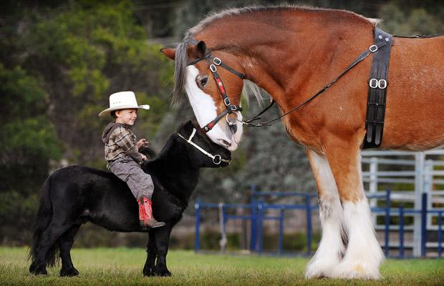
Standards of Measurement

Slide 8
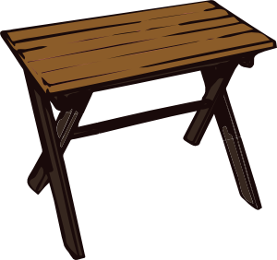
A standard is an exact quantity that people agree to use to compare measurements.
You and a friend need to move a table, but you're not sure if it will fit in your trunk. You don't have any measuring tools with you. How could you quickly determine if the table will fit?

Slide 9
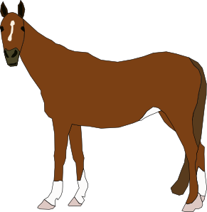
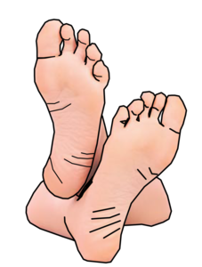
Historically, body parts were used as measuring devices.
Horses are measured in “hands”.
A “foot” was generally the average length of a persons foot.
What was the problem with this type of system?
Nowadays these terms have been standardized. 1 hand= 4 inches. 1 foot= 12 inches.

Slide 10
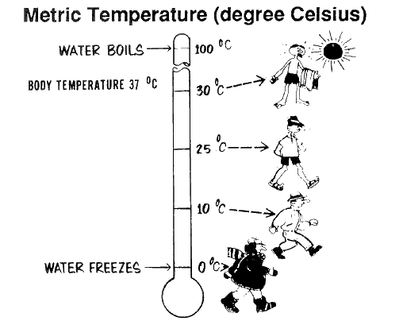
The Metric System
The metric system is used in science- and based on factors of 10.
It is also known as the International System
(SI from Système International). This is a system agreed upon by scientists.
*Not currently used in the U.S.;
England uses both English and metric.
No matter where the location- all of science uses METRIC.

Slide 11
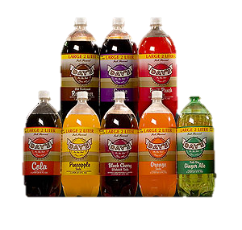
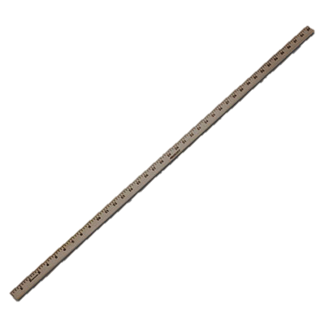
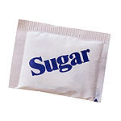
Popular Metric System Units:
2 _______ bottle of soda.
________ of sugar.
________ stick.
liter
a. gram
b. liter
c. meter
gram
meter

Slide 12
SI measurements
International System’s Standard Units of Measurement
Quantity | Name of Unit | Abbreviations
Length | Meter | m
Mass | Grams | g
Temperature | Kelvin | K
Time | Second | s
Amount of substance | Mole | mol
Electric current | Ampere | A
Light intensity | Candela | cd

Slide 13
SI Units
General SI units
Length = meter (m)
Mass = gram (g)
Volume = liter (l)
For quantities that are larger or smaller than the SI units, prefixes are added to the names of the units. These prefixes represent multiples of 10.
PREFIX | EXAMPLE
Kilo= 1,000 | 1 kilometer= 1000 meters
Milli= 1/1000 | 1 millimeter= 0.001 meters
Centi= 100 | 1 centimeter= 0.01 meters

Slide 14
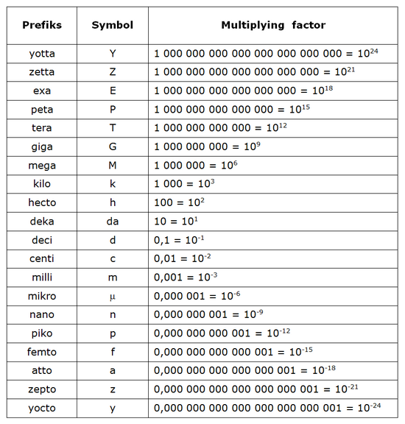

Slide 15
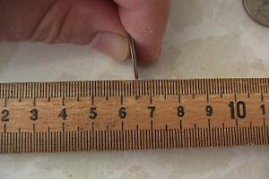
SI units are based on factors of 10, so it is easy to convert them!
Example: There are 10 millimeters in 1 centimeter;
100 centimeters in 1 meter.
A mm is about as thick as a dime. Notice there are about 10 dimes between the 6 and the 7 on this photo.
The large numbers represent centimeters.

Slide 16
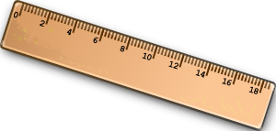
Using your ruler, calculate…
1. Width of your desk _______ cm
2. Width of your desk ______ mm
3. Length of your index finger _____ cm
4. Length of your index finger ______mm

Slide 17
Length Measurements
Millimeter = tiny objects, such as eyelashes or fingernails.
Centimeter = small objects, such as your foot- or you! (your height).
Meter = larger sizes and distances, such as a vehicle or a room
Kilometer = much larger distances
Do you know the English units for the lengths above?
inches
feet
miles

Slide 18
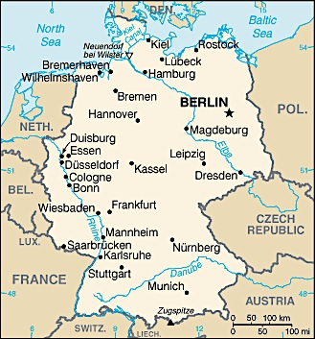
Use the scale to determine the distance between Berlin and Frankfurt.
In kilometers? _____
In miles? ________
KILO = 1000
There are 1000 meters in a kilometer
1 kilometer = 0.62 mi

Slide 19
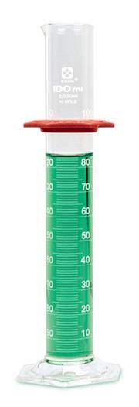
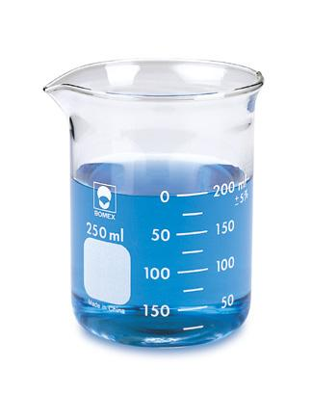
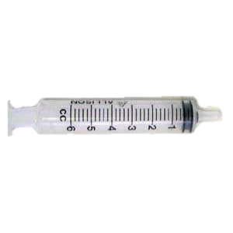
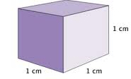
Volume= the amount of space an object occupies. A liquid’s volume is usually measured.
SI units for volume: Liters (could also be kiloliters, milliliters, centiliters).
Beakers and Graduated cylinders are generally used to measure volume
1 ml= one cubic centimeter, which is used in medicine.

Slide 20
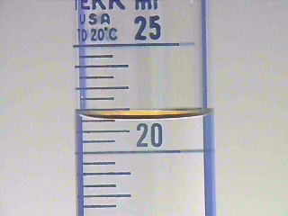
Reading a Graduated Cylinder
Always read from the bottom part of the meniscus.
This graduated cylinder reading is 23 ml.
Find out more about reading graduated cylinders here.

Slide 21
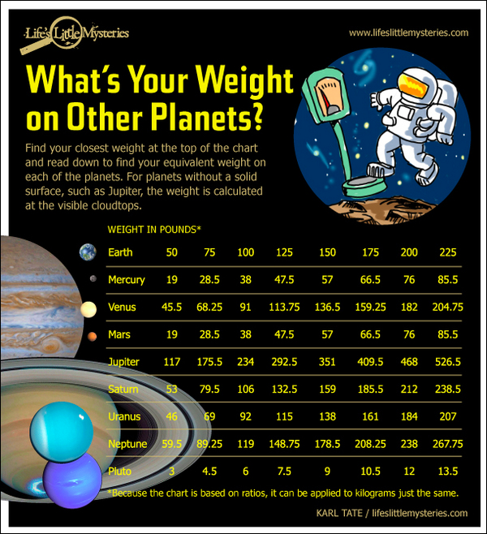
Mass: the amount of matter in an object
The mass of an object is NOT the same as its weight.
Mass is fixed and unvarying- it is also independent of the object’s location.
Weight is the measure of the earth’s gravitational force “pulling” on the object. It is not fixed; it can vary by location.

Slide 22
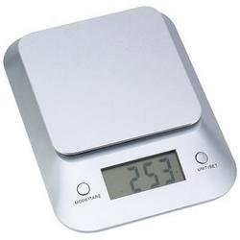
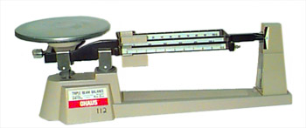
Mass Measurements
Mass is typically measured in grams (g), or kilograms (kg).
Could also be measured in milligrams, micrograms, or centigrams.
Mass is typically measured using an electronic scale or a triple beam balance.

Slide 23
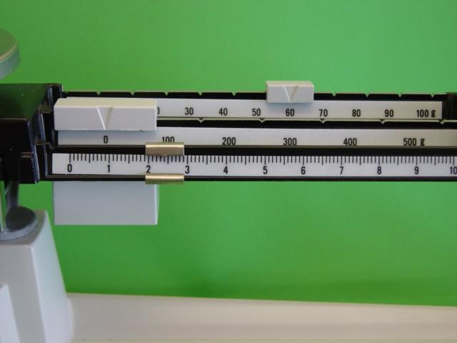
Reading a Triple Beam Balance
Answer: 62.4g

Slide 24
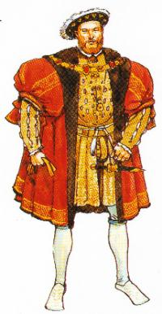
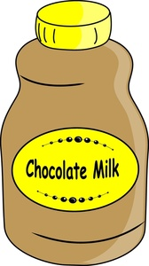
Prefixes
Back to those prefixes we mentioned earlier…
We are familiar with kilo, milli and centi.
But what about deca, deci, or hecto?
Here is a way to remember all the prefixes from 10³ to the 10⁻³ (1,000 to 1/1000):
KING HENRY DIED MONDAY DRINKING CHOCOLATE MILK
Huh?

Slide 25
King= Kilo
Henry= Hecto
Died= Deka
Monday= Meter (one unit)
Drinking = Deci
Chocolate= Centi
Milk= Milli
1,000 or 10³
100 or 10²
10 or 10¹
1 or 10⁰
0.1 or 10⁻¹
0.01 or 10⁻²
0.001 or 10⁻³

Slide 26
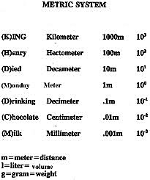

Slide 27
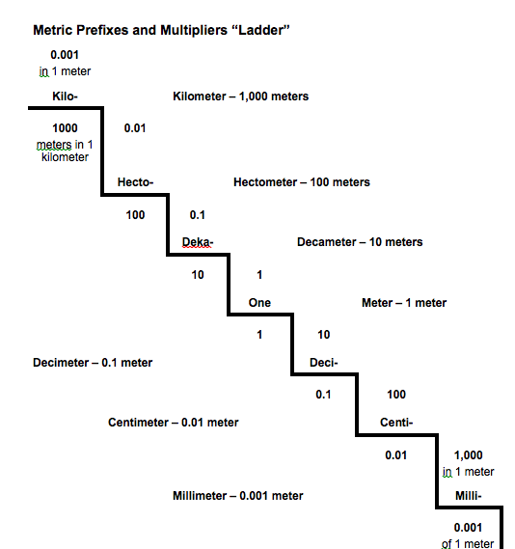
This ladder has two sides (on the steps and under the steps).
Can you see the difference?

Slide 28
Try It!
How many meters in 1 kilometer? ____________
How many meters in 1 decimeter? ___________
How many meters in 1 millimeter? _____________
1000
0.1
0.001
.0001
How many kilometers in 1 meter? ____________
How many decimeters in 1 meter? ___________
How many millimeters in 1 meter? _____________
10
1000

Slide 29
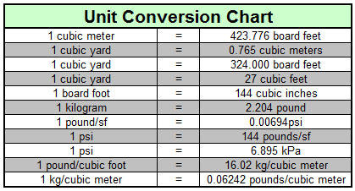
UNIT CONVERSIONS
It is often useful to be able to convert from one unit of measure to another.
Examples:
Converting miles into kilometers
Converting centigrams into kilograms.
Converting meters into inches.

Slide 30
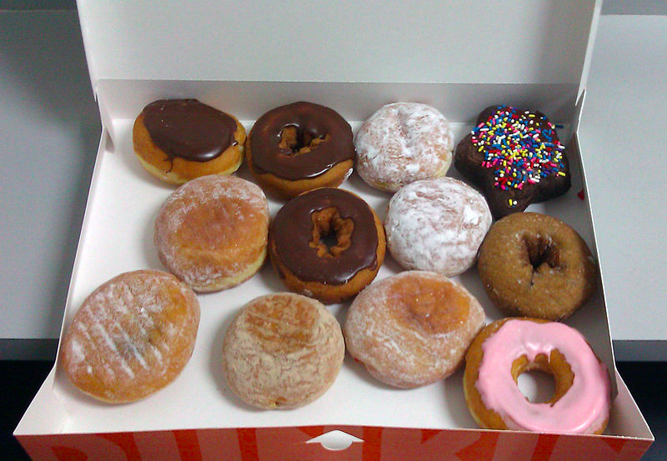
Let’s try an example using a dozen donuts.
1 dozen = 12 donuts
The two “units” involved in this unit conversion are the number of dozens and number of individual donuts.
Let’s say that we have 36 donuts.
When doing unit conversions, you will always have a given and an unknown. Which unit is given?
GIVEN= number of donuts (36)
UNKNOWN= number of dozens (?)

Slide 31
You want to know how many dozen in 36 donuts,
and you know there is 1 dozen per 12 donuts, or
1 dozen
This is known as the conversion factor.
Conversion factors are ALWAYS equal to ONE.
Use this relationship to convert from individual donuts to number of dozen donuts.
12 donuts
1 dozen
= 1
What do you mean conversion factors are equal to one?
12 donuts

Slide 32
Making a Unit Conversion Factor
1 dozen donuts = 12 individual donuts.
(You could also say that 12 inches is the same as 1 foot, or 16 ounces is the same as 1 pound, etc. etc.).
Since they are equal, it is like writing , or etc.
1
1
2
2
3
3
1 dozen
The top value is always equal to the bottom value. However, when the unit conversion is expressed, they will have different units.
12 donuts
OR
12 donuts
1 dozen

Slide 33
Your conversion factor must accomplish two things:
It must cancel out the units of the given piece of information.
2) It must introduce the unit you are solving for.
Dimensional Analysis using unit conversions:
unit₁ x conversion factor = unit₂
Your conversion factor should be set up as follows:
What you want to get to
What you are coming from

Slide 34
Converting Units- Step One
In order to set up the conversion factor, you must consider what you are solving for.
Be sure to set up your conversion in such a way that the unit of the given cancels out to give us the unit we are solving for.
What you want to get to
1 dozen
12 donuts
What you are coming from.
This means that the top value must include the unit you are solving for (what you want to get to), and the bottom value must include the unit you are trying to cancel (what you are coming from).

Slide 35
Converting Units- Step Two
In order to convert units, you must use your given (in this case, the number of individual donuts [36] and the conversion factor 1 dozen
12 donuts
Step 2) Set up and cancel out units
Be sure to set up your conversion in such a way that the unit of the given cancels out to give us the unit we are solving for.
1 dozen
12 donuts
36 donuts x = ?

Slide 36
Converting Units- Step Two continued
Cancel out units (the unit of the given [donuts] cancels out the denominator of the conversion factor to give us what we solving for- the number of dozens).
1 dozen
12 donuts
36 donuts x 1 dozen
12 donuts
36 donuts x =

Slide 37
Converting Units- Step Three
Solve!
1 dozen
12 donuts
36 donuts x 1 dozen
12 donuts
36 donuts x =
36 dozen
12
=
=
3 dozen

Slide 38
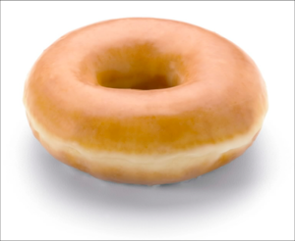
Let’s try converting donut mass to number of donuts…
Q: If you have 9900 grams of donuts,
how many donuts do you have
if each donut has a mass of 150 grams?
Before you begin…
Determine your “given”. _________
Determine which unit you must solve for. ________________
Set up your conversion factor:
9900 grams
Number of donuts
1 donut
150 grams

Slide 39
Q: If you have 9900 grams of donuts,
how many donuts do you have
if each donut has a mass of 150 grams?
Step One) Make Your Conversion Factor
150 grams
1 donut
The other conversion factor would be
How do I know I’m using the correct one?

Slide 40
Q: If you have 9900 grams of donuts,
how many donuts do you have
if each donut has a mass of 150 grams?
Step Two) Cancel Out Units
Step Three) Solve

Slide 41
Making a conversion factor:
If we know an equality relating two units, for ex:
1000 mg = 1 gram
Then we can make 2 “conversion factors”!
1000mg
1 gram
1 gram
1000 mg
OR
On your own, using the information above, try to convert 32 grams into milligrams.

Slide 42
Answer) 32,000 milligrams!
Given= 32 grams
Unknown= amount of milligrams (we need to solve for this).
Conversion factor- milligram and gram relationship
1 gram= 1000 milligrams
What you want to get to.
1000 milligrams
1 gram
32 grams x
32,000 mg
What you are coming from.

Slide 43
Try one more…
Converting English to Metric
1 kilometer= 0.62 miles
Convert 4 miles into kilometers.
Answer) 6.45 km

